Slide 1
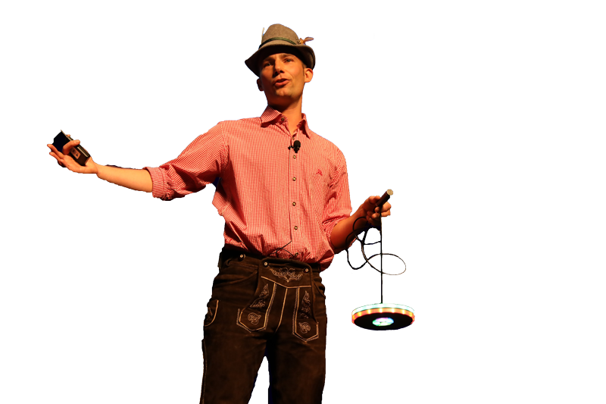
DevOps in the Real World with a focus on Shift-Left
Andreas Grabner, DevOps Activist, Dynatrace @grabnerandi
Join our Podcast Series bit.ly/pureperf

Slide 2
#1 How I explain DevOps …
… to somebody non-technical like …
Notes:
My parents ☺

Slide 3
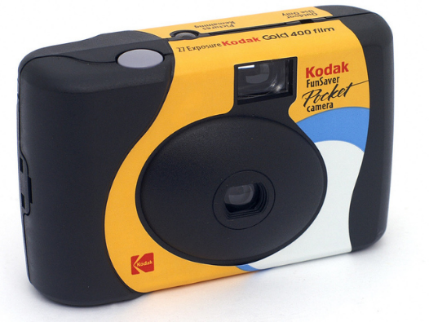
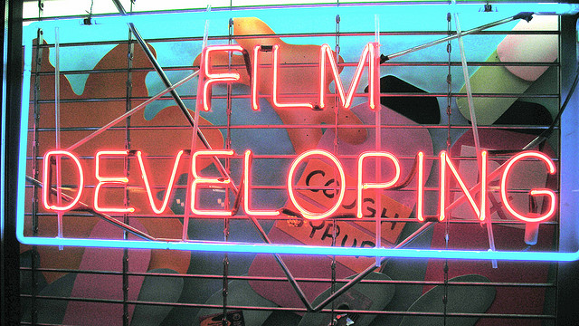
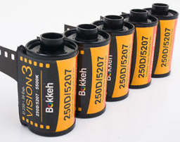
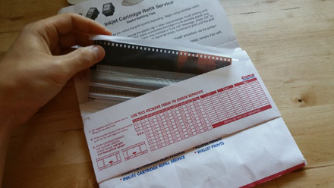
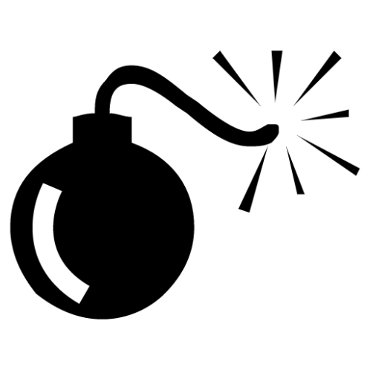
24 “Features in a Box”
Ship the whole box!
F r u s t r a t i o n !
Very late feedback ☹
Quality Control
Photo bomb!
Back to customer
Notes:
My analogy for Waterfall:
Putting many features into a single release
Ship it to some other entity who does quality control
Final product comes back very late -> hard to remember which features / fotos we created. Often we realize its not what we wanted

Slide 4
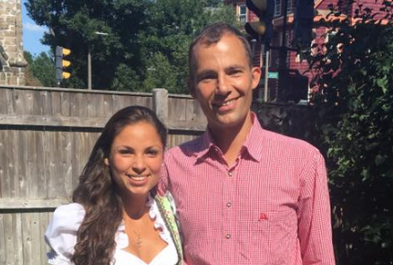
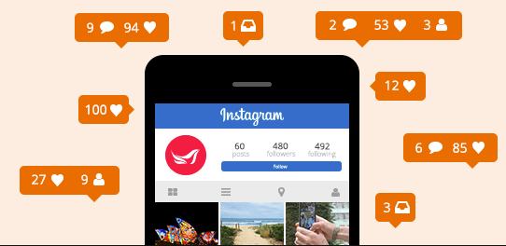
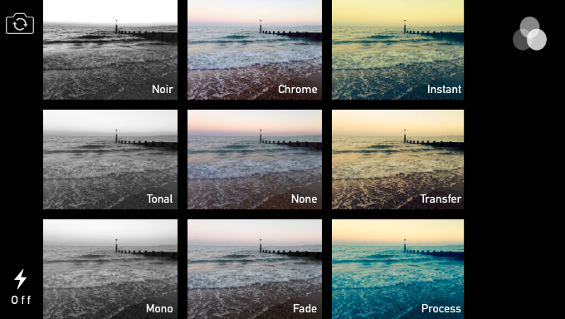
Continuous Delivery with Feedback Loops!
1 “Feature at a Time”
Immediate Customer Feedback
Optimize Before Deploy
Notes:
This is the new way of delivering software: Continuously – with small batch updates
I use the analogy on how my girlfriend takes pictures:
One at a time
Quality Control and Optimization is in her own hands thanks to software that is “part of the delivery chain” (foto app)
She also controls what to push into production -> post it on Instagram / Facebook
She wants to make her users (friends & family) happy – she is hoping for LIKES!
If she gets dislikes she can remove an image
If she gets comments she can take another picture and deploy it within seconds -> that is Continuous User Driven Innovation

Slide 5
Technical & Process Tips
Notes:
Now lets learn from some of those companies that made a transformation and those where DevOps was always in their DNA

Slide 6
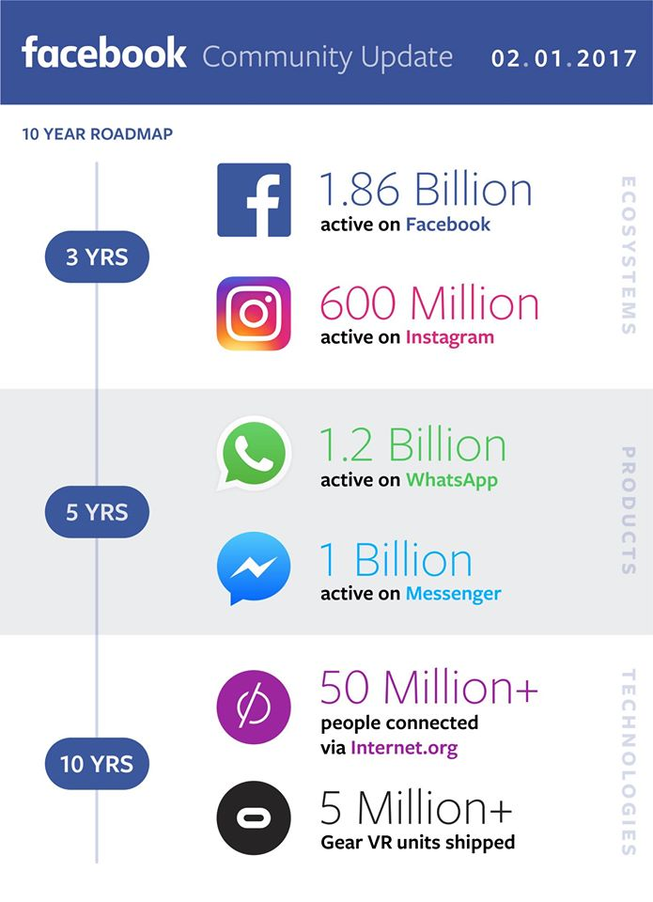
Goranka Bjedov
Onboarding @ FB
Features
Canary Releases
Push Karma
Notes:
I was in the fortunate situation to meet Goranka Bjedov, Performance Engineer at Facebook – she shared a lot of stories with me while I met her at WOPR this year.
If you want to learn more I recommend listening in to our podcasts with her
https://www.spreaker.com/user/pureperformance/034-monitoring-at-facebook-how-devops-wo
https://www.spreaker.com/user/pureperformance/033-performance-engineering-at-facebook-

Slide 7
6-8 Week Boot Camp
Notes:
You get assigned to a project. You will not be able to pick the product or technology that you are most familiar with but something that is totally new for you. With that the learning curve is much better.
You will Fix well known bugs and work on support tickets. This allows you to get familiar with the process at Facebook and you also get to know the teams.

Slide 8
Features
Release 1st, Optimize 2nd
Success Criteria
Fix-It Ticket
Notes:
Move Fast and Break Early!
Stop working on things that don’t matter
Quality of Pipeline takes away the fear of code commit

Slide 9
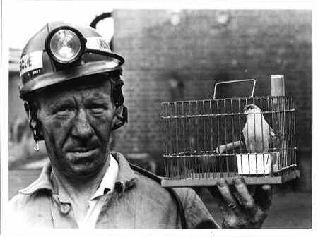
Canary Releases
Notes:
A/B Testing with New Zealand! - https://dzone.com/articles/pushing-twice-daily-our

Slide 10
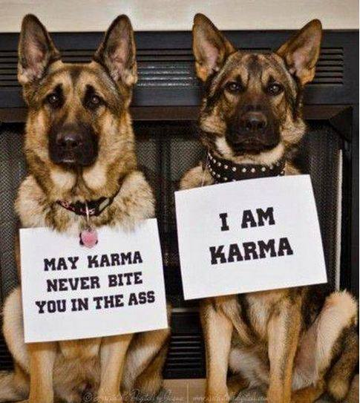
Push Karma
Notes:
Developers have a Push Karma which can go down if they push something bad!
Every dev starts with 4 stars - https://www.facebook.com/notes/facebook-engineering/release-engineering-and-push-karma-chuck-rossi/10150660826788920/

Slide 11
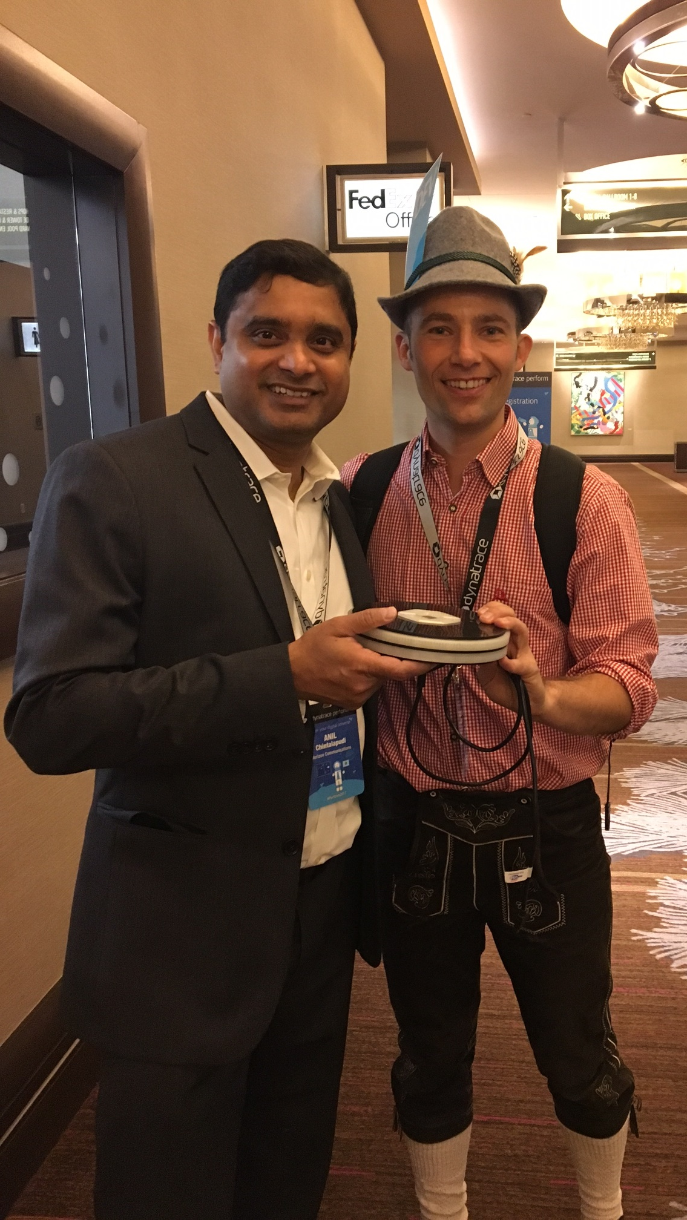
Notes:
Verizon is another great example of an enterprise company that transformed their approach to software delivery!

Slide 12
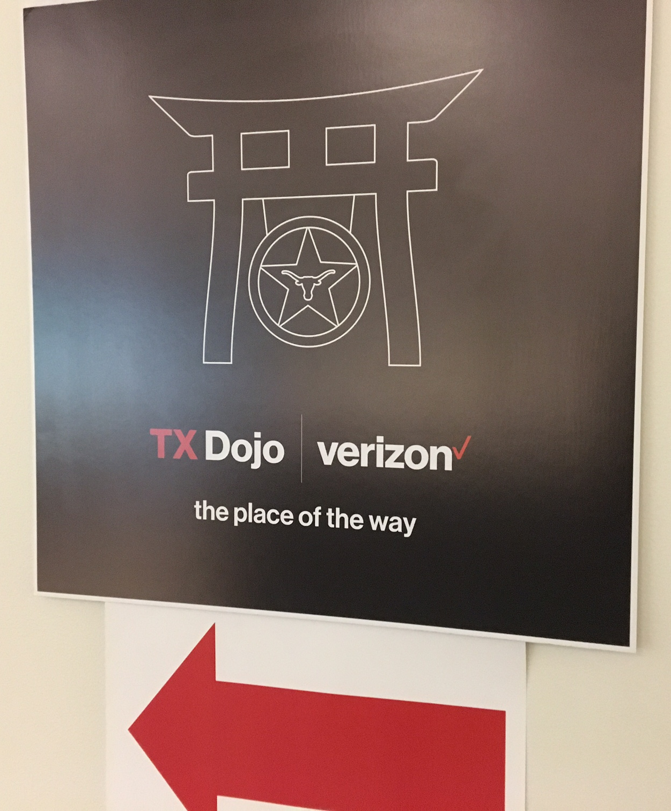
1 Monolithic App
6 Weeks to DevOps’ify App
Goal: Cloud Continuous Delivery
Dev take Ops Ownership
Notes:
Existing Monolithic Apps are “DevOps’ified” in DoJo’s. With the help of external consultants the team learns what it means to run software in the cloud and what it means to operate it!

Slide 13
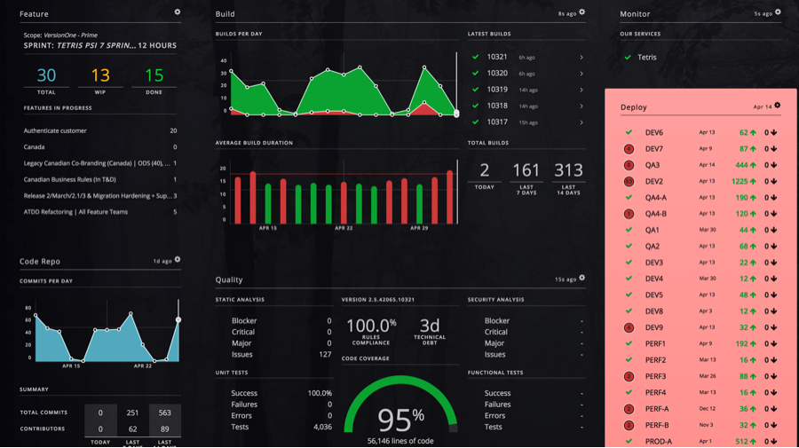
Notes:
Verizon also heavily relies on pipeline visualization to track quality from Dev to Prod. They rely on many tools but leverage CapitalOne’s Hygieia dashboards to visualize quality data – which also includes Dynatrace Performance across the lifecycle

Slide 14
Oct 2015
Apr 2016
~3x
faster
SPEED of Delivery
30 Days
10.5 Days
Cycle Time
50%
less bugs
QUALITY of Delivery
5.79
2.78
Avg. Bugs per Test
Full Webinar: https://pages.awscloud.com/devops_dynatrace_june_2017.html
Notes:
One of their key applications they recently transformed shows the benefit very nicely. If you want to learn more check out the webinar we did with Verizon: https://pages.awscloud.com/devops_dynatrace_june_2017.html

Slide 15
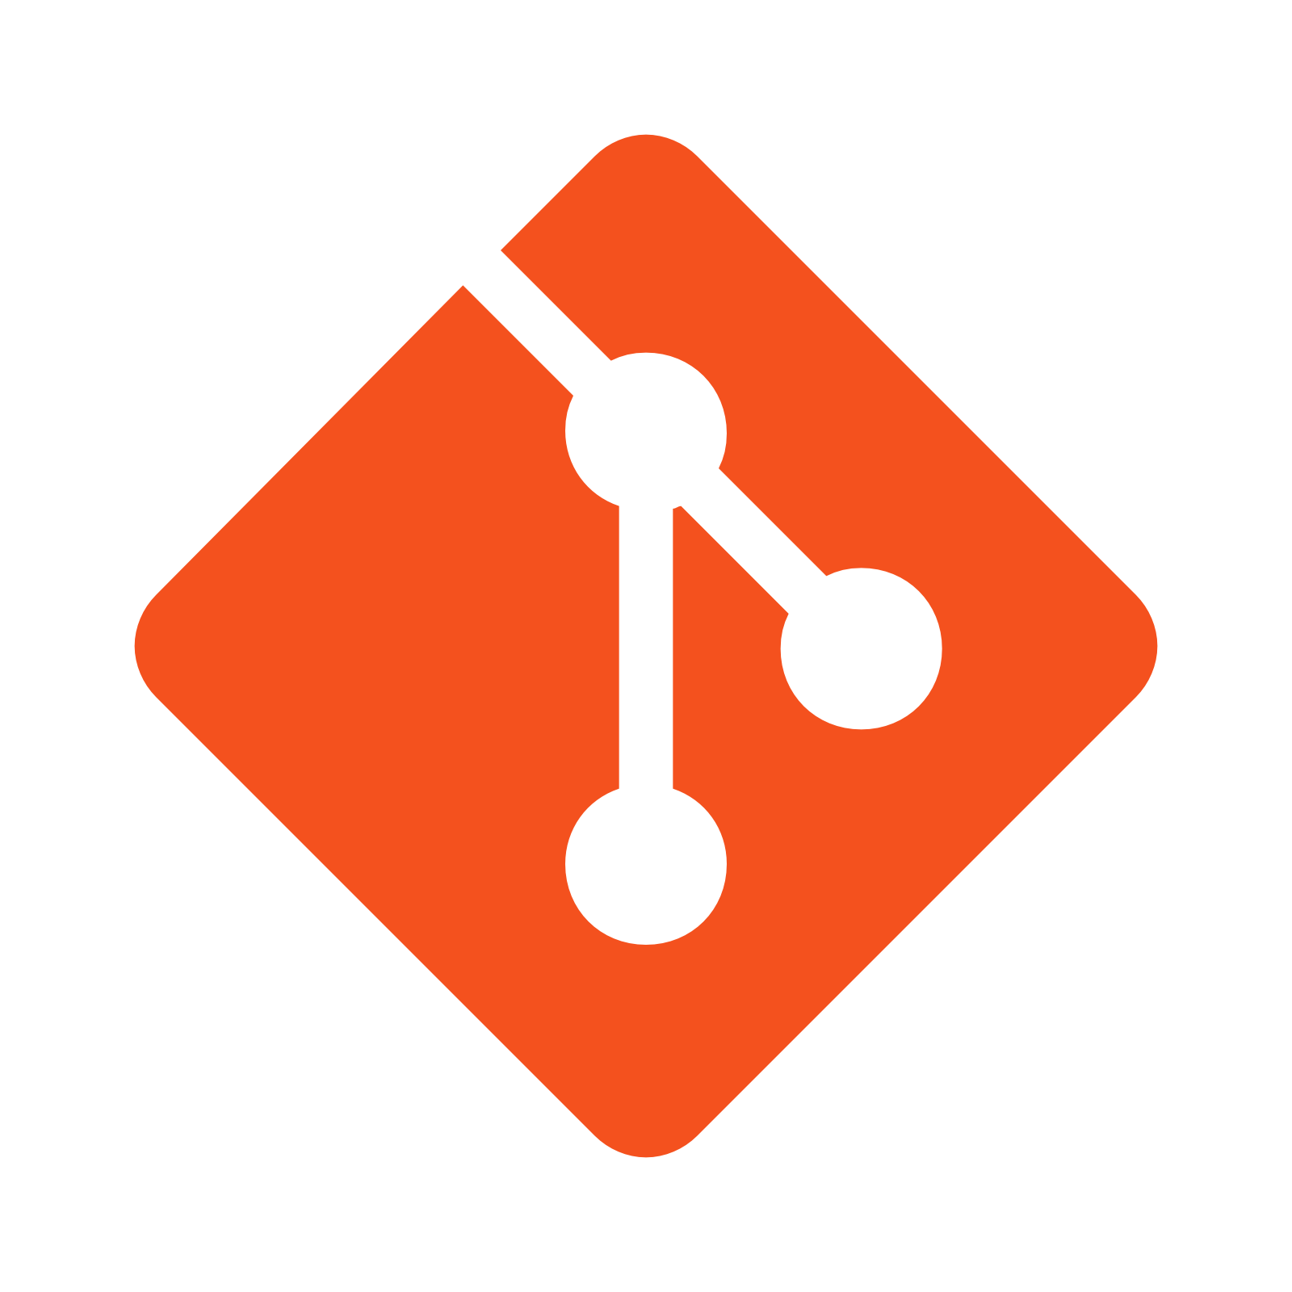
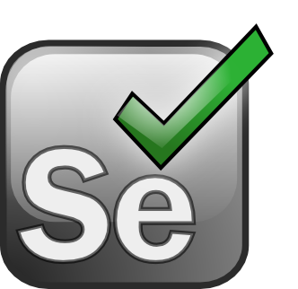
Shift-Left at
50
350
90
749
Notes:
Another great example is Sofico. A smaller software company from Belgium. Their Shift-Left approach was to stop bad code changes earlier based on monitoring data – fully integrated into their Bamboo Pipeline

Slide 16
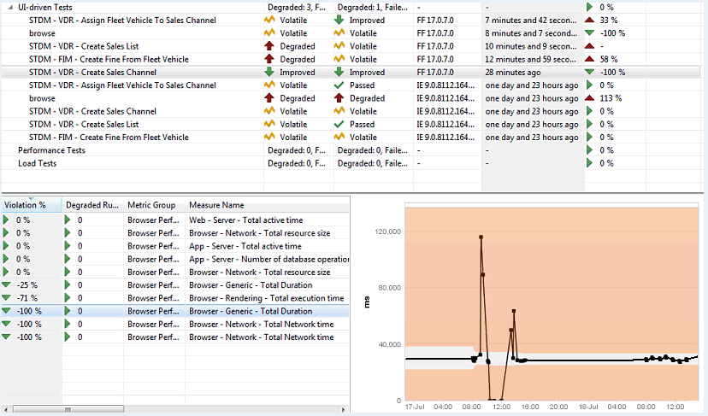
Every Test
Regressions Detected
Key Metrics per Test
Notes:
Dynatrace automatically detects regressions based on performance, architecture and scalability metrics

Slide 17
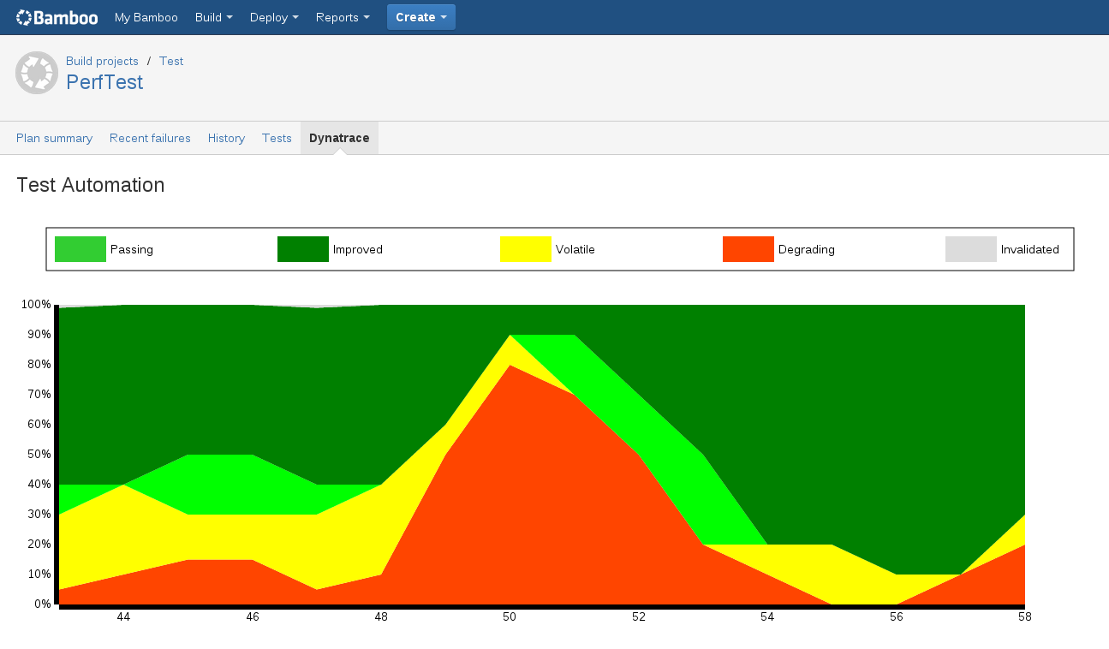
Fail Build Decision
Notes:
This information is brought back to the Pipeline and can stop the build early!

Slide 18
Shift-Left at
43x RT
0 OOM’s
Sync / Wait
50
350
90
749
Notes:
Sofico greatly increased quality once implementing Shift-Left: Faster Response Times of their Applications, No more Out of Memory and no problematic Sync/Wait issues

Slide 19
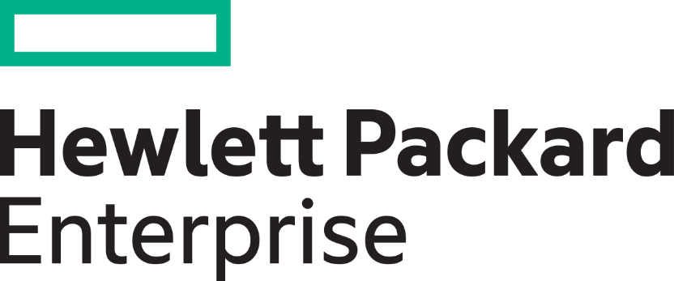
Mark Tomlinson
“Performance Sherpa”
Host of www.perfbytes.com
Notes:
One of my closest friends and mentors is Mark Tomlinson. Check out his work on perfbytes.com

Slide 20
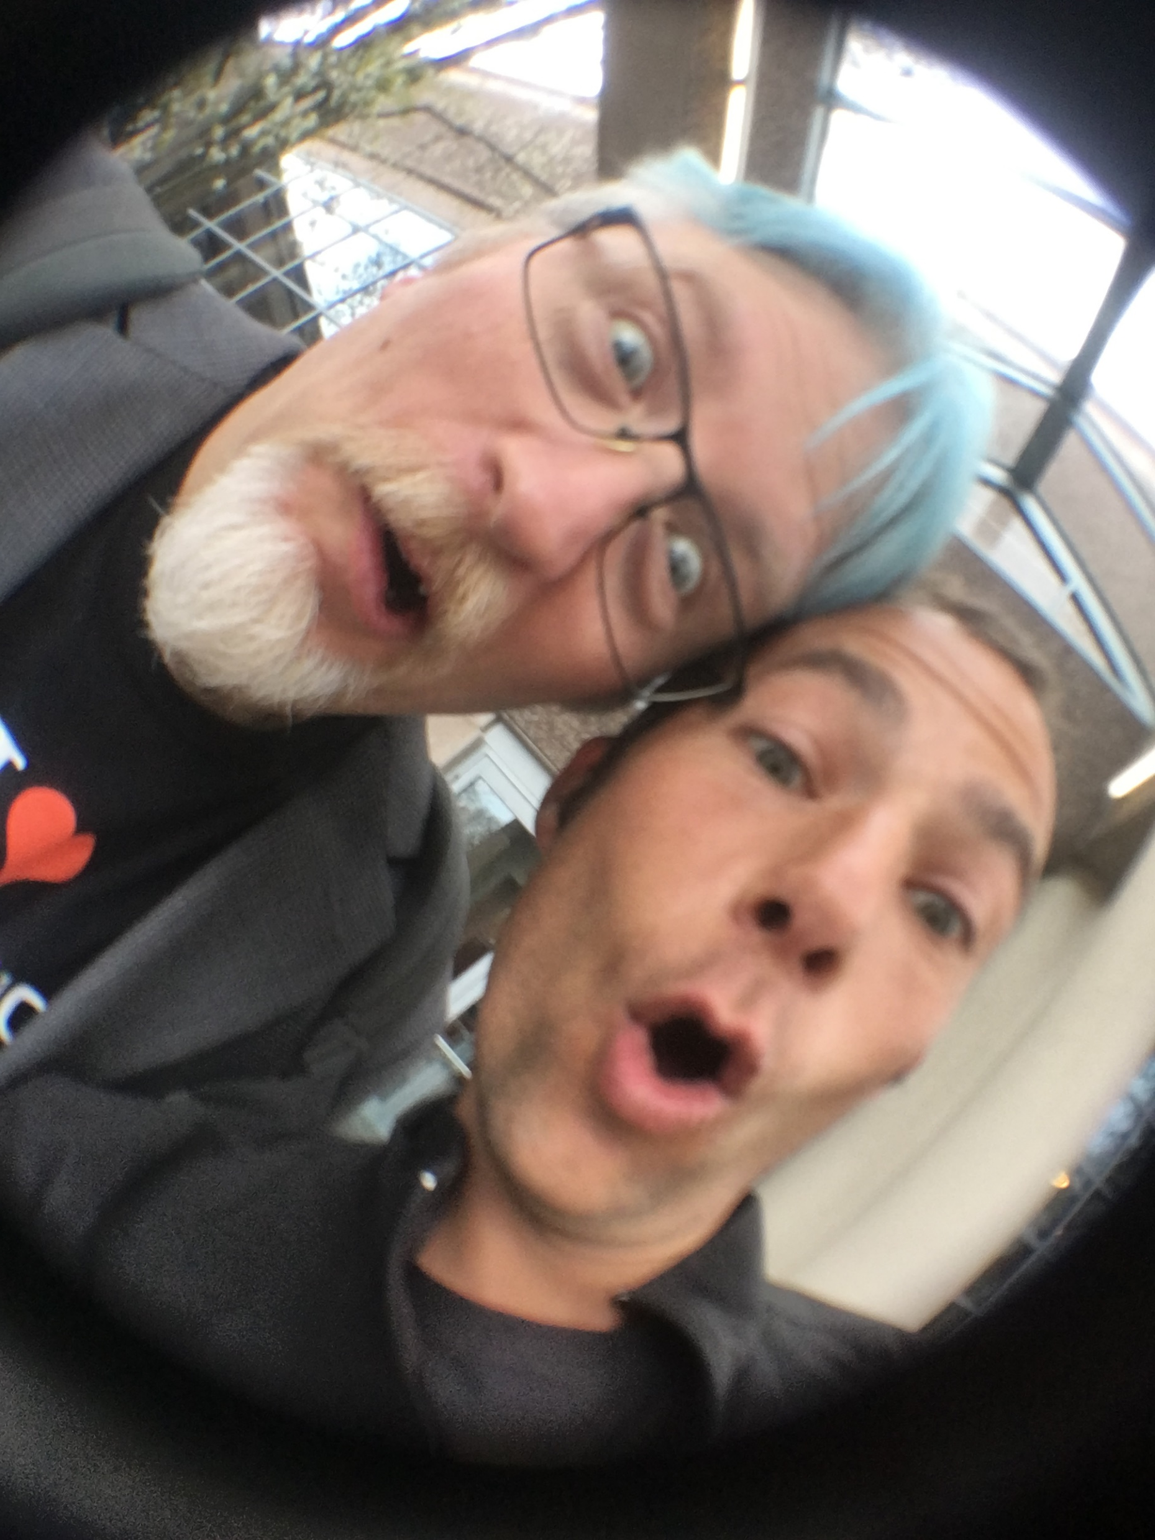
“If you can impact the [performance of the] code before it is written, then and only then, can you consider your work to be performance engineering. Otherwise, you are just doing testing.”
- Jim Duggan, Gartner
Notes:
He also exposed me to this great quote!

Slide 21
Continuous Performance as Self-Service
1
Create JIRA Ticket for Performance Feedback
2
Next Continuous Test Cycle picks up Request
3
Performance Feedback back on JIRA Ticket
1
2
3
Notes:
Fully automated self-service approach to delivering performance feedback to engineers by combining best of breed tools

Slide 22
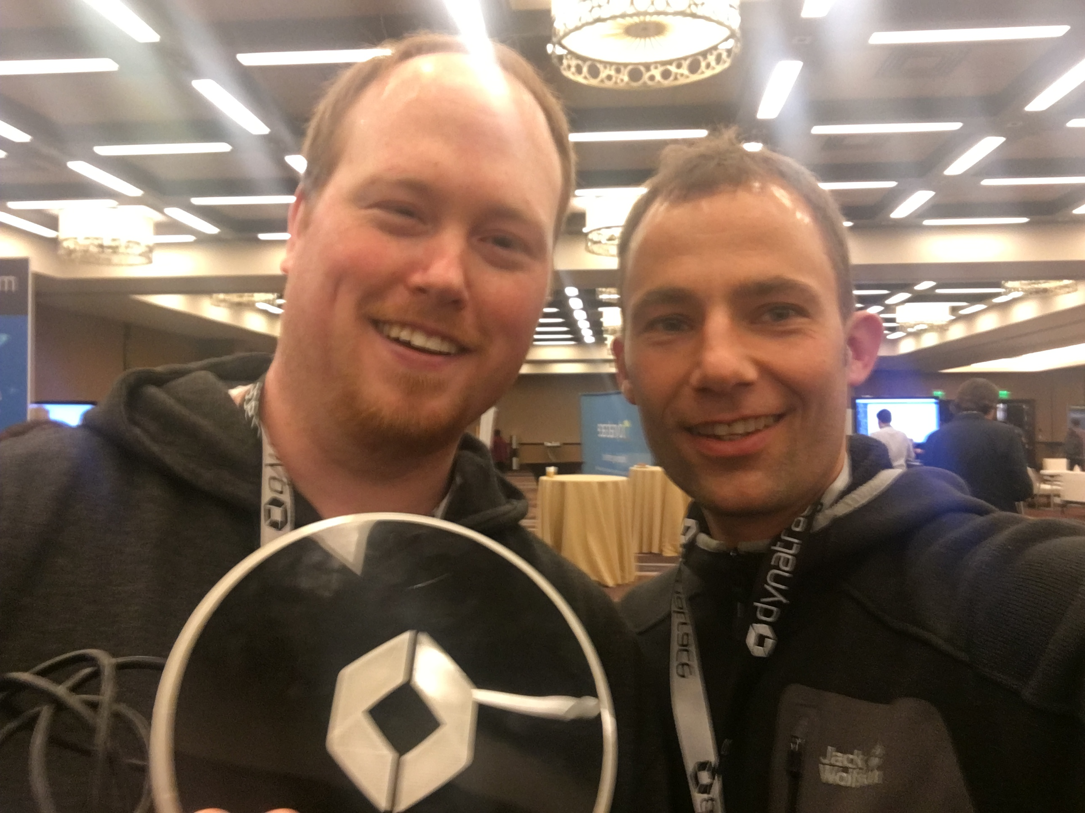
Notes:
Last story is from Sentry Insurance. Here is my buddy Derek

Slide 23
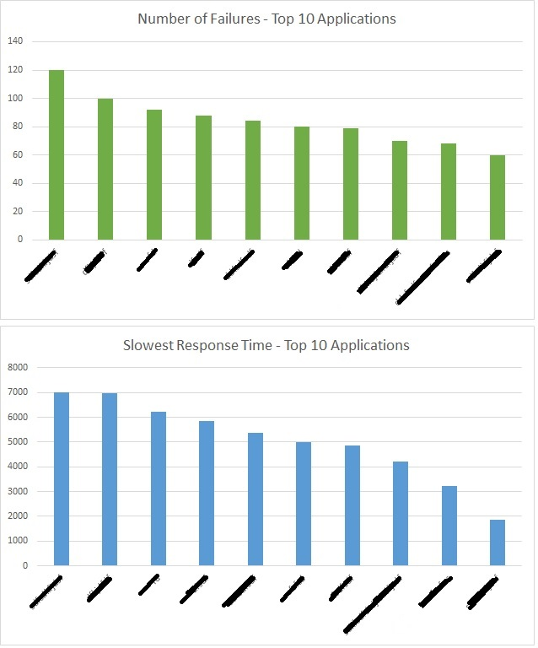
The “Bad App” List
What’s Next?
Notes:
Sentry keeps a “Bad App” list to show slow and failing apps. This list is publicly posted and is seen as a good challenge by the application teams to get off that Top 10 List!

Slide 24
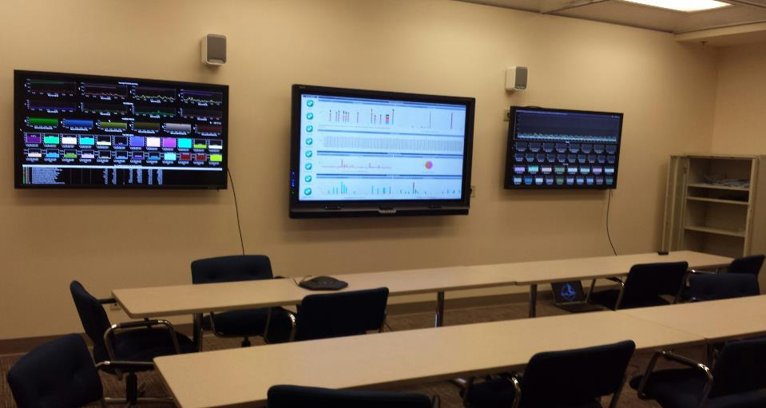
“The List”
What’s Next?
Notes:
Because nobody wants to spend time in the War Room to actually do firefighting. What they all want is …

Slide 25
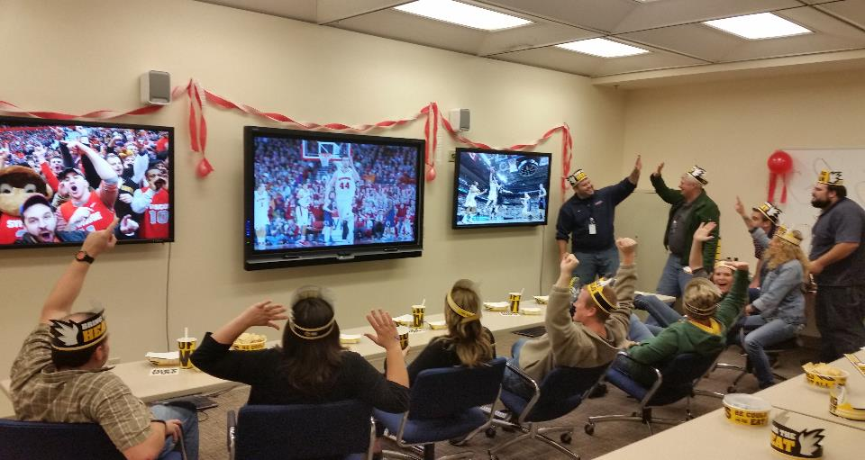
“The List”
What’s Next?
Notes:
… using the war room as a game room ☺

Slide 26
Culture & Personal Tips

Slide 27
“You Build It, You Run It!”, Amazon
?
DevOps == Devs on Call?
Shadowing Ops
Learning by doing!
Rotating Shifts
(Trade Shifts with others)
EVERYONE is on Call
Including CTO
Incentives
(pay internet at home, parties …)
Notes:
Here are several thoughts I picked up when it came to “Does DevOps mean Devs On Call?”

Slide 28
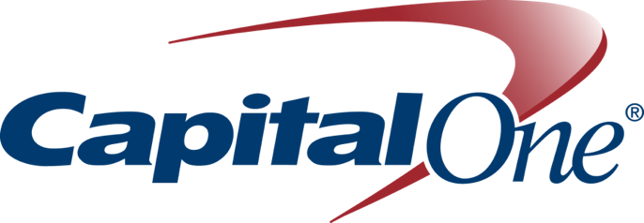
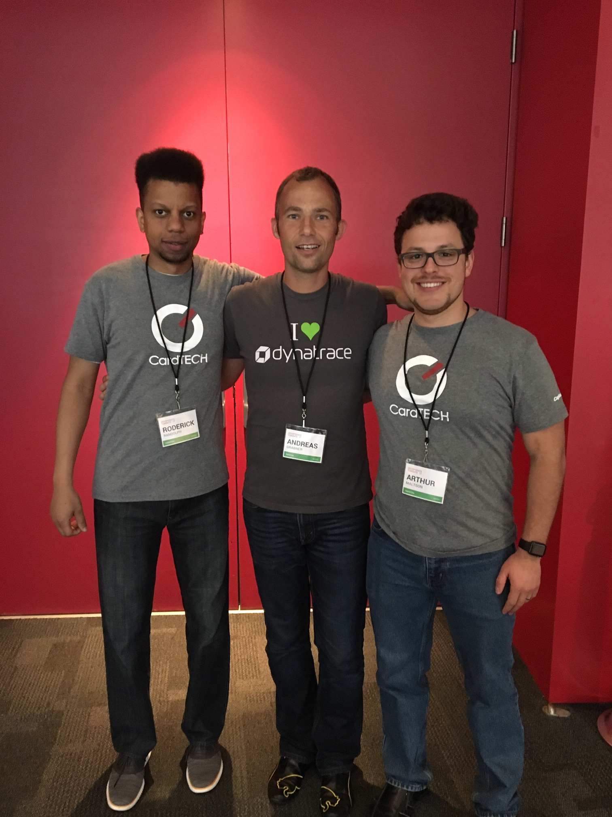
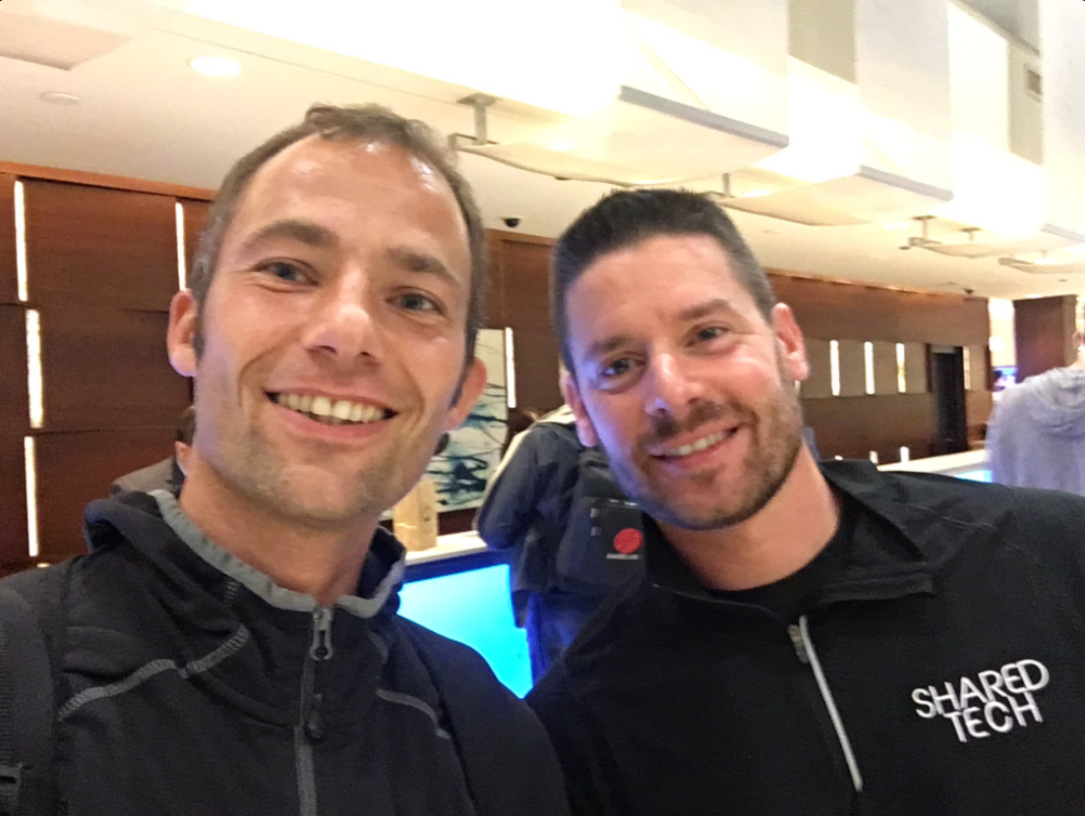
Notes:
Another shoutout to my friends at CapitalOne. Besides their great work on Hygieia they also figured out a way to being less disrupted at work

Slide 29
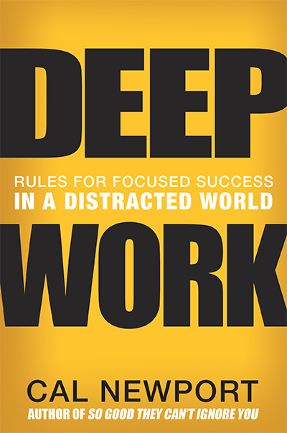
11 min - Mean Time Between Interruption
25 min - Mean Time To Deep Work
Study “Brain, Interrupted”: http://nyti.ms/1fdkVUT
Notes:
Based on a the research around “Deep Work” which says that we get disrupted too frequently and it takes too much time to get back into “Deep Work”

Slide 30
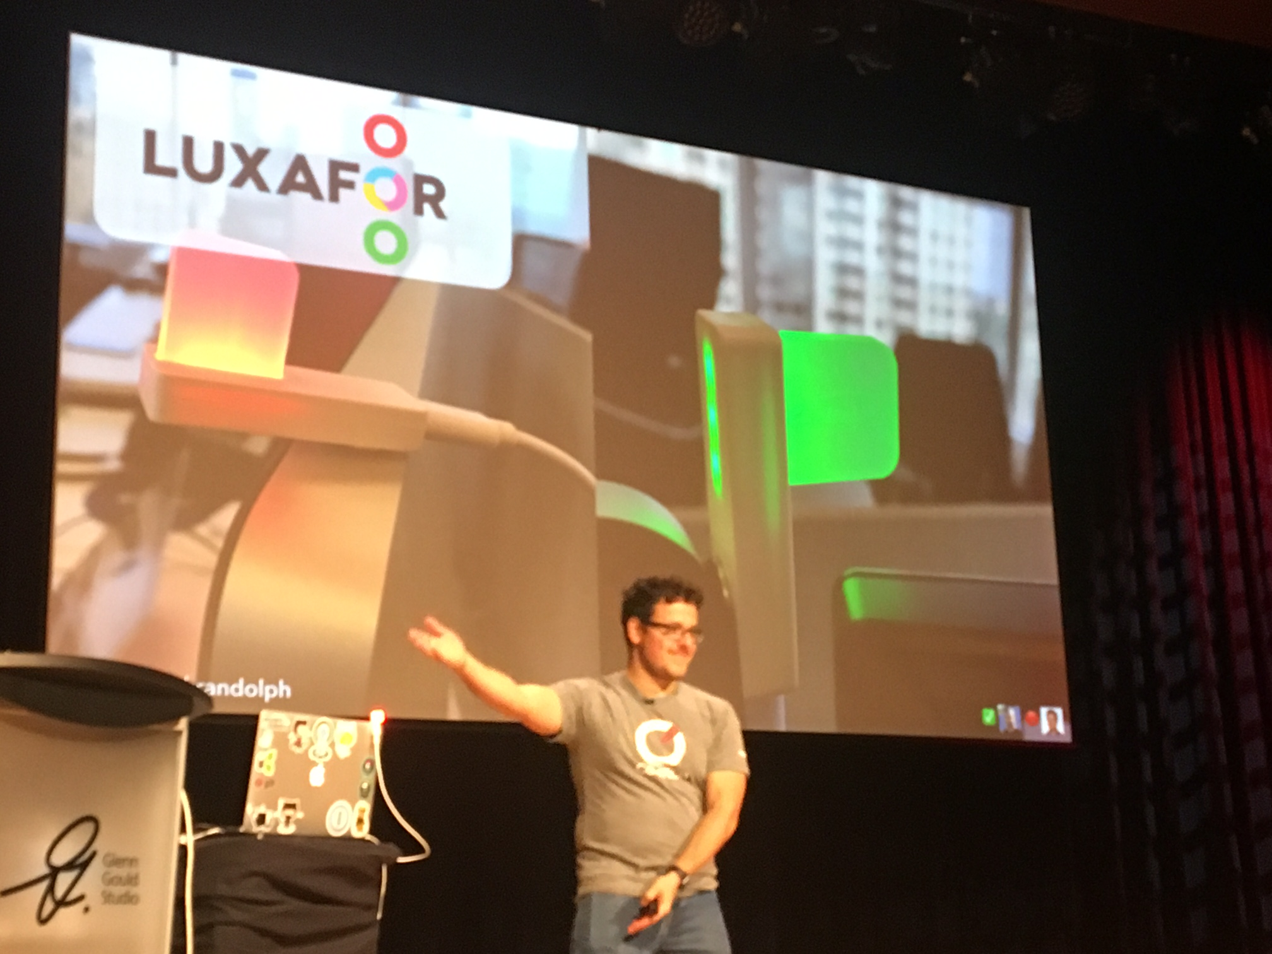
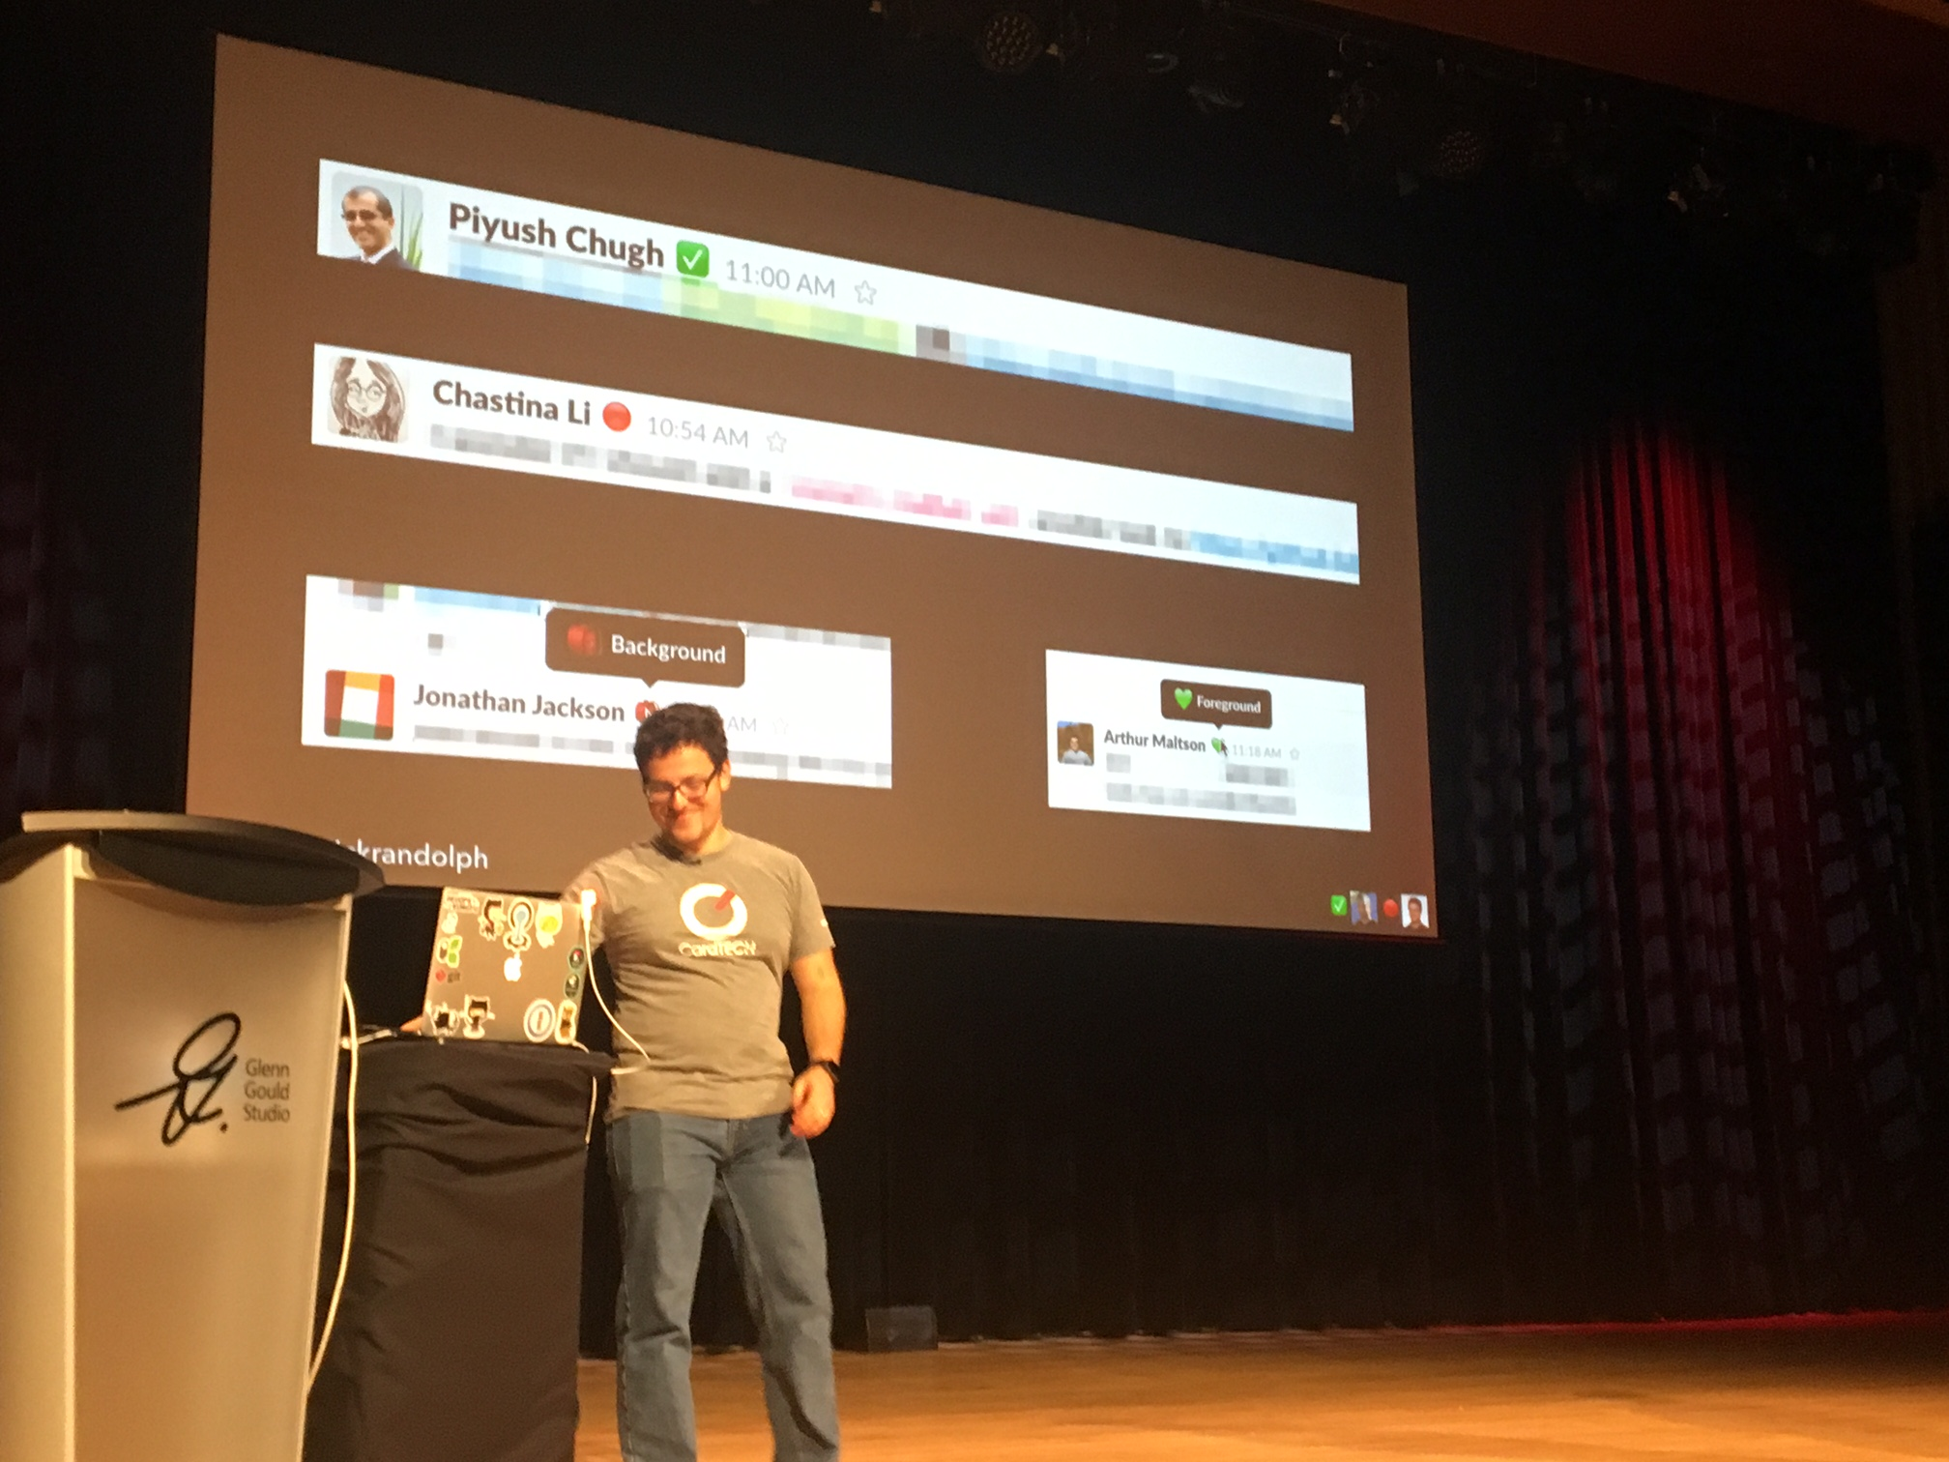
Foreground and Background Teams
also applies for “Devs On Call”
Notes:
They came up with the idea of a Foreground & Background Team. Background must not be disrupted and can always focus on their work. The foreground team takes the daily DevOps activities. To visualize the status they came up with these lights at their desktops!

Slide 31
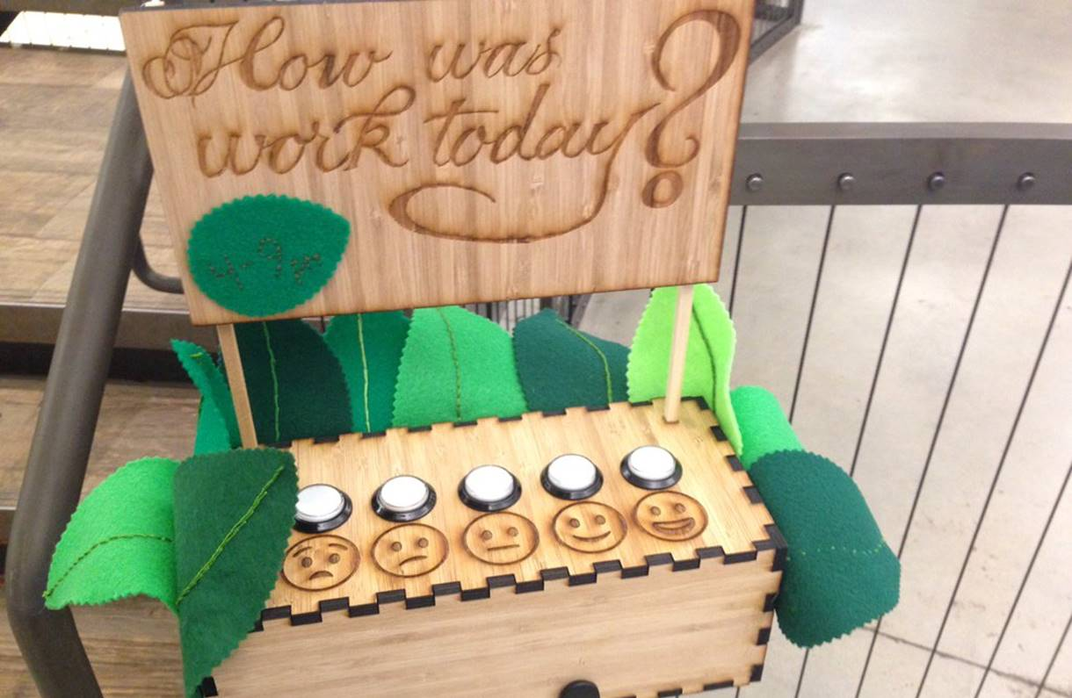

Slide 32
Notes:
I travel a lot and I learned my lessons the hard way when interacting with people from different cultures and nobody told me how to correctly act or react ….
But – communication is not only a challenge when we deal with totally different ppl

Slide 33
Andi: “Hey Karolina!! Quick Q!:
Who could help me with technical questions on AWS!!??”
Karolina: “Well … I think I can help you. What exactly do you need?”
2 Weeks Later in Boston – Face 2 Face
Karolina: “Good we finally meet face 2 face.
I really thought you were an a…..”
Andi: “??? WHAT ???”
Notes:
Here is the situation I ran into with Karolina
Why am I telling you about this? Because I think communication is one of the key cornerstones of good collaboration which is a key part of DevOps

Slide 34
7% verbal
55%
body language
38%
tone of voice
Notes:
These stats explain it to me on why face2face communication is key to successful collaboration
Special thanks to my colleague Peter Varhol for these insights! https://pvarhol.wordpress.com/about/

Slide 35
Why I choose email/chat?
I am in control!
I can edit!
I can end the conversation!
I can do it in a “boring” meeting!
What I loose?
Spontaneity
Connectedness / Relatedness
Unexpected problems
Unexpected solutions

Slide 36
Pick up the Phone or Video Chat vs Email
Managers: Lead by Example, Make time for Talk!
Design for conversations: Standups, Offsites,
Lunchroom, Open Workspace
Distributed Teams: bring them together from time 2 time
Notes:
Some advice

Slide 37
DevOps is about …
… creating more value …
… making money faster …
… by also making your life easier!

Slide 38
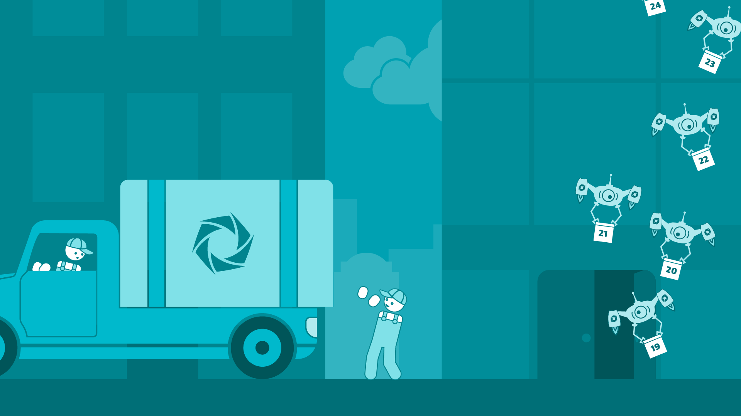
2011
2017
2 major releases/year
customers deploy & operate on-prem
26 feature releases/year
500 prod deployments/day
self-service online sales
SaaS & Managed
6 months
1h : Code -> Prod
major/minor release
sprint releases (continuous-delivery)
Notes:
Here is what we have achieved since then before I go into details about how we got there

Slide 39
Dynatrace Transformation by “The Number”
~120
340
26
More Agile
Code commits / day
Stories per sprint
Feature Releases / Year
93%
More Quality
31000
60h
Unit & Int Tests / hour
UI Tests per Build
Production bugs found by Dev
More Stability
450+
99.998%
500
Global EC2 Instances
Global Availability
Deployments / Day
Notes:
Number of EC2 Instances: exact number 15th May 2017: 439 instances in dev+sprint+prod(157) – prod instances increased by ~ 25. In parallel we reduced instances in dev and sprint for cost saving purpose. So in sum we still have ~450 instances as we already had end of 2016.
Deployments per working day: 5680 SaaS and 2410 Managed deployments within 28 days(=20 working days): 8090/20 = 404 deployments/working day 400/8h = 50 deployments/working hour 50/60min = 0,8 deployment per minute = ever 1m18s a new deployment
Prod-found bugs by dev: 1.1.2017 – 15.5.2017= 92,52 % ~ 93%
Global Availability:
1.1.2017 – 15.5.2017= 100%
1.1.2016 – 15.5.2017= 99,9956 %
Commits/Day: Since move to Gits commits per day went down from 200 to about 120 commits per day. Reason is that devs first collect commits on their private branch before pushing it to master.

Slide 40
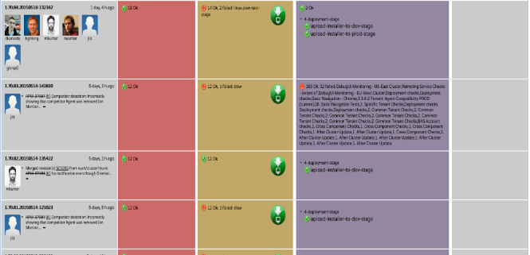
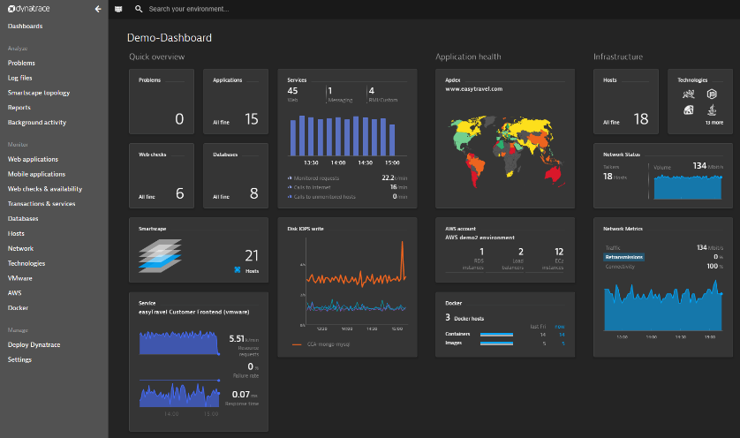
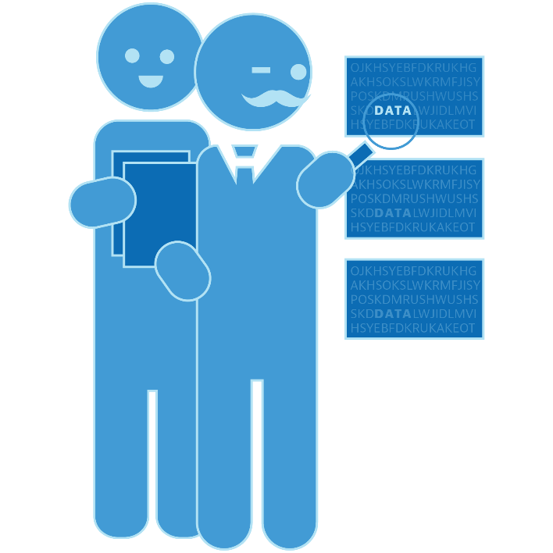
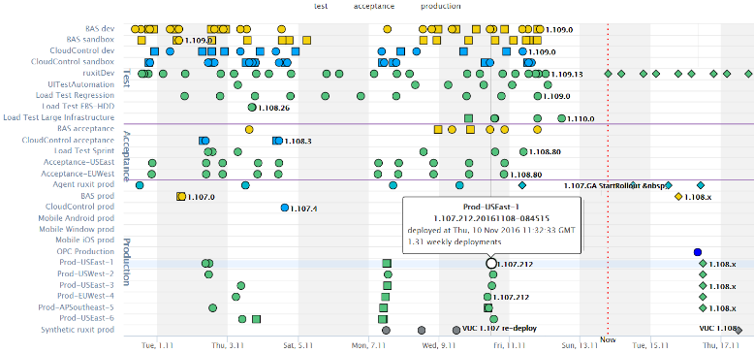
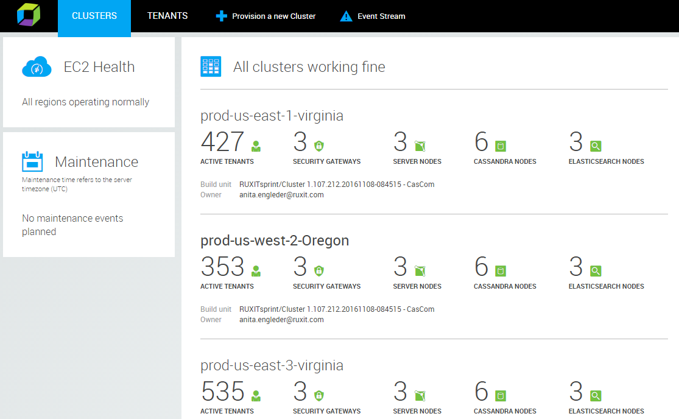
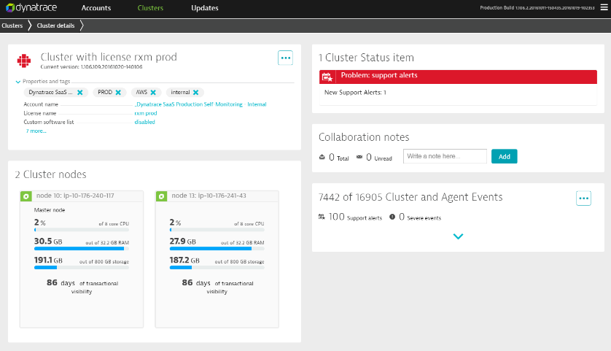
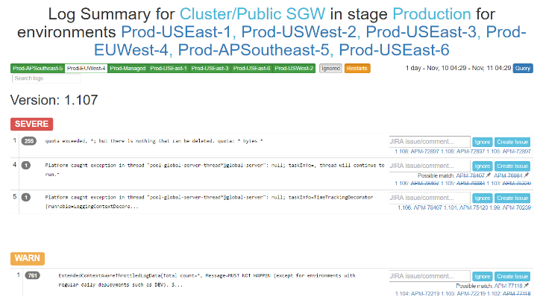
Our “DevOps Team’s” Role
Pipeline Visualization
Acting as engineers & production managers
Dynatrace
Deployment Timeline
Dynatrace Managed/SaaS
Orchestration Layer
Log Overview
using Dynatrace Log API
JIRA Integrations
Notes:
Our DevOps Team – initially 7 people – now only 3 – are
Responsible for “The Delivery Pipeline and the DevOps Tool Chain”
Their Customers: The different Dev Teams that want to push features through the pipeline into production

Slide 41
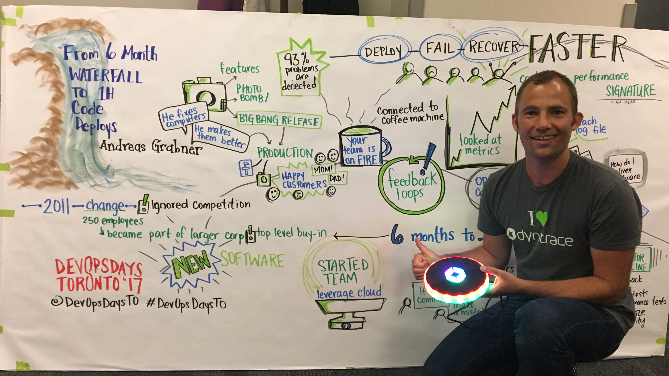
https://www.devopsdays.org/events/2017-toronto/program/andreas-grabner/
Notes:
They even let me on stage and talk about our Dynatrace Business and DevOps Transformation: https://www.devopsdays.org/events/2017-toronto/program/andreas-grabner/

Slide 42
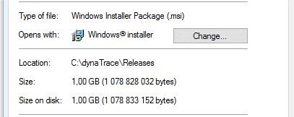
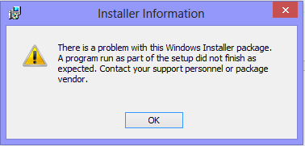
Lesson #1: Velocity uncovers new bottlenecks!
Months
1
2
3
4
5
6
1
Challenges
Solutions
Componentize
Automate Rollout/Rollback
A/B Rollout Model
Notes:
12/20/2017
42
42
Going from 6 to 1 Month Cycles
Offered to: On-Premise Customers + SaaS-Deployments
Challenge: 1GB Monolithic Download
Impact: Error prone updates
Solution: Componentize, Automate Rollout/Rollback Capability, A/B Rollout Model

Slide 43
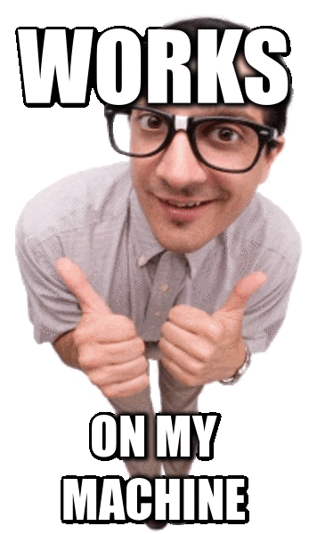
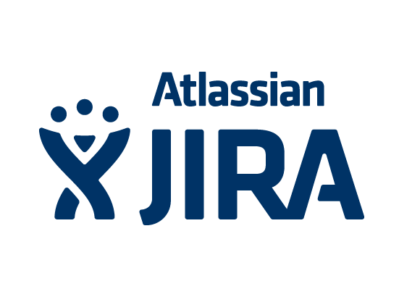
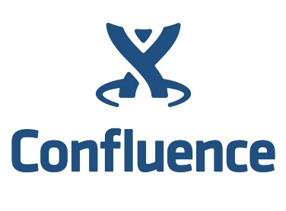
Lesson #2: Need to Increase Sprint Quality
Works in Production
www.dynatrace.com
support.dynatrace.com
dev-jira.dynatrace.org
community.dynatrace.com
dev-wiki.dynatrace.org
Notes:
12/20/2017
43
43
Sprint Reviews Done on “dynaSprint“
Daily Builds get deployed on “dynaDay“. Sprint builds to “dynaSprint“
If you can only show it “on your dev machine“ its NOT DONE!
Deploy Sprint Builds into our internal Production Environment
We monitor Website, Support, Licensing, Community ... With Dynatrace
If we break our own back office software we ALL feel the pain right away

Slide 44
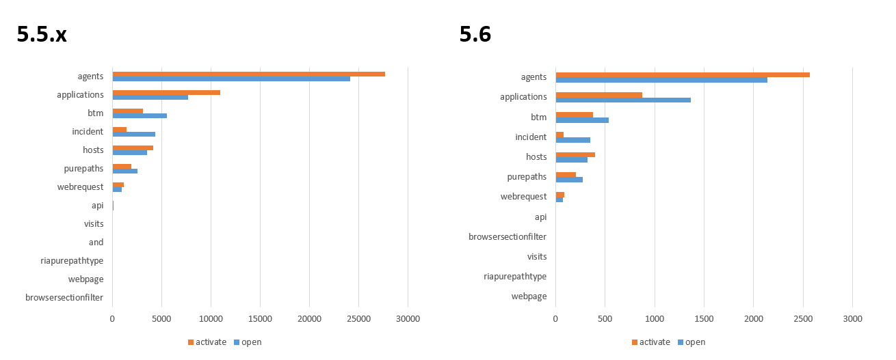
Lesson #3: Essential End User Feedback Loop
“We THINK we know!”
“We KNOW we know!”
Notes:
12/20/2017
44
44
Which Features to Optimize? Which Features to „Phase Out“?
Allows Reducing Technical and Business Debt
Allowed us to “Call Out Sales!” for requested features nobody used!

Slide 45
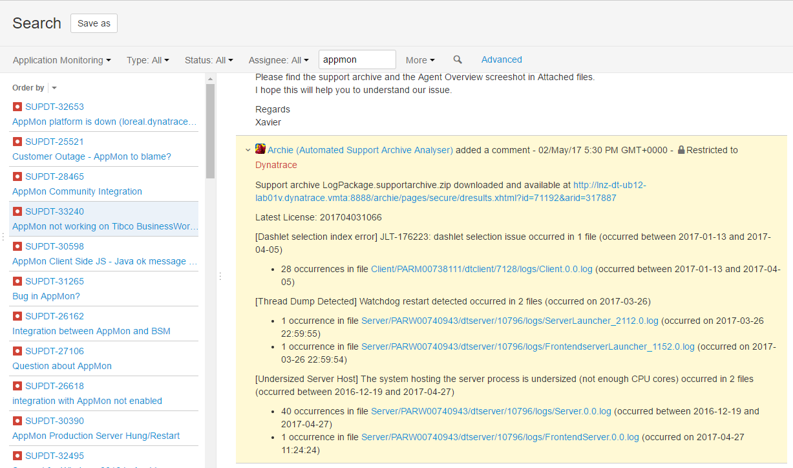
Lesson #4: Automated Error Analysis
Birth of “ARCHIE” our “Automated Log Archive Analyzer” integrated with JIRA
Notes:
12/20/2017
45
45

Slide 46
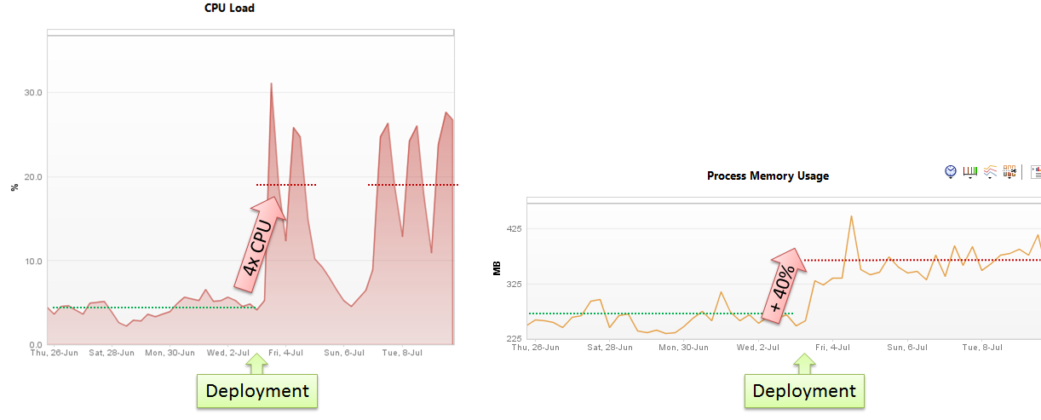
Lesson #5: We started to understand “The Cloud”
4x $$$ to IaaS
Notes:
12/20/2017
46
46
What Cloud Services to use for which tasks!
It SCALES but it AIN’T CHEAP if you make a mistake!

Slide 47
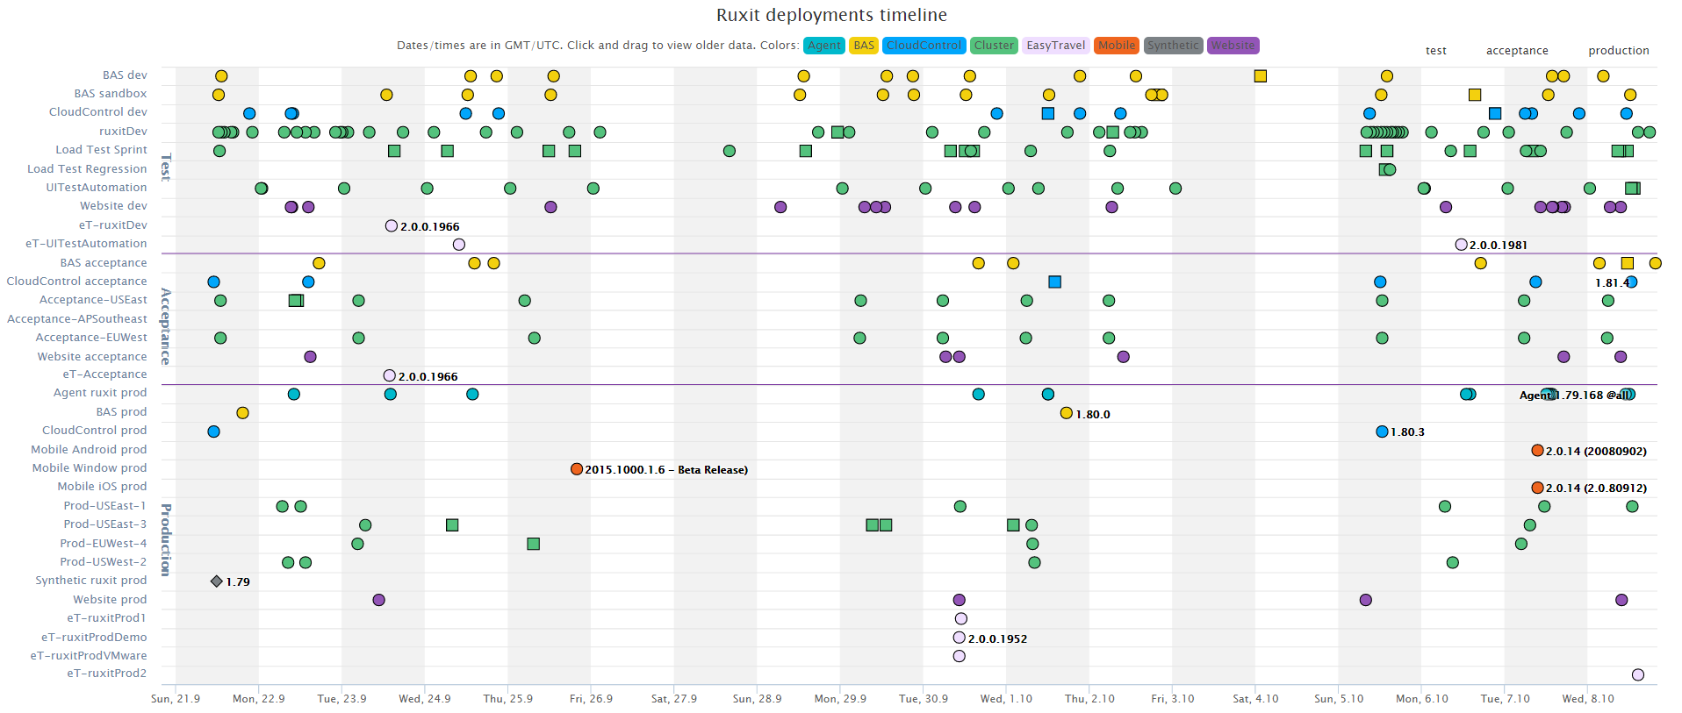
Lesson #6: Pipeline quality + 10 min Builds
Notes:
Key Lessons Learned: Raise the awareness of quality and the impact of each individual developer on the bottom line -> which is quality in production
“Eat our own dogfood” aka “Drink our own Champagne” -> we install sprint builds into our internal systems
Visualize Build and Pipeline Quality via UFOs
Make Devs Look into production as well

Slide 48
Dev: Shift-Left - Architectural Regression Decisions
31k
Unit/Int-Tests / hour
60h UI-Tests / Build
== Functional Passed / Failed
= Capturing Application Metrics
+ # of Images, # of JS, Load Time …
+ # of SQL, # of Logs, # of API Calls, # of Excepts ...

Slide 49
Continuous Performance @ Dynatrace
“Performance Signature” for Build Nov 16
“Performance Signature” for Build Nov 17
Notes:
This is how we do it at Dynatrace. Thomas is responsible for our Continuous Performance Environment. Read more on the blog: https://www.dynatrace.com/blog/dynatrace-on-dynatrace-detecting-regressions-in-continuous-performance-environments/

Slide 50
Dev: Shift-Left - Architectural Regression Decisions
Baseline Every Metric of every Test
Stop the Pipeline Early!
Regression
Baseline
https://github.com/Dynatrace/ufo
Notes:
Even if the deployment seemed good because all features work and response time is the same as before. If your resource consumption goes up like this the deployment is NOT GOOD. As you are now paying a lot of money for that extra compute power
Dynatrace can look at key resource, performance, scalability and architectural metrics and trend it from build-to-build. If Dynatrace detects a regression it can notify the build pipeline (Jenkins, Bamboo, TFS, …) that the current code change should not be promoted to the next phase
Screenshot from Dynatrace AppMon

Slide 51
dynatrace.com/ufo
3d print: dynatrace.github.io/ufo

Slide 52
Biz: User Feedback Driven Decisions
Total Number of Users
per User Experience
Conversion Rate
Notes:
The next slides show a scenario that happened in our organization. This dashboard is used by our marketing and business teams to see how well frequented our website is (total numbers in top chart), how user experience plays out (top chart with green/yellow/red) and how many people sign up for our free trial offering (conversion rate)

Slide 53
Biz: User Feedback Driven Decisions
New Features + Day # 1 of Mkt Push
Overall increase of Users!
Jump in Conversion Rate!
Notes:
May 1st was a push of a new release and a marketing campaign started that promoted these features and tried to get people to sign up
Seems everything was working as expected

Slide 54
Biz: User Feedback Driven Decisions
Day #2 of Marketing Campaign
Users keep growing
Increase # of “tolerating” users!
Lower Conversion as Day #1
Notes:
Day 2 started good but we also saw that slower web site performance (due to the heavy load) was impacting our end user experience and also conversion rate

Slide 55
Biz: User Feedback Driven Decisions
Hotfix Deployment was rolled out
Spikes in FRUSTRATED Users!
Drop in Conversion Rate
Notes:
The Dev Team provided a hotfix to make the sign up for faster
#1: It got deployed around noon
#2: Fix had negative impact as it broke the whole website due to a javascript problem on certain browsers
#3: problem was immediately visible to both business (drop in conversion) and dev (they looked at the reported JavaScript problems and user experience)

Slide 56
Biz: User Feedback Driven Decisions
Fix of the Hotfix was rolled out
User Experience Back to Normal
Jump in Conversion Rate!
Notes:
Due to the fast feedback from Production the Dev Team immediately fixed that regression – bringing the system back to where they wanted it to be in the first place

Slide 57
Lesson #8: Make Alerts more Actionable
Notes:
12/20/2017
57
57

Slide 59
Path to NoOps: With a little guidance from AI
Release
Automation
Dynatrace Automation
API, CLI, Auto-Detection
Dynatrace Smartscape
docker run –e DT_TAGS=BLUE
dtcli tag srv CartServicev2 GREEN
dtcli evt push pg tomcat1 desc=JVMMemIncr hint=+100MB
dtcli evt push host .*demo version=123 source={git_commit}

Slide 60
Path to NoOps: With a little guidance from AI
?Escalate at 2AM?
…
Auto Mitigate!
…
?
1
CPU Exhausted? Add a new service instance!
2
High Garbage Collection? Adjust/Revert Memory Settings!
4
3
Issue with BLUE only? Switch back to GREEN!
4
Hung threads? Restart Service!
Update Dev Tickets
3
?
Impact Mitigated?
2
Mark Bad Commits
5
Still ongoing? Initiate Rollback!
1
Escalate
5
?
Still ongoing?

Slide 61
Shift-Left: Break Pipeline Earlier
c0123bd
nov17
myservice:nov17
myservice:nov17
myservice:nov17
myservice:nov17
space:UAT
space:PERF
space:PROD
myservice:BLUE
space:PROD
myservice:nov16
myservice:nov17
Selenium Perf Data
myservice:BLUE
myservice:nov16
myservice:GREEN
space:PROD
space:PERF
myservice:GREEN

Slide 62
Shift-Left: Performance as Self-Service
c0123bd
Diagnostics
myservice:tmp57
myservice:tmp57
space:PERF

Slide 63
Actionable Feedback Loops: Business
New Requirement Definition
Labels become Key User Action
Success Criteria
Live Data Queries

Slide 64
Be proud of your feature!
DevOps → (No)Ops
Notes:
We learned that we need to have self-service in our pipeline. Intuitive Dashboards, Chat Ops and Voice Ops to allow developers to pro-actively react on feedback from the pipeline

Slide 65
DevOps: Cultural and tooling tips from around the world
Andreas Grabner, DevOps Activist, Dynatrace @grabnerandi
Join our Podcast Series bit.ly/pureperf

