Slide 1
Apache Solr
Apache Solr – Introduction
David Shemer
Notes:
When I started working on this presentation I realized that trying to explain the concepts of a search engine and provide real value in 45 minutes is not going to be easy.
I will start with a quick what is solr and what it provides, then run a demo on how to install and run a solr server on your machine in a few minutes and from there I will go deeper and deeper
To this new world of content which most arent familiar with

Slide 2
Overview
What is Solr
standalone open-source enterprise search server with a
“REST-like” API, Written in java
How it works
You provide him with the Data in various formats: Text, Database Queries, Xml, Json, Word, Pdf, Email and email attachments…
Solr indexes (Slice and Chops) them by using a schema you define in advance
In the schema there are very specific definitions to how data is sliced using anlyzers, tokenizers and filters.
You query on your data with highly featured search syntax

Slide 3
Overview
What can you do with solr
BLAZING Fast queries
BLAZING Fast data retrieval
facet (Group by) queries
Geospatial Search with multiple points and geo polygons
Out of the box autocomplete support
Results Highlighting
Server statistics exposed over JMX
Auto failover and recovery
Extensible Plugin Architecture
Notes:
Uverse - masters of, true “lood” ,obama

Slide 4
illustration of need
Search has been moving from an expensive, complicated option to an affordable and more easy necessity.
How solr is being utilized in the industry
Large websites search engine
Big Data Analytics
Fine grained access for organization users to data
Performance booster - façade to your data layer
Writing more interesting and fast algorithms
No SQL (Not only SQL) engine
Geo Location Engine
Discovery and Recommendations

Slide 5
Demo
Download
http://lucene.apache.org/solr/downloads.html
tutorial - http://lucene.apache.org/solr/4_6_0/tutorial.html
Extract
unzip solr-4.6.0.zip
Run (on jetty)
cd sdjug/solr-4.6.0/example/
java Xmx512m -jar start.jar
The administration server is up and running
http://localhost:8983/solr

Slide 6
Demo
Index
cd to exampledocs
java -jar post.jar money.xml monitor.xml manufacures.xml
Solr index using http://localhost:8983/solr/update..
Query
*:*
+id:a*
Display The different options for the Admin UI
View the solr directory structure

Slide 7
The Components – Core Config
Core
a running instance of a Solr index with its own schema and configuration.
Can hold thousands of cores simultaneously.
Core Configuration – solrconfig.xml
Index dir
Caching
Query Listeners
DIH – Data Import Handler Configuration
UI Section

Slide 8
The Components - Schema
Schema – schema.xml
Indexing guidelines you add to your fields:
What is searchable (indexed=true|false)
What is retrievable (stored=true|false)
Is this the default field for search (default)
Data Types
Basic data types (string, int, boolen, float )
Advanced data types (text)
Custom data types (text_en_spliting_tight)
Data type = Analyzer
Analyzer = Tokenizers + Filters

Slide 9
Tokenizers
Tokenizer
Split your text based on pattern
Examples:
solr.LetterTokenizerFactory – ignore all none letters chars
In: "I can't.”
Out: "I", "can", "t”
solr.NGramTokenizerFactory minGramSize="4" maxGramSize="5”
In: "bicycle”
Out: "bicy", "icyc", "cycl", "ycle", "bicyc", "icycl", "cycle"
More on:
http://docs.lucidworks.com/display/solr/Tokenizers

Slide 10
Filters
The filter looks at each token in the stream sequentially and decides whether to pass it a long, replace it or discard it.
Examples:
solr.TrimFilterFactory
In: " Kittens! ", "Duck"
Out: "Kittens!", "Duck”
"solr.StopFilterFactory" words="stopwords.txt" ignoreCase="true"
More on:
http://wiki.apache.org/solr/AnalyzersTokenizersTokenFilters

Slide 11
Queries
Query parsers
Lucene – Default
eDismax – generally makes the best first choice query parser for user facing Solr applications.
Simple Queries:
Search for word "foo" in the title field.
title:foo
AND OR
(title:"foo bar" AND body:"quick fox") OR title:fox
+/ /-
+title:foo -title:bar

Slide 12
Queries
More Queries
startDate:[20020101 TO 20030101]
createdate:[1995-12-31T23:59:59.999Z TO 2007-03-06T00:00:00Z]
pubdate:[NOW-1YEAR/DAY TO NOW/DAY+1DAY]
Distance
Search the words foo and bar with distance of 4 chars
"foo bar"~4
All the Documents with a field*
field1:[* TO *]
-field1:[* TO *]
Define query parser and Uses the default field:
q={!lucene q.op=AND df=text}myfield:foo +bar -baz

Slide 13
Queries
Score
Each document in the results list gets one
It’s the default sort of the results
You can and should influence the score
Boosting
field1:"foo bar"^50 OR field2:"foo bar"^0.0001
Slop - distance between the terms
ps=10 field1:"foo bar"~10^50 OR field2:"foo bar"~10^20
Function Query
Nested Query
Notes:
You can run very long queries in amazingly fast manner

Slide 14
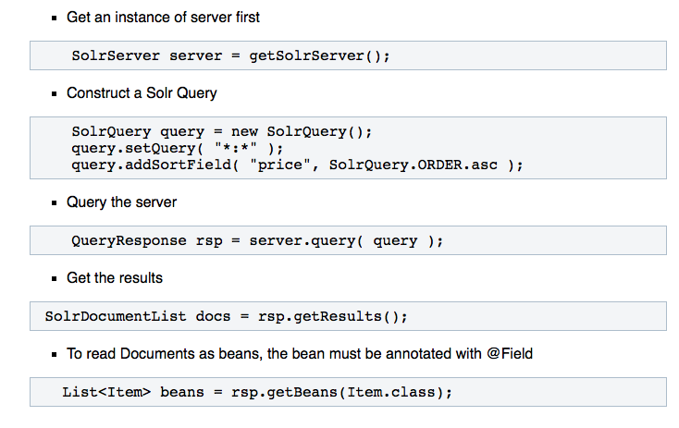
SolrJ
SolrJ - java client to access solr.
offers a java interface to add, update, and query the solr index

Slide 15
Alternatives
Elastic search
Sphinx
Xapian
OpenSearchServer

Slide 16
More Reading
http://lucene.apache.org/solr/4_6_0/tutorial.html
http://wiki.apache.org/solr/Solrj
http://wiki.apache.org/solr/DataImportHandler
http://www.lucenerevolution.org/2013/Lucene-Solr-Revolution-2013-Presentation

Slide 17
Toda
Thank you.
David Shemer

