Slide 1
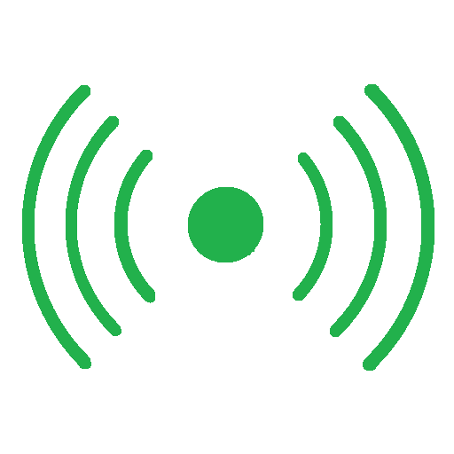
Network Explorer
Wi-Fi network, Wi-Fi device and Bluetooth device discovery app
Bill Wixted

Slide 2
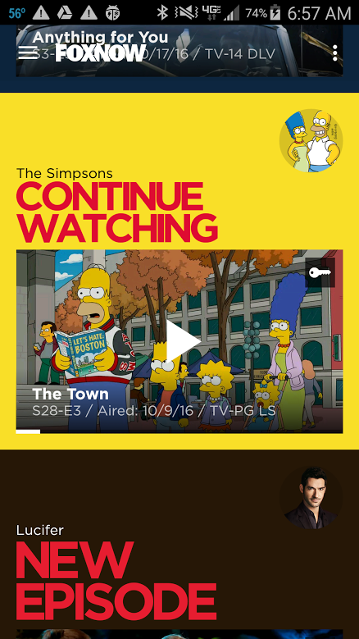

Slide 3
www.phunware.com/company/careers/
bwixted@phunware.com

Slide 4
Overview
Network Utilities Review
Fragments & Navigation Drawer Design
Wifi Network Discovery
Bluetooth Device Discovery
Wifi Device Discovery
3rd party: ACRA, Google Analytics

Slide 5
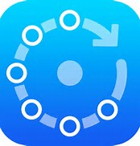
Fing
5,000,000 + downloads
137,000 reviews with 4.5 rating
WiFi network monitoring
Port scanning
Ping, traceroute, DNS tools

Slide 6
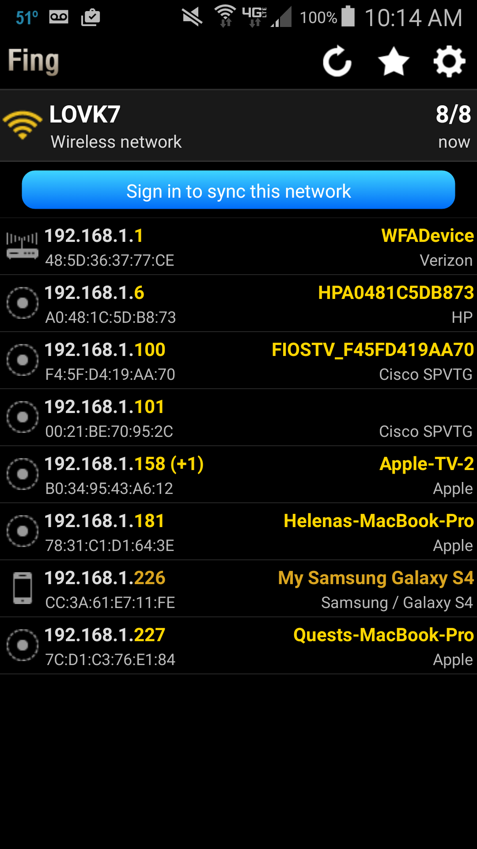

Slide 7
IP Tools
1,000,000 + installs
89,000 reviews with 4.5 rating
WiFi scanning
Port scanning
Ping, traceroute, DNS lookup

Slide 8
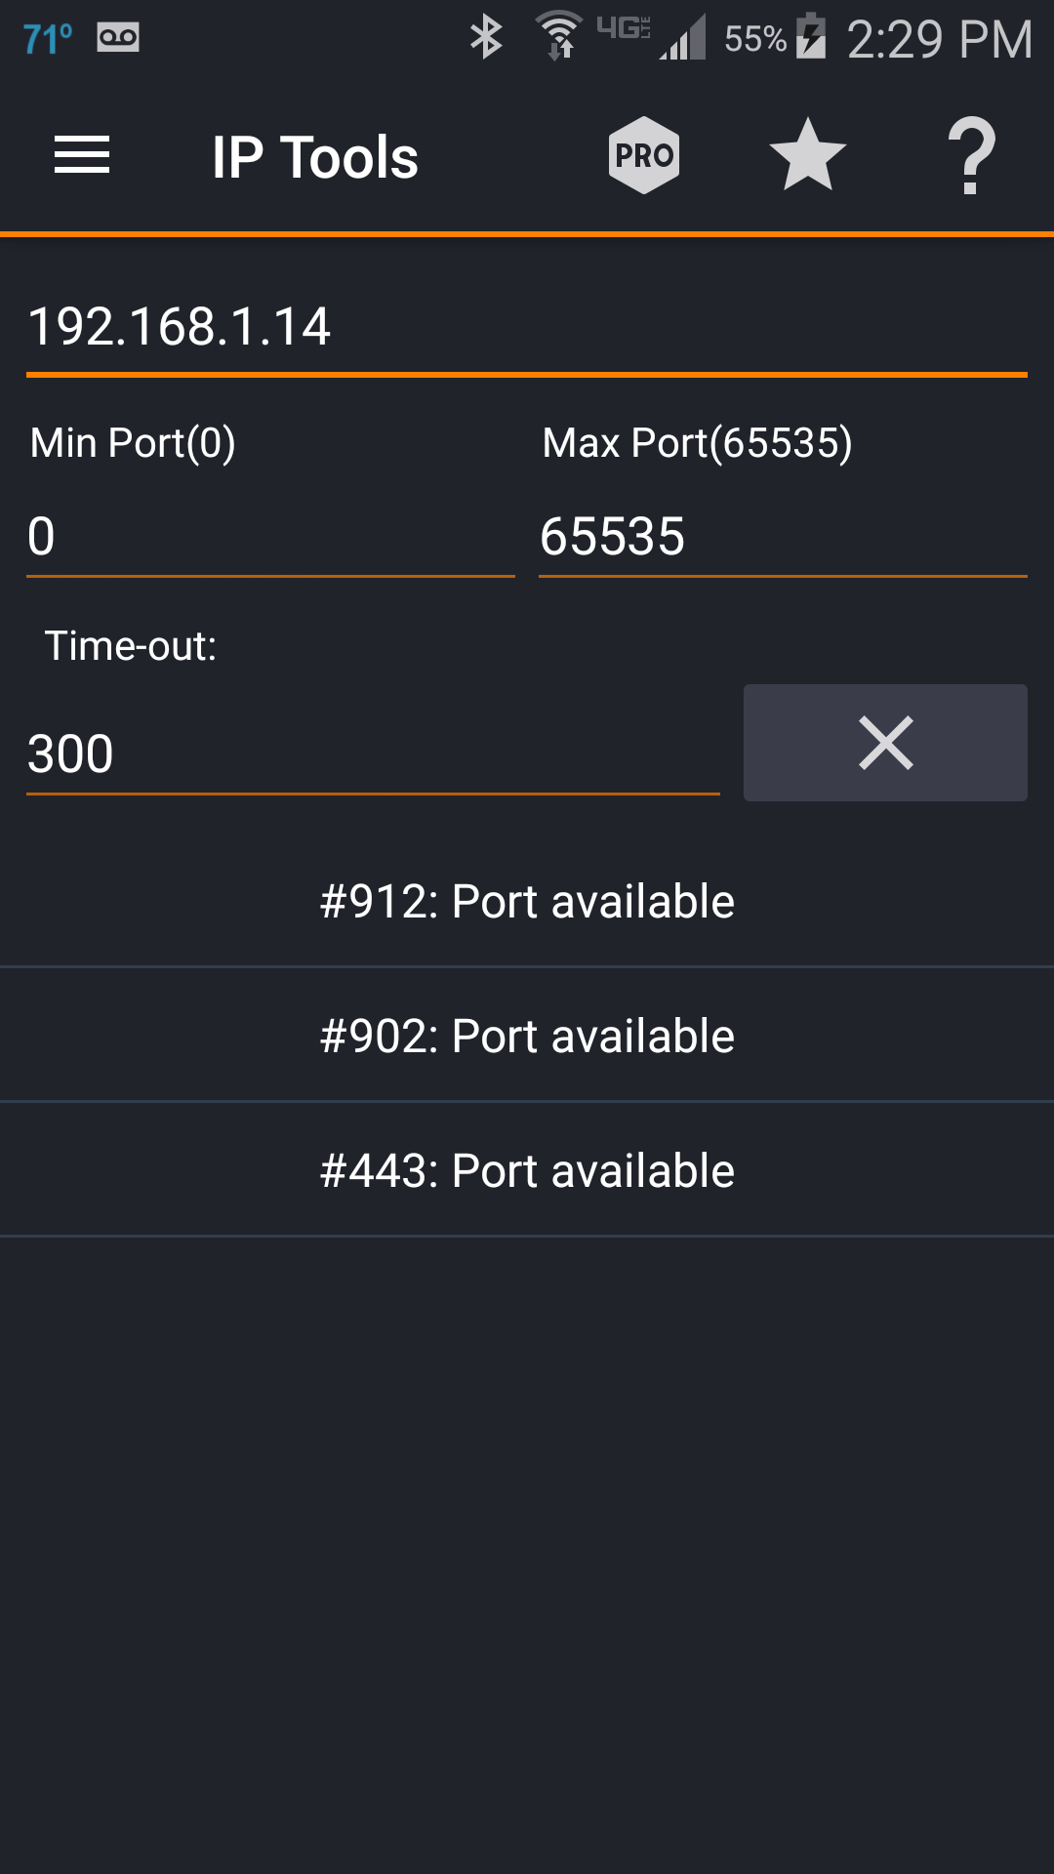
IP Tools

Slide 9
Network Scanner
1,000,000 + installs
1,700 reviews with 4.5 rating
WiFi network scanning
Save info to file

Slide 10
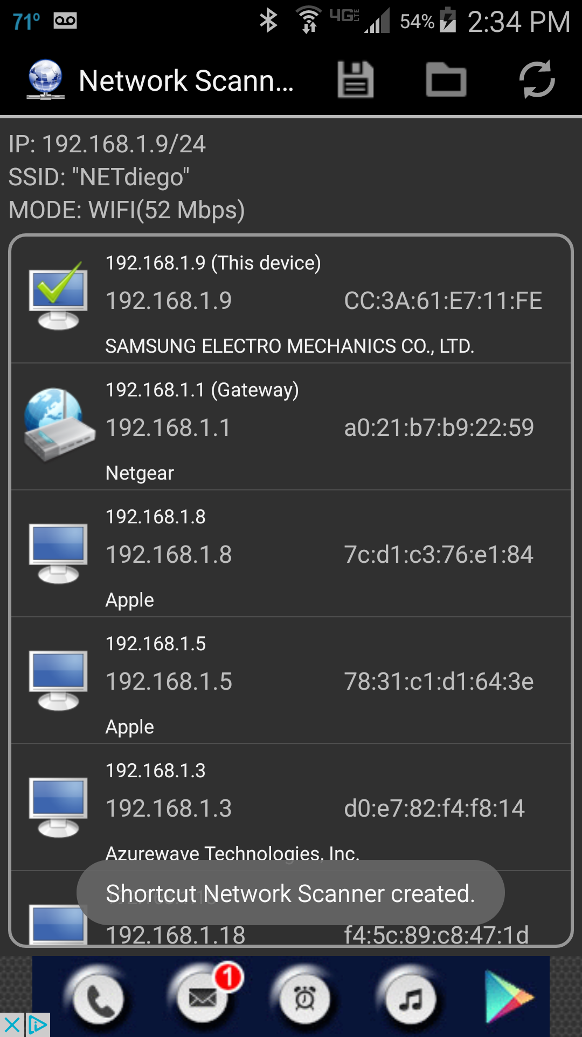

Slide 11
NetX
100,000+ downloads
3,300 reviews with 4.4 rating
WiFi Network Scanner
Port Scanning

Slide 12
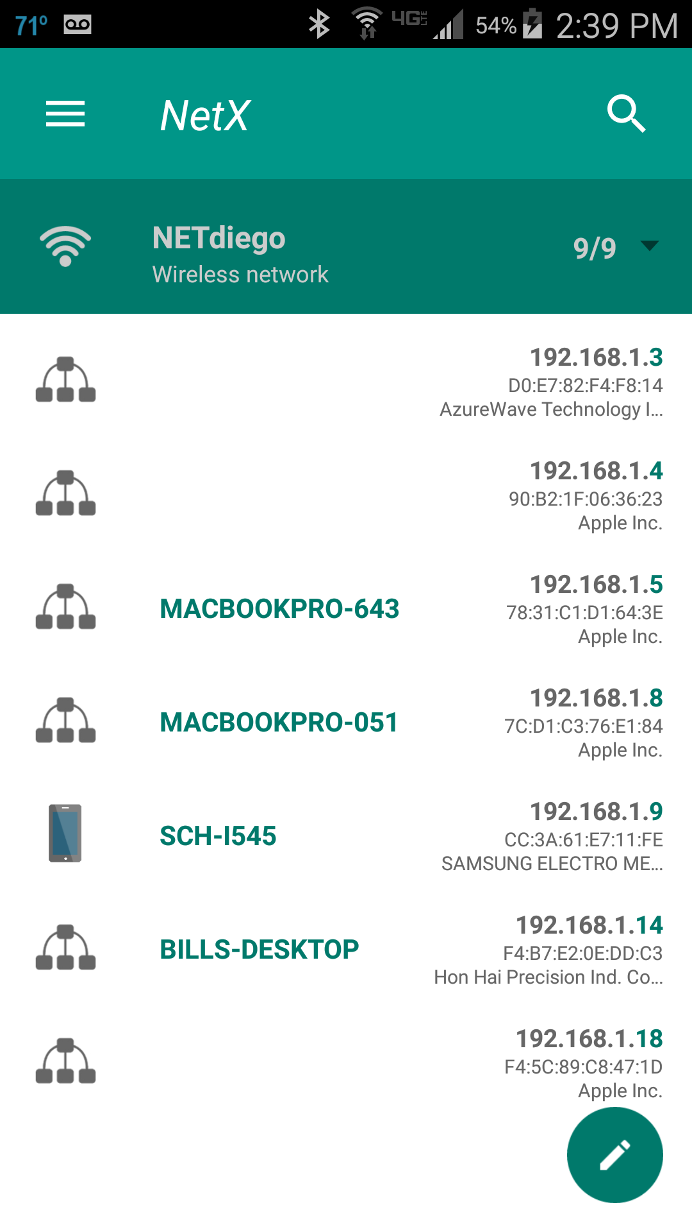
NetX

Slide 13
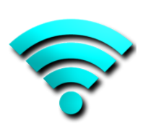
Network Signal Info
1,000,000 + installs
28,000 + reviews with 4.1 rating
Mobile network, WiFi, device info
Mobile network and Wifi signal strength graphs
Map for cell tower location

Slide 14
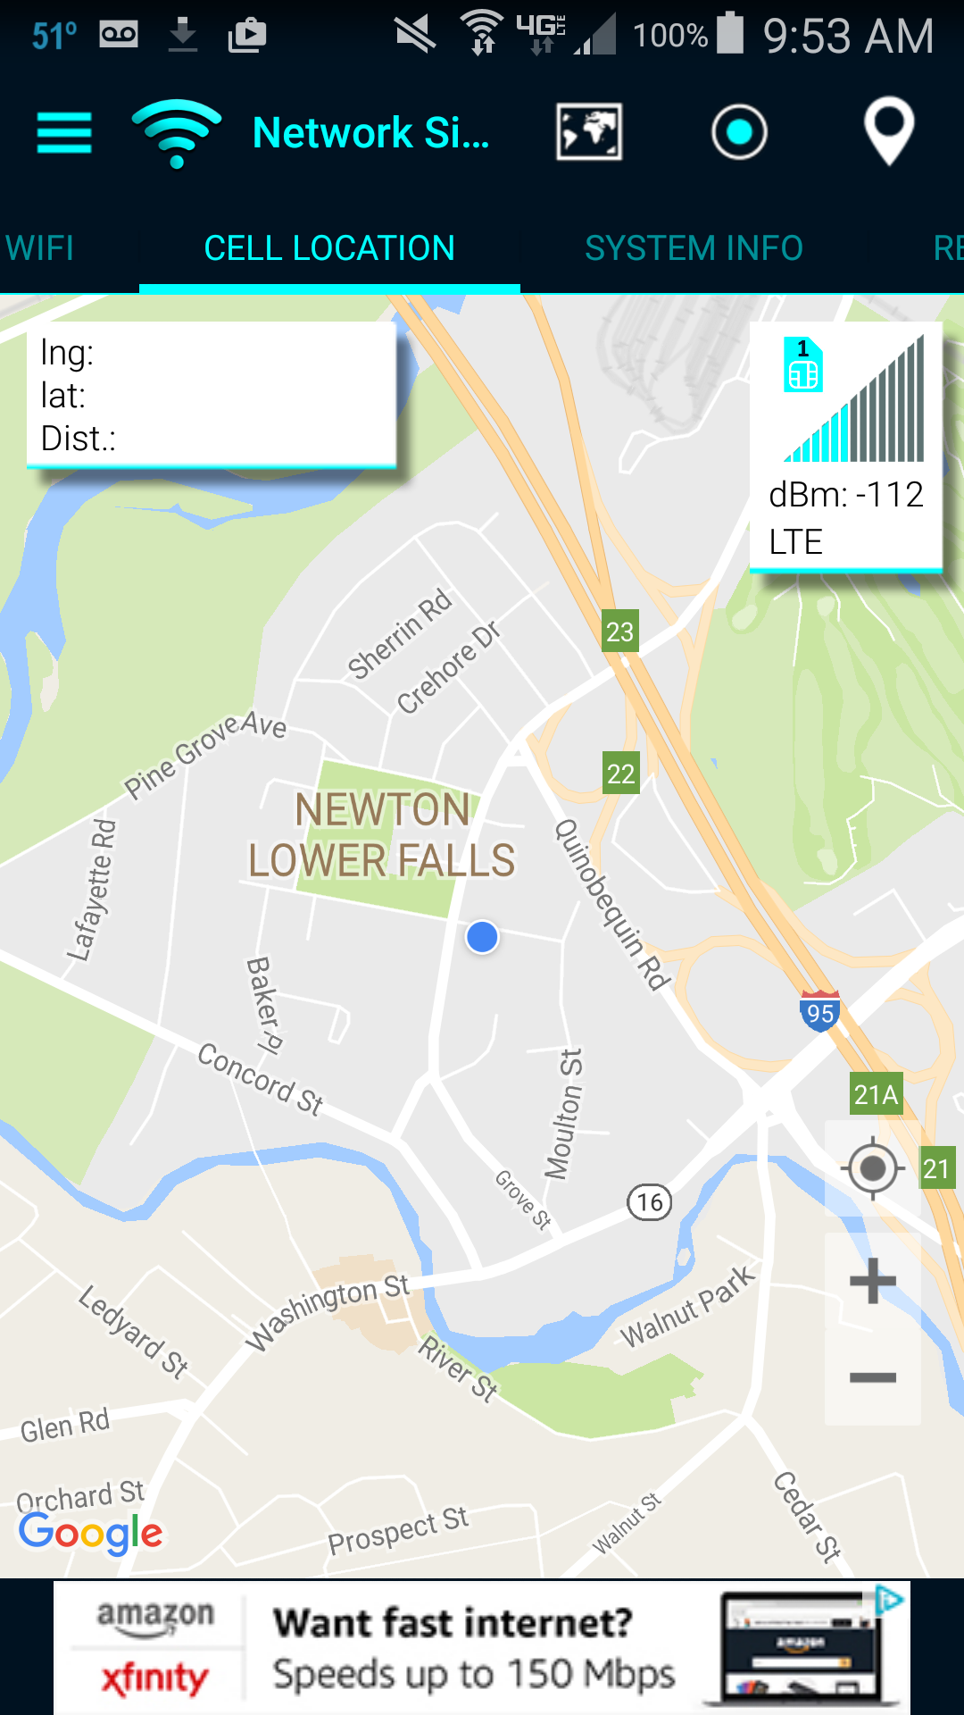

Slide 15
Who Is On My Wifi
100,000 + installs
3,000 + reviews with 3.6 rating
Wifi network monitoring
Allows tagging and labeling of devices

Slide 16
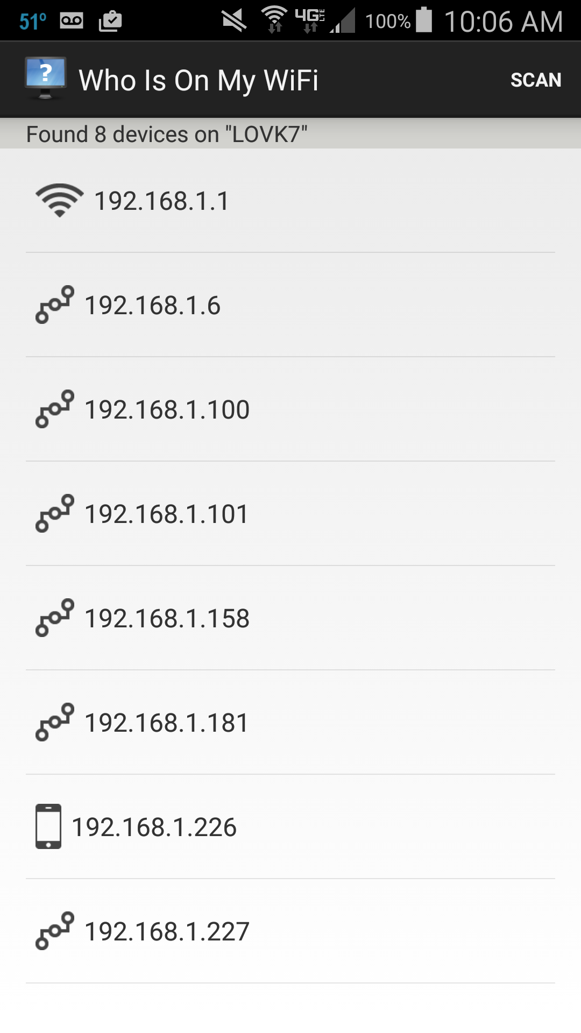

Slide 17
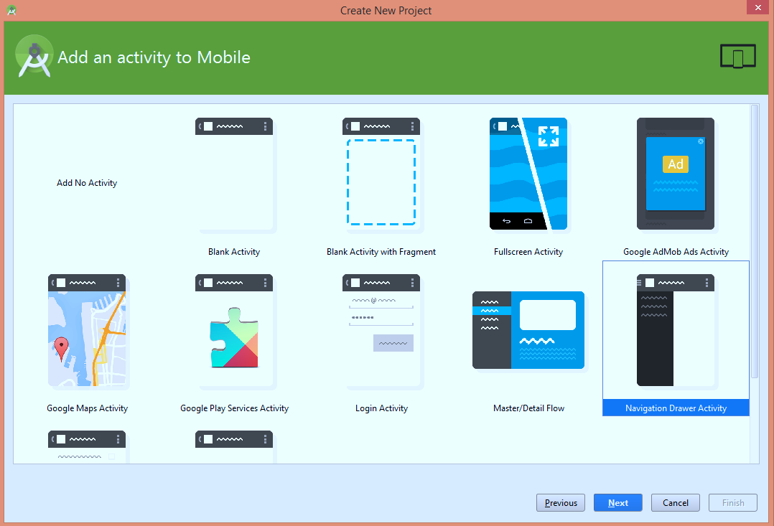
New Project Wizard

Slide 18
Navigation Drawer Fragment
MainActivity extends AppCompatActivity
PlaceholderFragment
NavigationDrawerFragment.java
ArrayList<NavDrawerItem> items = new ArrayList<>();
items.add(0,new NavDrawerItem(“Wi-Fi Networks”,"1",R.drawable.ic_wifi));
items.add(1,new NavDrawerItem(“Wi-Fi Devices”,“2",R.drawable.ic_laptop));
items.add(2,new NavDrawerItem(“Bluetooth Devices”,“3",R.drawable.ic_blue));
items.add(3,new NavDrawerItem(“About”,“4",R.drawable.ic_info));
items.add(4,new NavDrawerItem(“Terms”,“5",R.drawable.ic_document));
items.add(5,new NavDrawerItem(“Help”),“6",R.drawable.ic_help));
BaseAdapter adapter = new
NavDrawerListAdapter(getActionBar().getThemedContext(),navDrawerItems);
mDrawerListView.setAdapter(adapter);

Slide 19
AppCompatActivity
Added in v7 support library
replaced ActionBarActivity
Material design features
Consistent look and feel across Android versions
Action bar, Toolbar support
Fragment support via parent class FragmentActivity
<style name="AppTheme" parent="Theme.AppCompat.Light.DarkActionBar">
public class MainActivity extends AppCompatActivity
dependencies { compile 'com.android.support:appcompat-v7:23.0.1'

Slide 20
Action Bar
If using AppCompat you must use getSupportActionBar
Define “homeAsUpIndicator” in styles.xml
MainActivity::onOptionsItemSelected handles press events
public boolean onCreateOptionsMenu(Menu menu) {
getMenuInflater().inflate(R.menu.main, menu)
ActionBar actionBar = getSupportActionBar();
actionBar.setHomeButtonEnabled(true); actionBar.setDisplayShowHomeEnabled(true);

Slide 21
Fragments
Each Fragment extends v4.app.Fragment
Use getSupportFragmentManager
public void onNavigationDrawerItemSelected(int position) {
fragmentID = position;
FragmentManager fragmentManager = getSupportFragmentManager();
if (position == WIFI_NETWORKS) {
fragmentManager.beginTransaction()
.replace(R.id.container,
WifiNetworksFragment.newInstance(position + 1),
WIFI_NETWORKS_TAG)
.addToBackStack(null)
.commit();
}

Slide 22
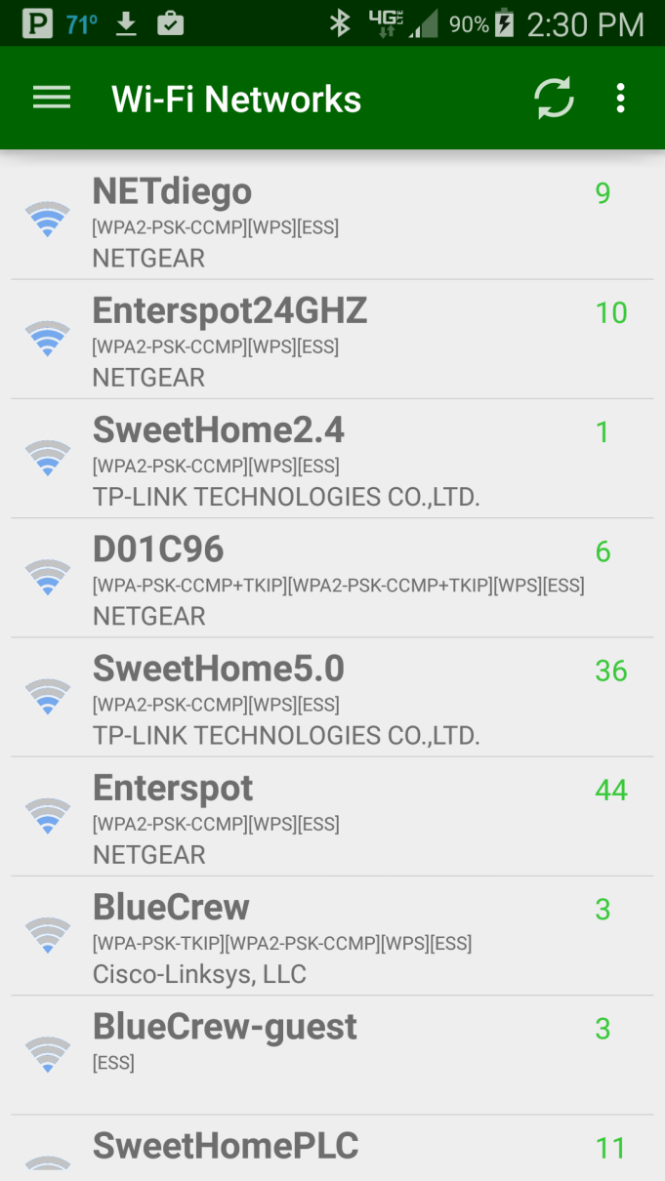
Wi-Fi Network Discovery
WifiManager
BroadcastReceiver

Slide 23
Wi-Fi Network Discovery

Slide 24
Received Signal Strength Indication (RSSI)
RSSI is a measure of power present in received radio signal
Comes from ScanResult.level
Units are dBm (“decibel milliwatts”)
|--------|-------------------|
| P(dBm) | P(mW) |
|--------|-------------------|
| 50 | 100000 |
| 40 | 10000 | strong transmitter
| 30 | 1000 | ^
| 20 | 100 | |
| 10 | 10 | |
| 0 | 1 |
| -10 | 0.1 |
| -20 | 0.01 |
| -30 | 0.001 |
| -40 | 0.0001 |
| -50 | 0.00001 | |
| -60 | 0.000001 | |
| -70 | 0.0000001 | v
| -80 | 0.00000001 | sensitive receiver
| -90 | 0.000000001 |
|--------|-------------------|

Slide 25
Signal Strength Graph
Layout refers to custom class
<com.effinitytech.networkexplorer.SignalStrengthGraph android:layout_width="match_parent" app:layout_heightPercent="45%" android:layout_below="@+id/table" android:layout_height="225dp" android:layout_margin="10dp" android:layout_gravity="center" android:id="@+id/signalStrengthGraph" />
Custom class
public class SignalStrengthGraph extends SurfaceView implements SurfaceHolder.Callback

Slide 26
SurfaceView - SurfaceHolder
SurfaceView
provides a dedicated drawing surface
provides a surface in which a secondary thread can render into the screen
SurfaceHolder
abstract interface
allows editing of pixels in the surface
public class SignalStrengthGraphThread extends Thread {
@Override
public void run()
{
Canvas mcanvas = surfaceHolder.lockCanvas(); signalStrengthGraph.doDraw(mcanvas, mRssi); surfaceHolder.unlockCanvasAndPost(mcanvas);

Slide 27
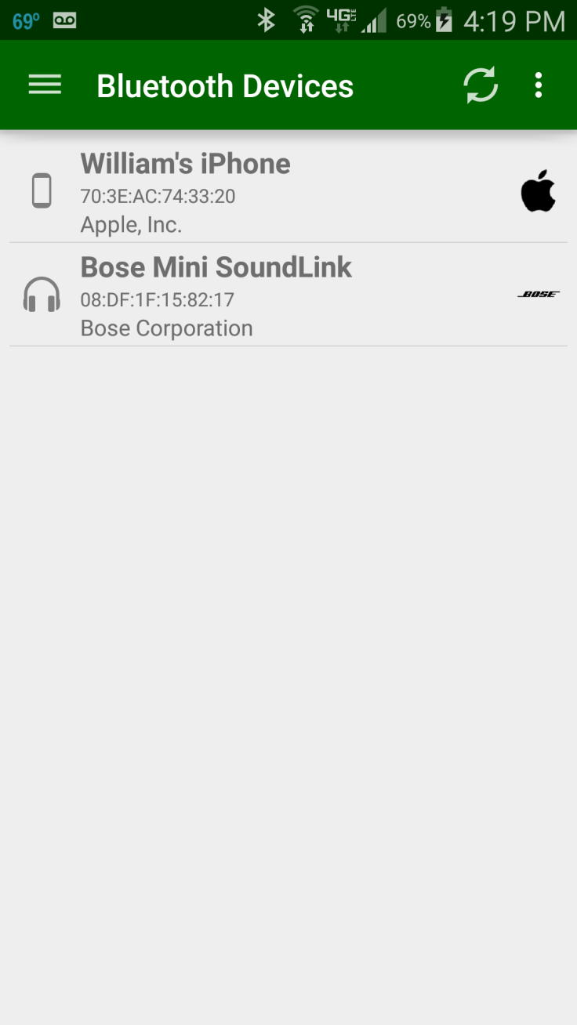
Bluetooth Device Discovery
BluetoothAdapter
BroadcastReceiver

Slide 28
Wi-Fi Device Discovery
WifiDevicesScanner
DeviceDiscoverer

Slide 29
Address Resolution Protocol (ARP)
Telecommunication protocol used for resolution of network layer addresses into link layer addresses
In other words, it resolves network address (IP) to a physical address (MAC)
Broadcast: “who is X.X.X.X tell Y.Y.Y.Y”
Target sends "X.X.X.X is hh:hh:hh:hh:hh:hh“ to “Y.Y.Y.Y”

Slide 30
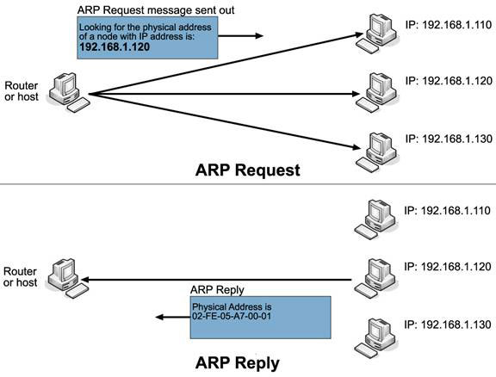

Slide 31
MAC Address
MAC, Media Access Control, address is a globally unique identifier assigned to network devices,
MAC addresses are 6-byte (48-bits) in length, and are written in MM:MM:MM:SS:SS:SS format.
OUI (organizationally unique identifier) assigned by IEEE
CC:3A:61:E7:11:FE
OUI NIC-specific

Slide 32
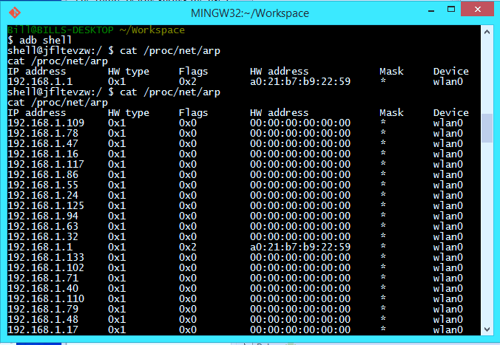
ARP Cache

Slide 33
Device Manufacturer Lookup
OUIs are assigned by IEEE
http://standards-oui.ieee.org/oui/oui.txt
Conversion to asset (devices.txt)
Load into map for lookup (DeviceManager)

Slide 34
Subnet Scanning
IP: 192.168.1.10
NetMask: 16777215 (0xFFFFFF)
CIDR: 24 (this is “Class C” -> 254 hosts)
Start IP: 192.168.1.1
192.168.1.
10
Network
Host

Slide 35
Subnet Scanning
InetAddress.IsReachable
uses ICMP (Internet Control Message Protocol)
Tools like ping and traceroute use it

Slide 36
Wifi Device name
Network Service Discovery
NetBios

Slide 37
Port Scanning
Open socket to IP/Port
Ports 1 to 65535
try { socket = new Socket(); socket.bind(null); socket.connect(new InetSocketAddress(ip, port), TIMEOUT); socket.close(); connected = true; } catch (IOException e) {

Slide 38
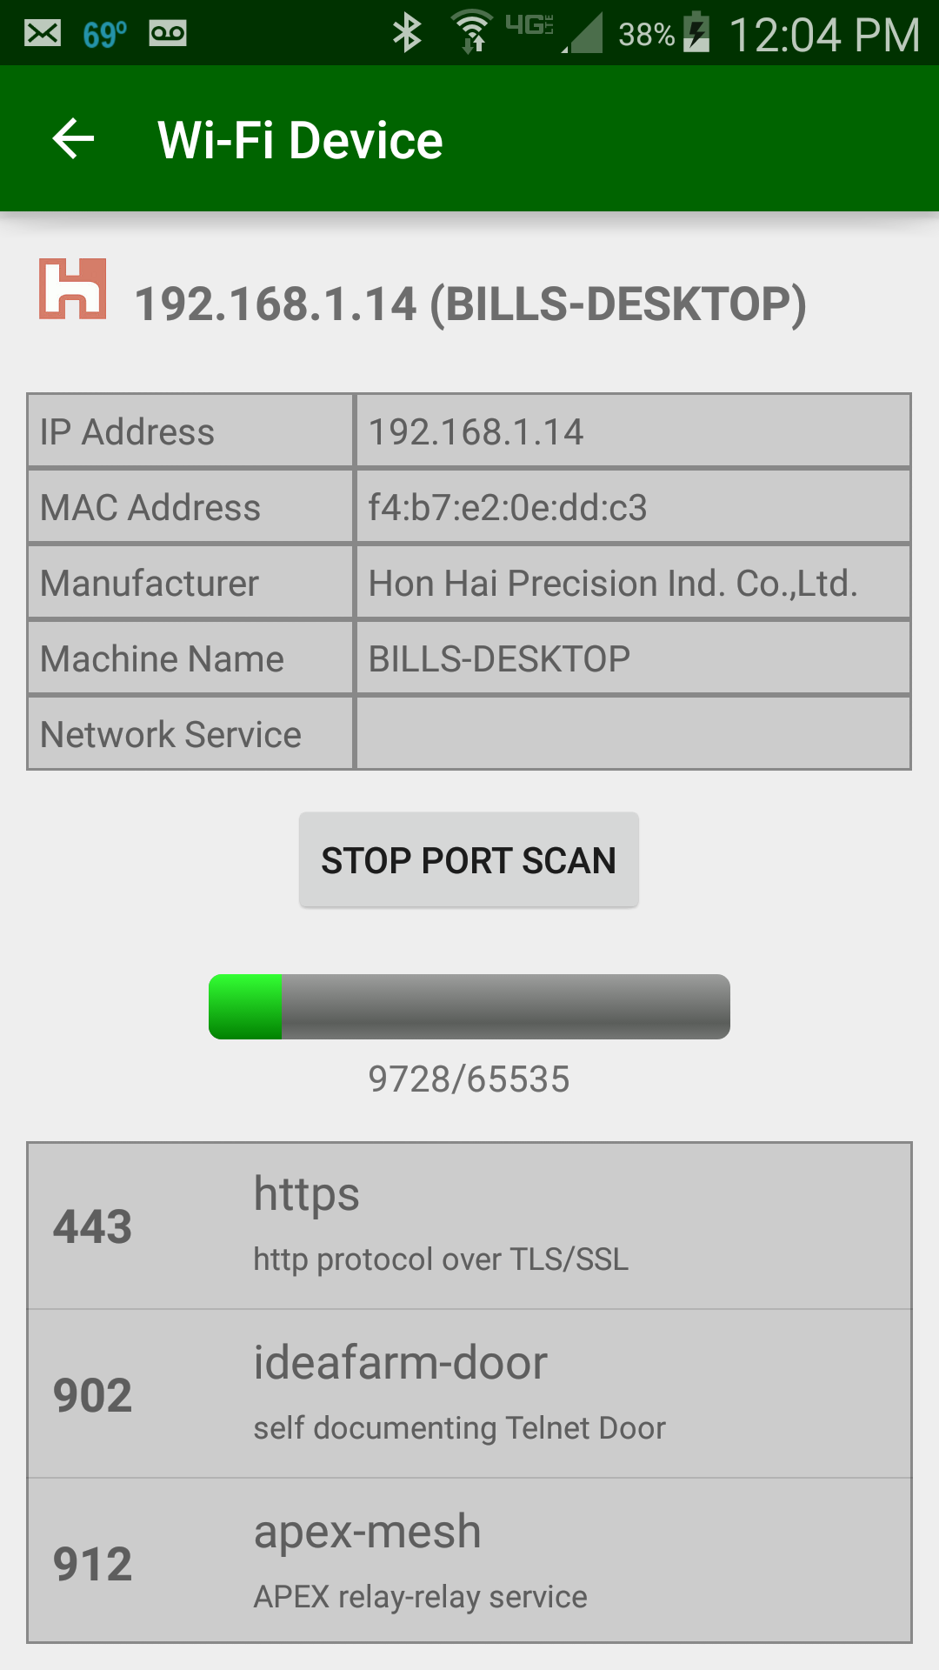
Port Scanning

Slide 39
ACRA
Crash reporting tool
import org.acra.ACRA; import org.acra.annotation.ReportsCrashes;
@ReportsCrashes(formUri = "http://effinitytech.com/update.php")
public class MainApp extends Application { @Override public void onCreate() { super.onCreate(); ACRA.init(this); }

Slide 40
ACRA
ACRA module containing acra-4.7.0.aar
PHP to catch crash reports
$fileName = 'temp/crash'.date('Y-m-d_H-i-s').'.txt';
$file = fopen($fileName,'w');
foreach($_POST as $key => $value) {
$reportLine = $key." = ".$value."\n";
fwrite($file, $reportLine);
}
fclose($file);

Slide 41
ACRA
Crash report
3-10 16:58:46.307 D/AndroidRuntime( 5090): Shutting down VM
03-10 16:58:46.307 E/NetworkExplorer( 5090): java.lang.RuntimeException: Unable to start activity ComponentInfo{com.effinitytech.networkexplorer/com.effinitytech.networkexplorer.WifiNetworkActivity}: java.lang.NumberFormatException: Invalid int: "NETGEAR"
03-10 16:58:46.307 E/NetworkExplorer( 5090): at android.app.ActivityThread.performLaunchActivity(ActivityThread.java:2693)
03-10 16:58:46.307 E/NetworkExplorer( 5090): at android.app.ActivityThread.handleLaunchActivity(ActivityThread.java:2758)
03-10 16:58:46.307 E/NetworkExplorer( 5090): at android.app.ActivityThread.access$900(ActivityThread.java:177)
03-10 16:58:46.307 E/NetworkExplorer( 5090): at android.app.ActivityThread$H.handleMessage(ActivityThread.java:1448)
03-10 16:58:46.307

Slide 42
Google Analytics
import com.google.android.gms.analytics.GoogleAnalytics; import com.google.android.gms.analytics.Tracker;
public class MainApp extends Application { private Tracker mTracker; private void ERROR(String msg, Exception e) { NLogger.ERROR(msg,e); } @Override public void onCreate() { super.onCreate(); } synchronized public Tracker getDefaultTracker() { if (mTracker == null) { GoogleAnalytics analytics = GoogleAnalytics.getInstance(this); mTracker = analytics.newTracker(R.xml.global_tracker); } return mTracker; } }

Slide 43
Google Analytics
Build.gradle:
dependencies { compile fileTree(dir: 'libs', include: ['*.jar']) compile 'com.android.support:appcompat-v7:23.0.1' compile project(':acra-4.7.0') compile 'com.google.android.gms:play-services-analytics:8.4.0' } apply plugin: 'com.google.gms.google-services‘
AndroidManifest.xml:
<uses-permission android:name="android.permission.WAKE_LOCK" tools:node="remove" />

Slide 44
Google Analytics
MainActivity::onAttachFragment

Slide 45
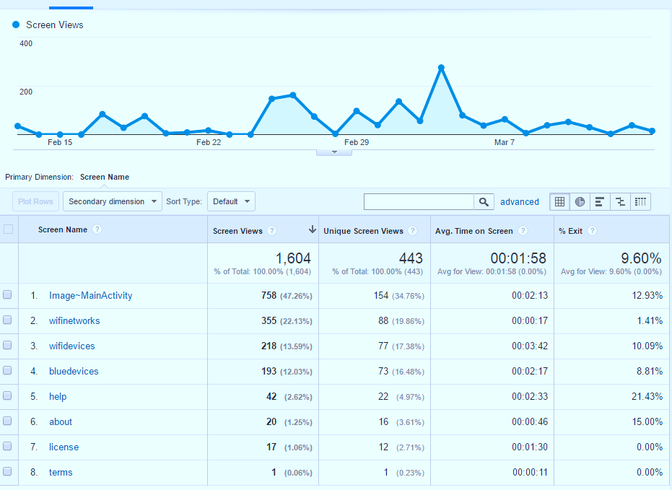
Google Analytics

Slide 46
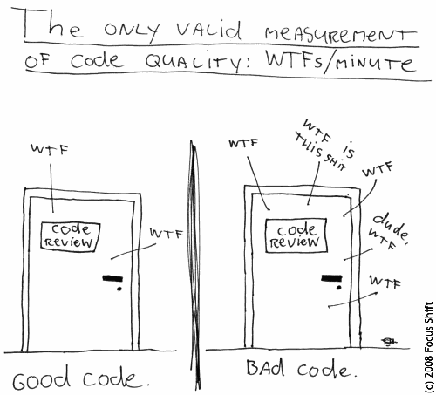

Slide 47
Avoiding Memory Leaks
A garbage collector is not an insurance against memory leaks
Do not keep long-lived references to a context-activity (a reference to an activity should have the same life cycle as the activity itself)
Try using the context-application instead of a context-activity
Avoid non-static inner classes in an activity if you don't control their life cycle, use a static inner class and make a weak reference to the activity inside. The solution to this issue is to use a static inner class with a WeakReference to the outer class, as done in ViewRoot and its W inner class for instance
http://android-developers.blogspot.com/2009/01/avoiding-memory-leaks.html

Slide 48
Future Enhancements
Cell Tower Info and Map
Augmented Reality View to find cell tower
BLE scanning

