Slide 1
Oracle Code One 2018
An Overview
Paul Webber
November 20, 2018

Slide 2
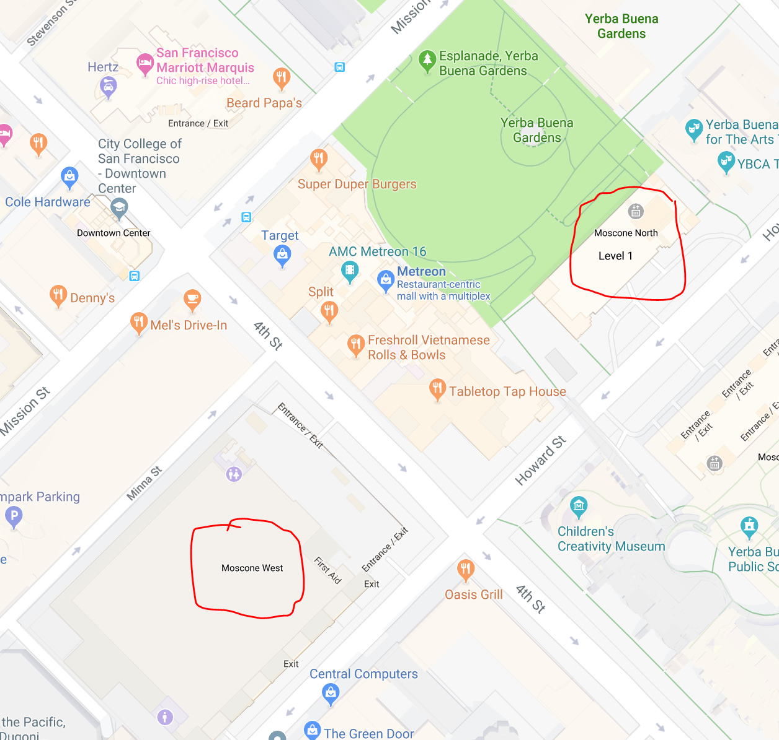
The Conference Oct 22 - 25
Saturday, Oct 20
Java Champion Summit at Parc 55
Saturday/Sunday, Oct 20/21
JavaOne4Kids, Oracle HQ
Sunday, Oct 21
Conference Preparation and Rehearsals
Monday - Thursday, Oct 22 - 25
Sessions at Moscone West

Slide 3
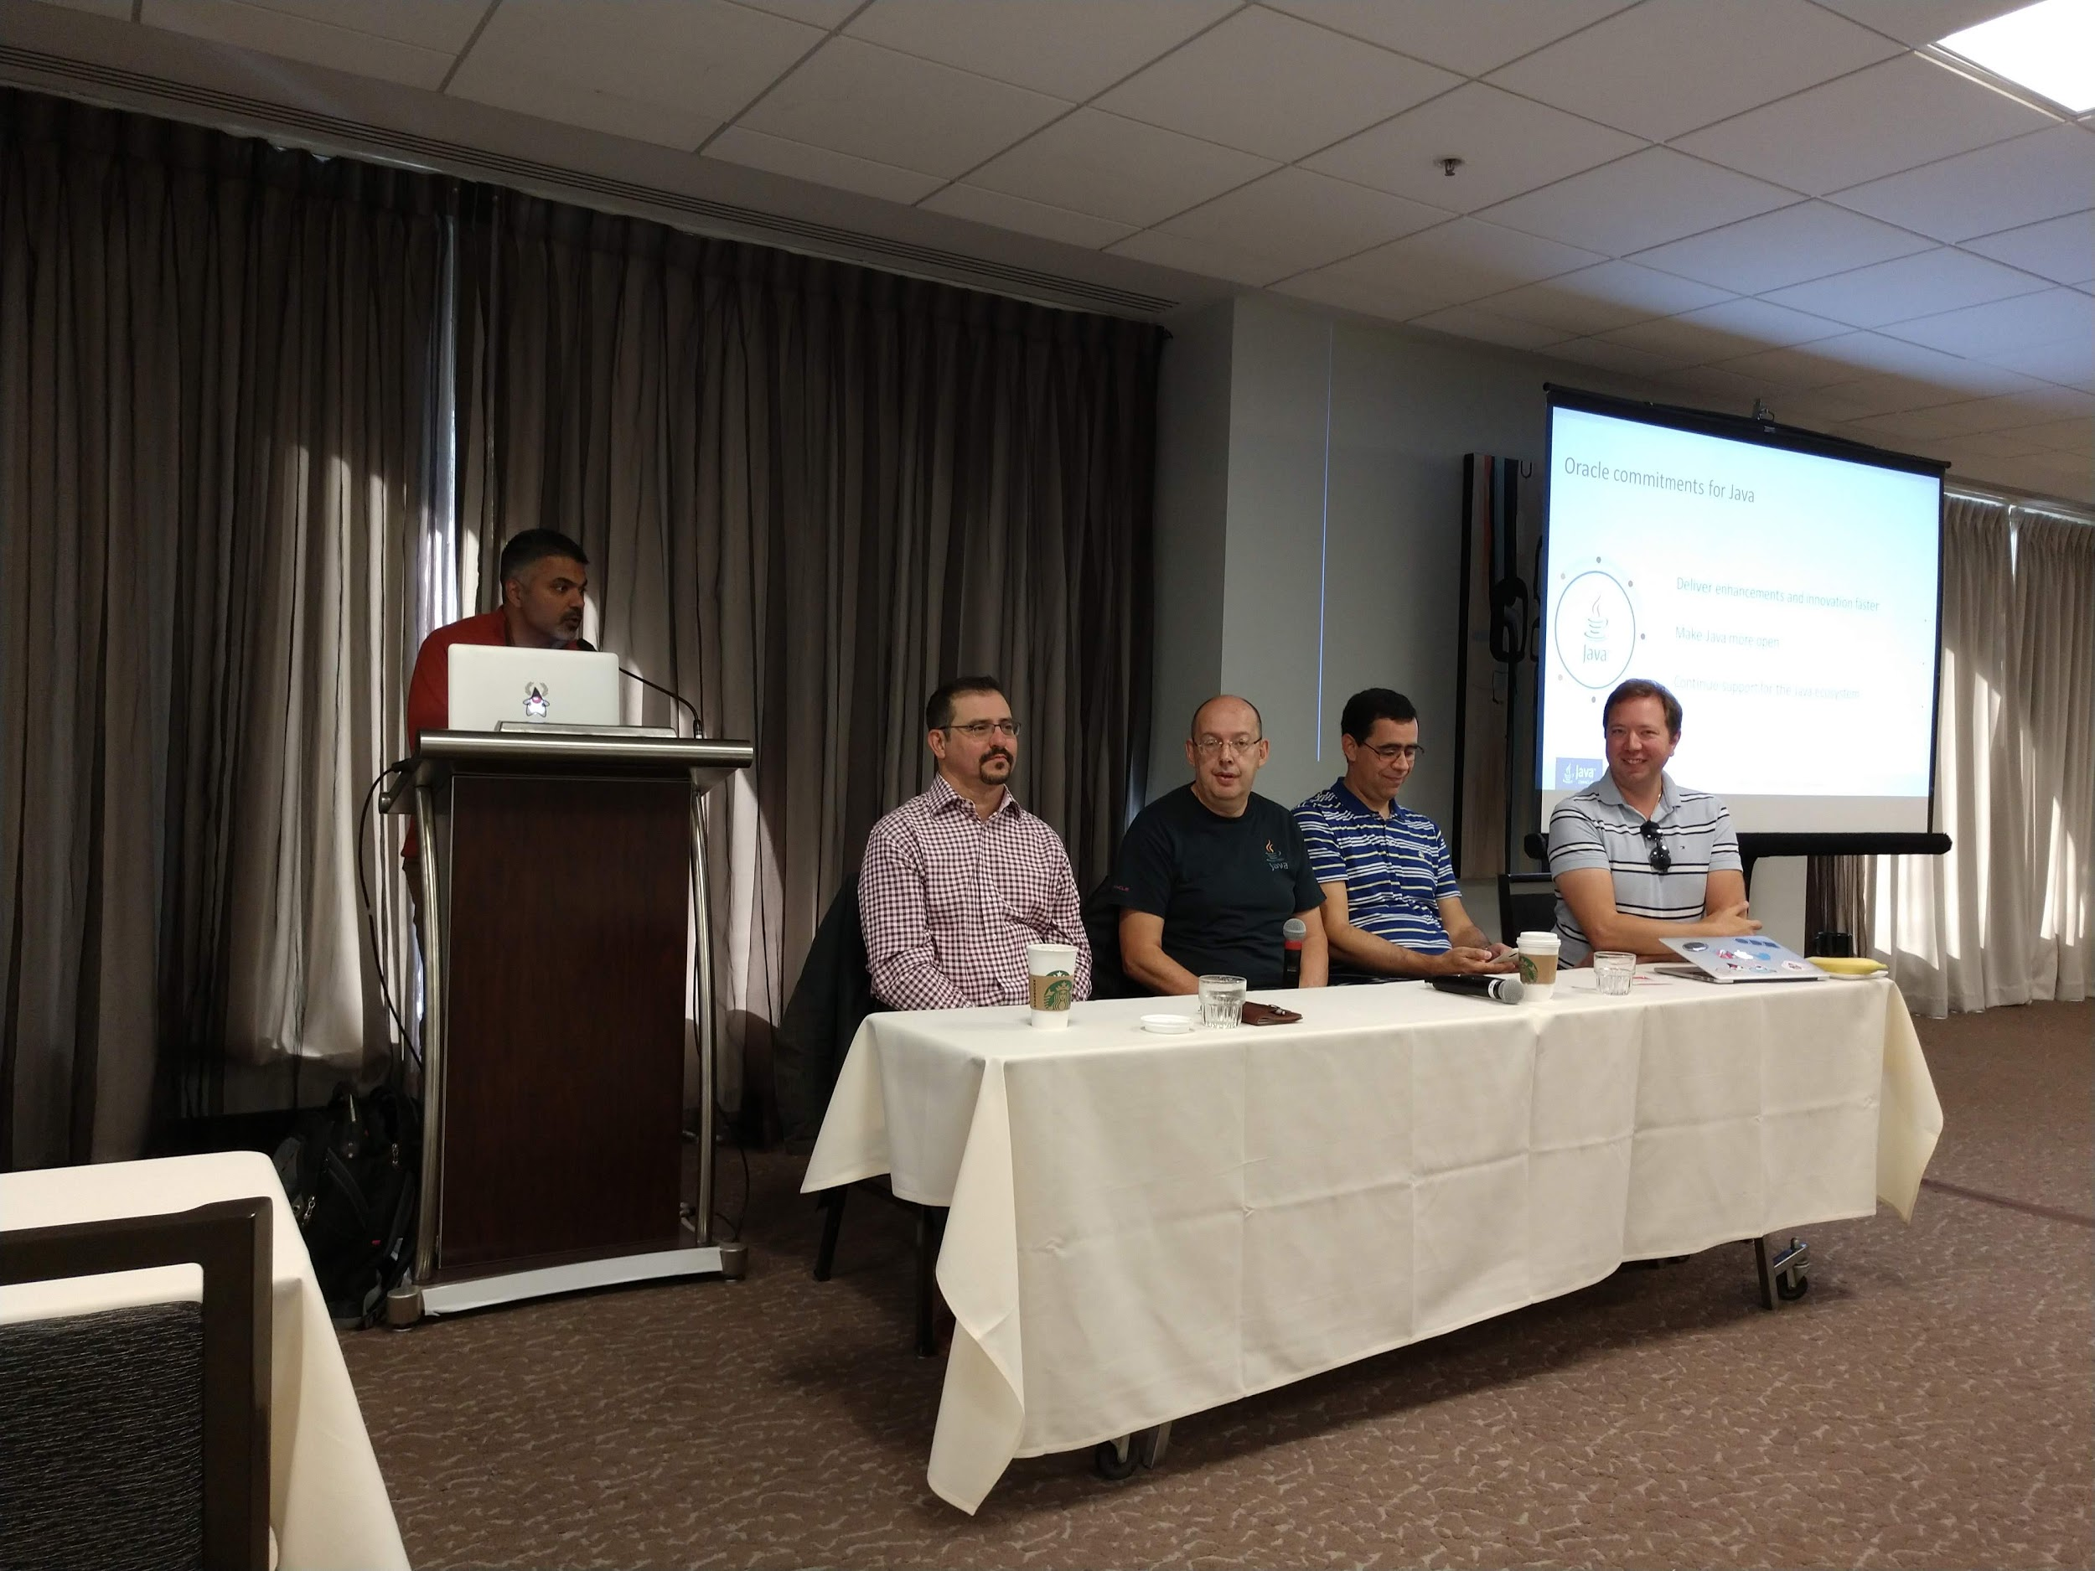
Java Champion Summit
Oracle
Java Platform Panel
Moderator: Sharat Chander, Senior Director, Java Product Management & Developer Relations
Georges Saab, Vice President, Software Development, Java Platform Group
Bernard Traversat, Vice President, Software Development - Java Platform
Aurelio Garcia-Ribeyro, Director of Product Management
Mikael Vidstedt, Director of Software Engineering, Java Virtual Machine
Java SE Licensing Model
Aurelio Garcia-Ribeyro
Sharat Chander
Java and Containers
Mikael Vidstedt
JakartaEE
Will Lyons, Senior Director Product Management
Notes:
100 Champions from around the world.
Learn how Oracle is continuing to steward ongoing Java technology enhancements.
Learn what’s new in Java, gain an understanding of recent additions to the language and platform,
and get a look ahead at enhancements that are in development that will continue to improve developer productivity.
Jakarta EE is an open source initiative at the
Eclipse Foundation that will evolve Java EE 8
technologies to meet the requirements of
cloud-native computing.

Slide 4
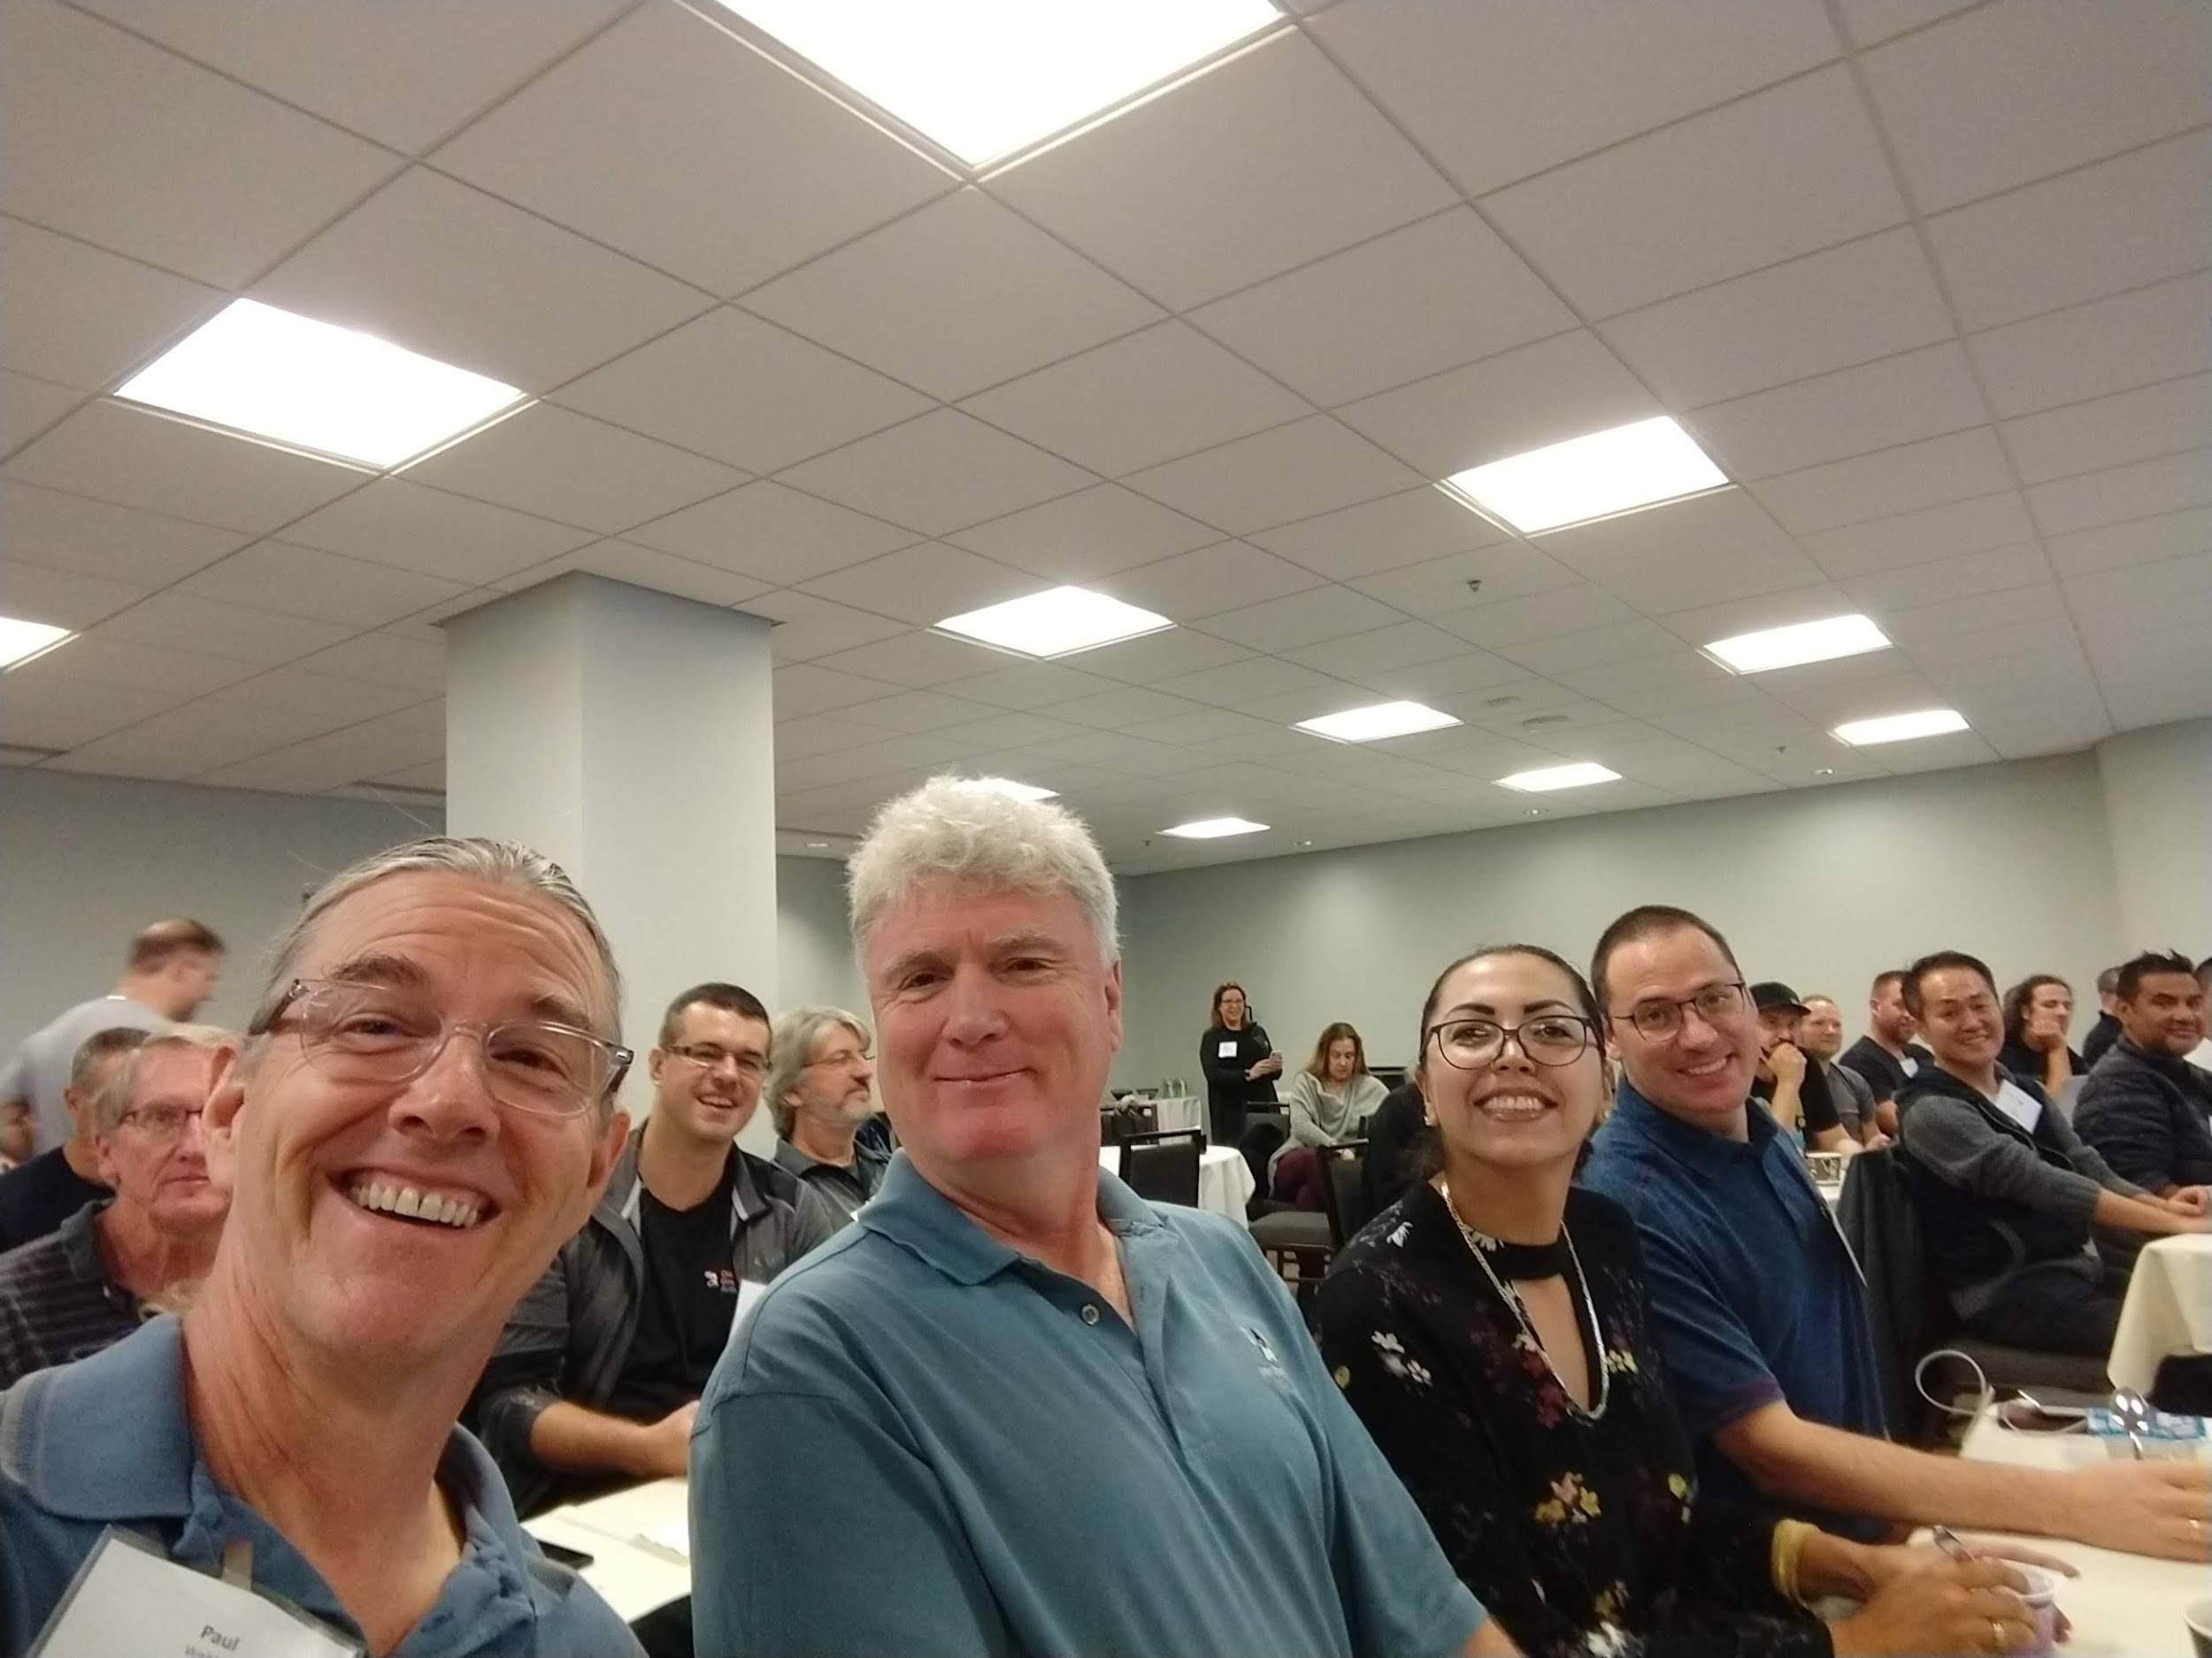
Java Champion Summit
Community
Java and Machine Learning
Zoran Sevarac
WomenInTech and diversity efforts on Conferences like JavaLand
Ix-Chel Ruiz
JUG Evolution in Latin America
Cesar Hernandez
Alexis Lopez
Update on Microprofile
Ivar Grimstad
OpenJFX Update
Johan Vos
JCP Executive Committee Update
Notes:
Overview of the current Java machine
learning landscape, what needs to be done in
order to make Java no 1 platform for machine
learning development, and ongoing efforts in
that domain.
Several JUG and organizations around the
world are making an effort to increase,
support and celebrate diversity in Tech. From
organizing meetings and technical sessions to
recruiting mentors.
The integration of Latin America JUG's keep
moving forward. Developer tours, Java Days
and hack days had increased along with the
participation of more Java Champions and
Developer Champions.
Eclipse MicroProfile will be introduced and
Demonstrated - new community dedicated to optimizing the Enterprise Java mission for microservice based architectures.
An update on the current status of OpenJFX,
Updates from the JCP Executive Committee on the work that has been going on over the last 12 months and plans for the next

Slide 5
JDK 11 Released! List of JEPs from the JSRs
https://openjdk.java.net/projects/jdk/11/
181: Nest-Based Access Control
309: Dynamic Class-File Constants
315: Improve Aarch64 Intrinsics
318: Epsilon: A No-Op Garbage Collector
320: Remove the Java EE and CORBA Modules
321: HTTP Client (Standard)
323: Local-Variable Syntax for Lambda Parameters
324: Key Agreement with Curve25519 and Curve448
327: Unicode 10
328: Flight Recorder
329: ChaCha20 and Poly1305 Cryptographic Algorithms
330: Launch Single-File Source-Code Programs
331: Low-Overhead Heap Profiling
332: Transport Layer Security (TLS) 1.3
333: ZGC: A Scalable Low-Latency Garbage Collector (Experimental)
335: Deprecate the Nashorn JavaScript Engine
336: Deprecate the Pack200 Tools and API
Notes:
JEP == JDK Enhancement Proposals
JSR == Java Specification Requests

Slide 6
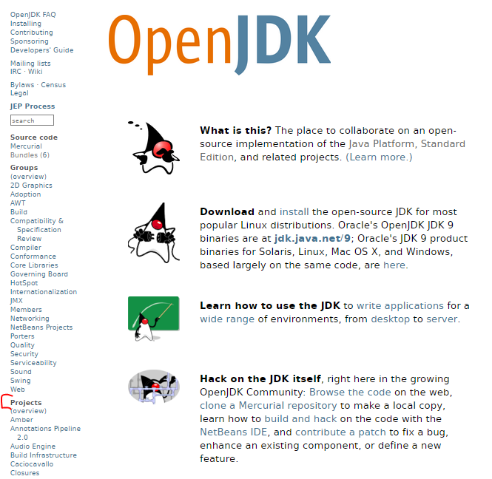
More Info on JEPs
http://openjdk.java.net/

Slide 7
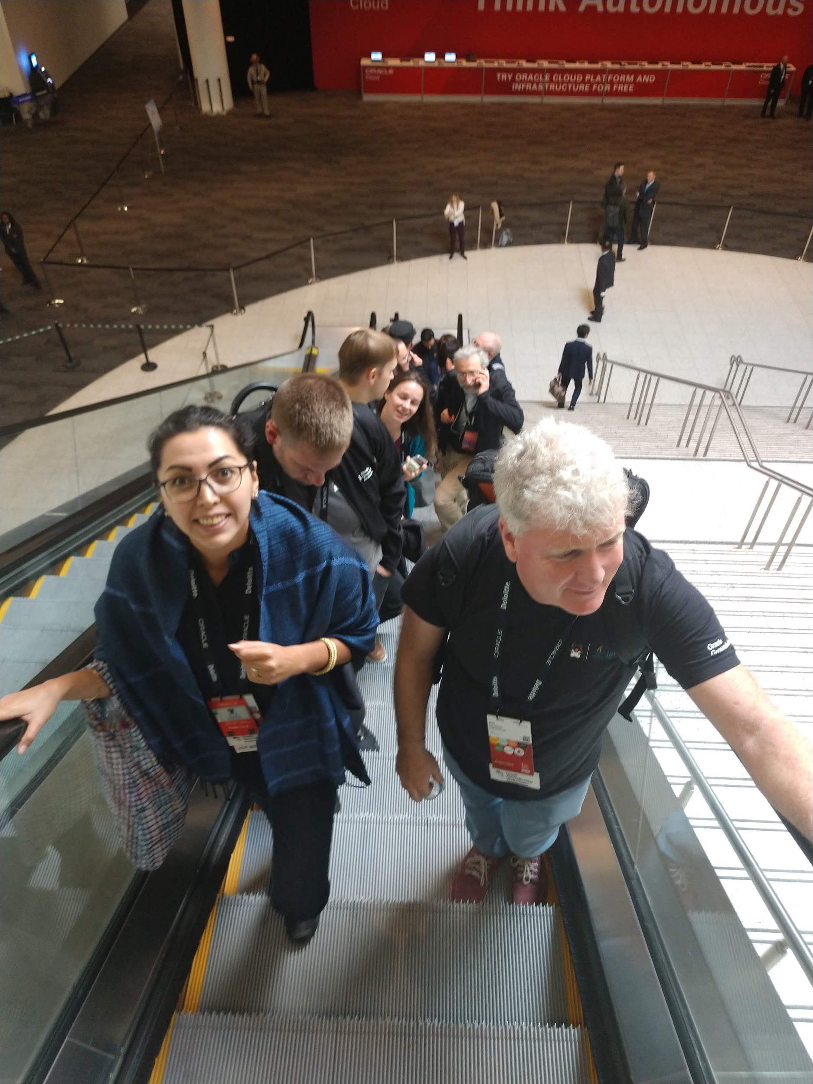
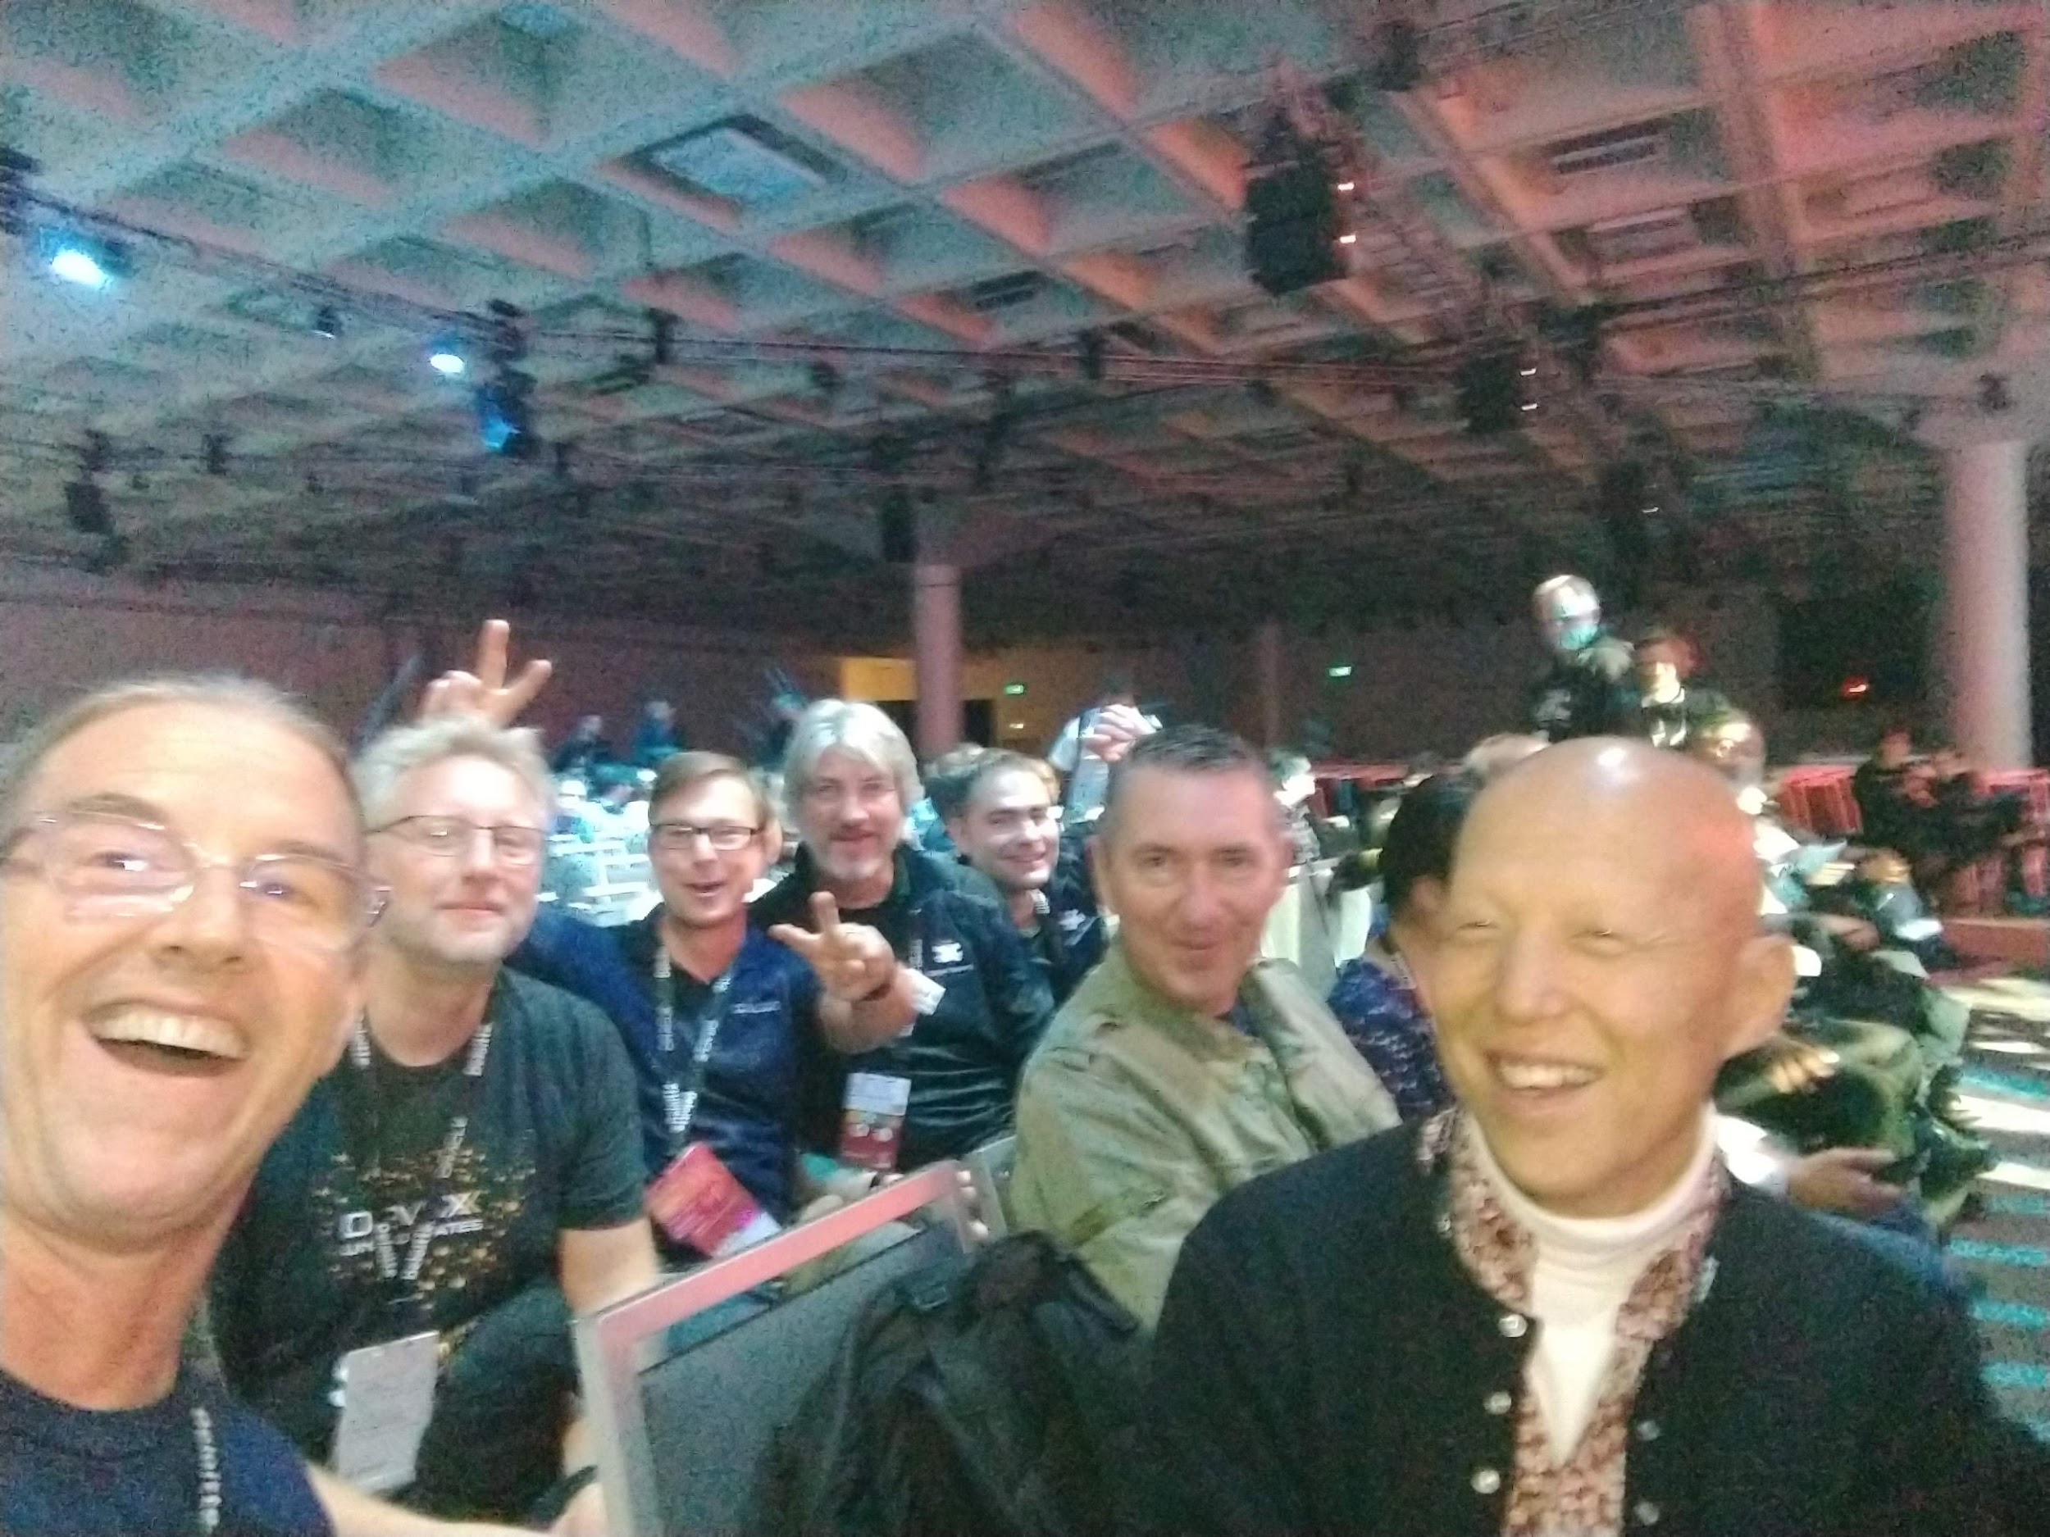
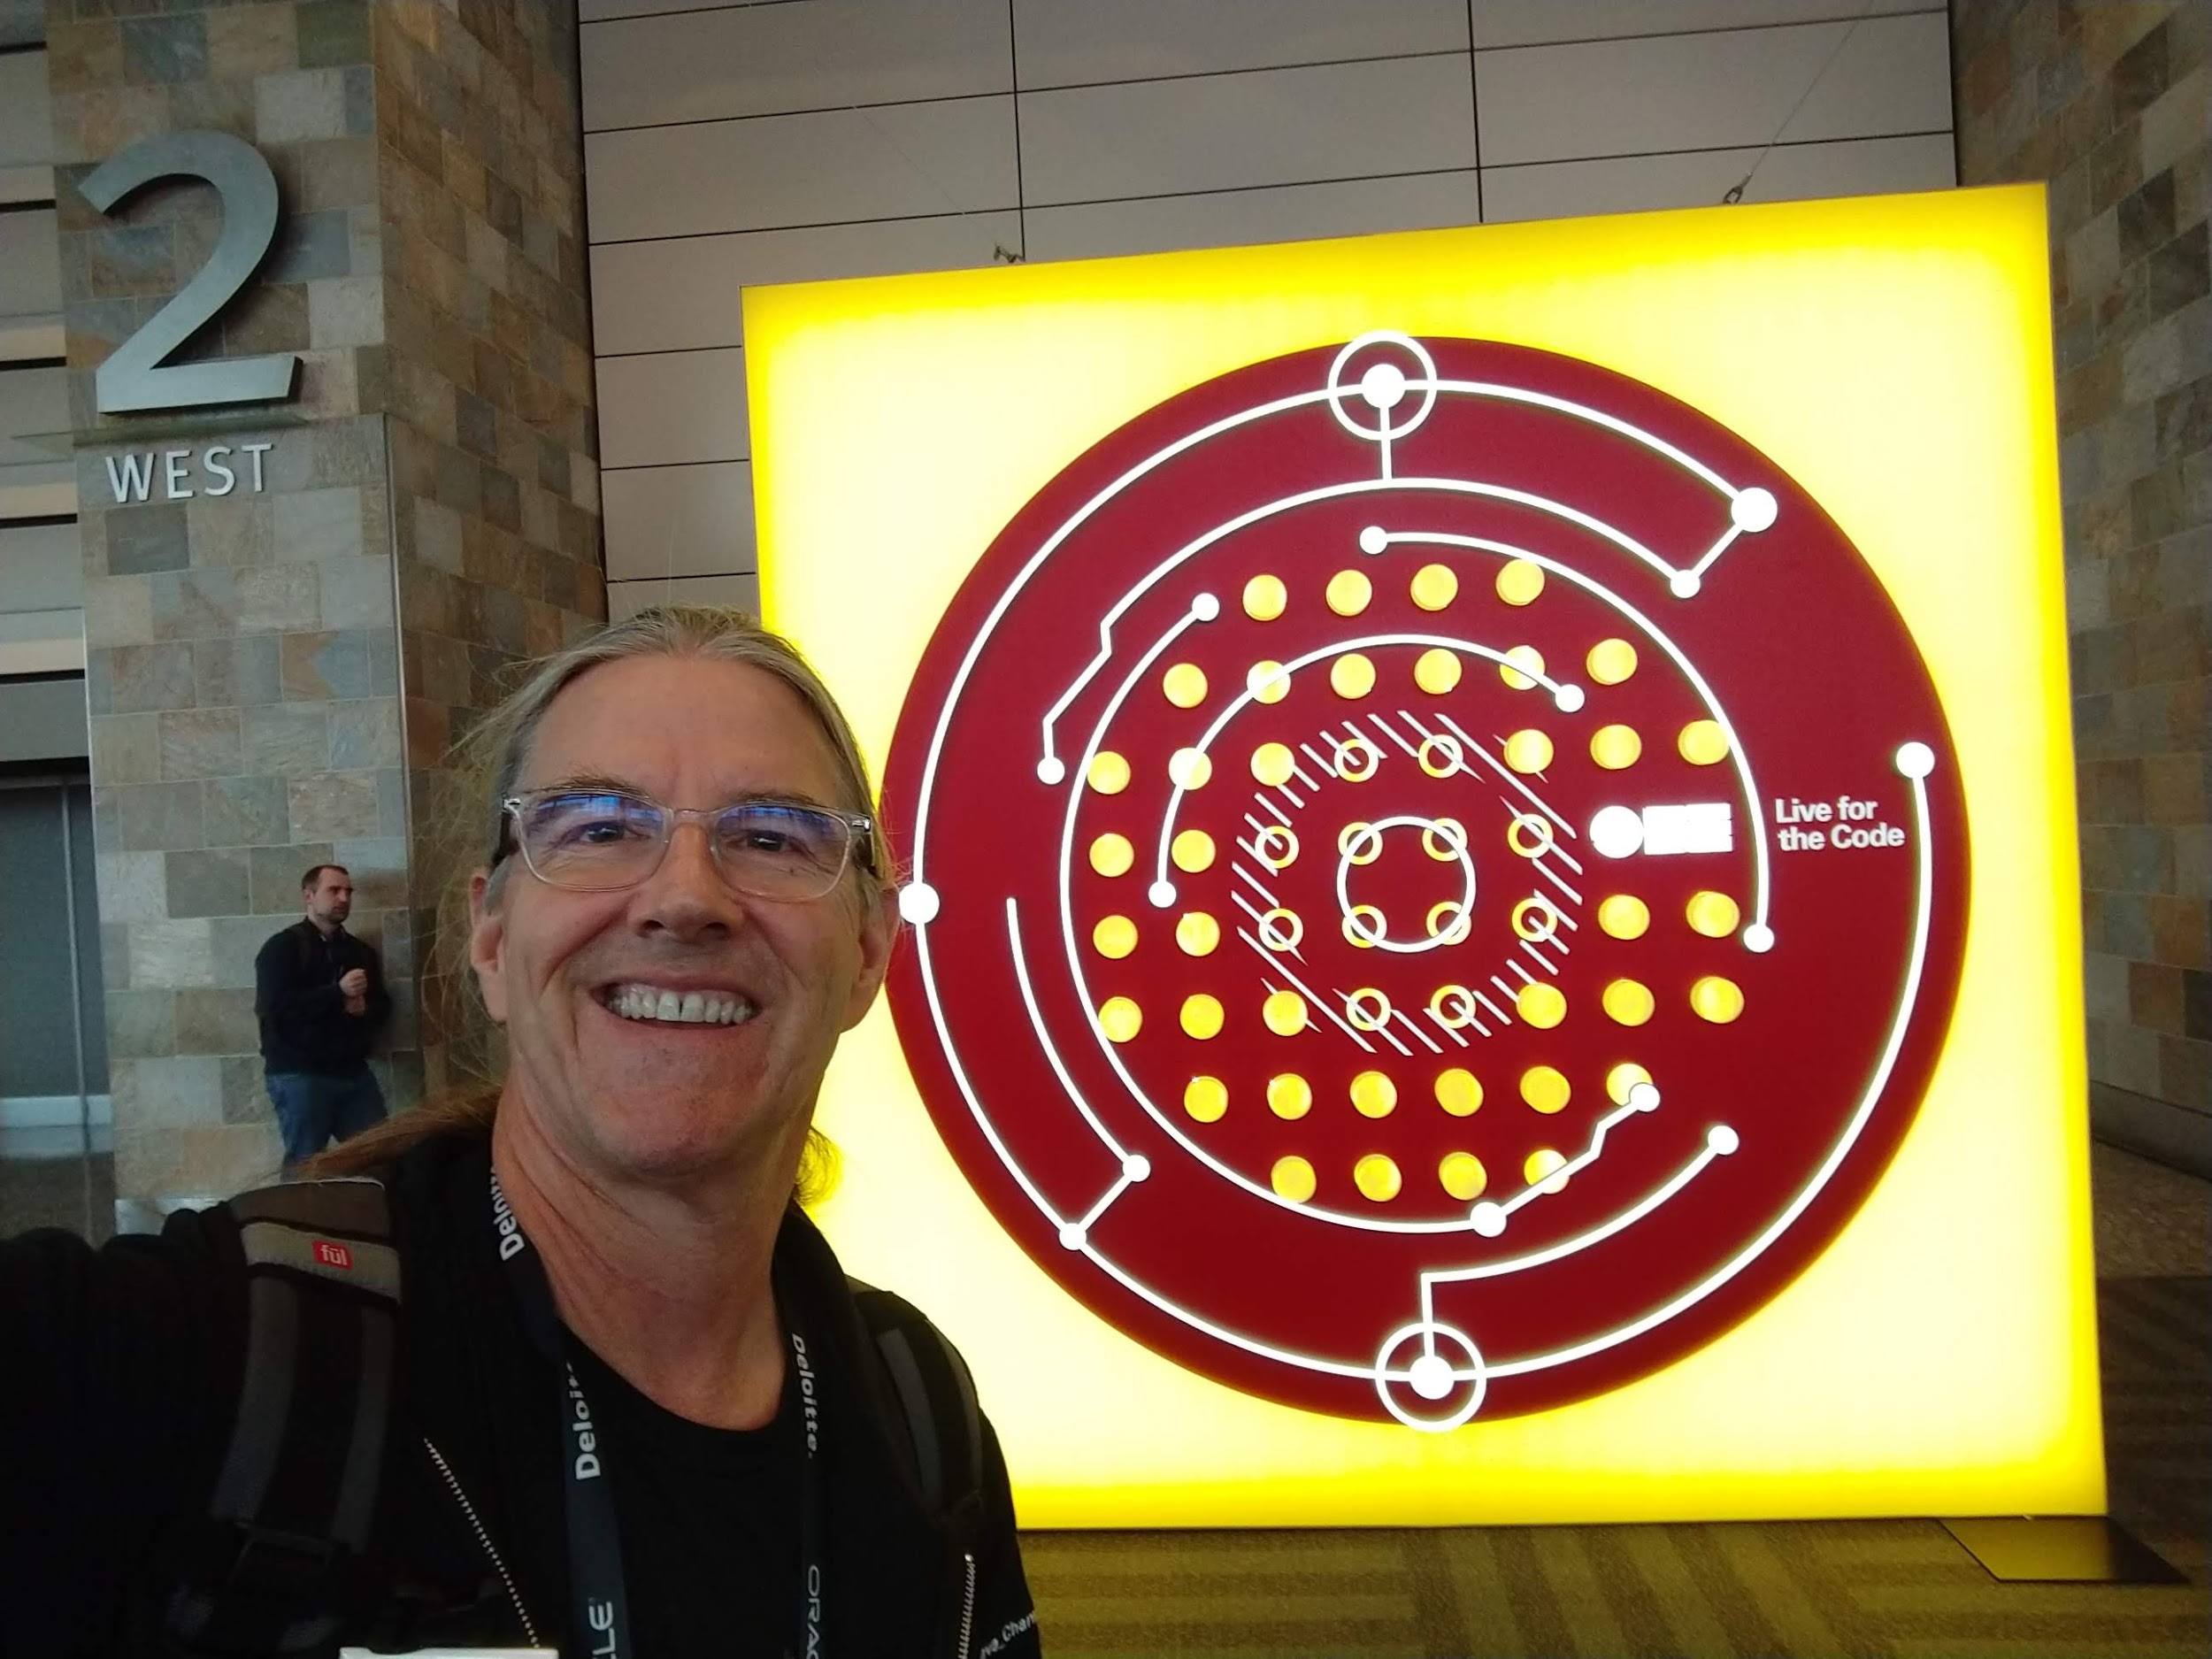
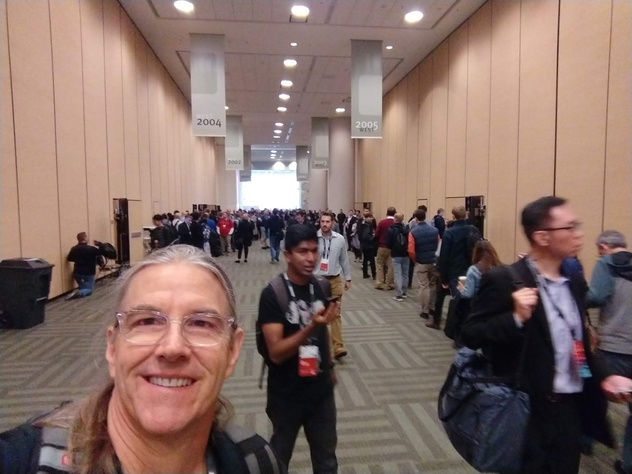
Welcome to CodeOne!
https://www.oracle.com/code-one/

Slide 8
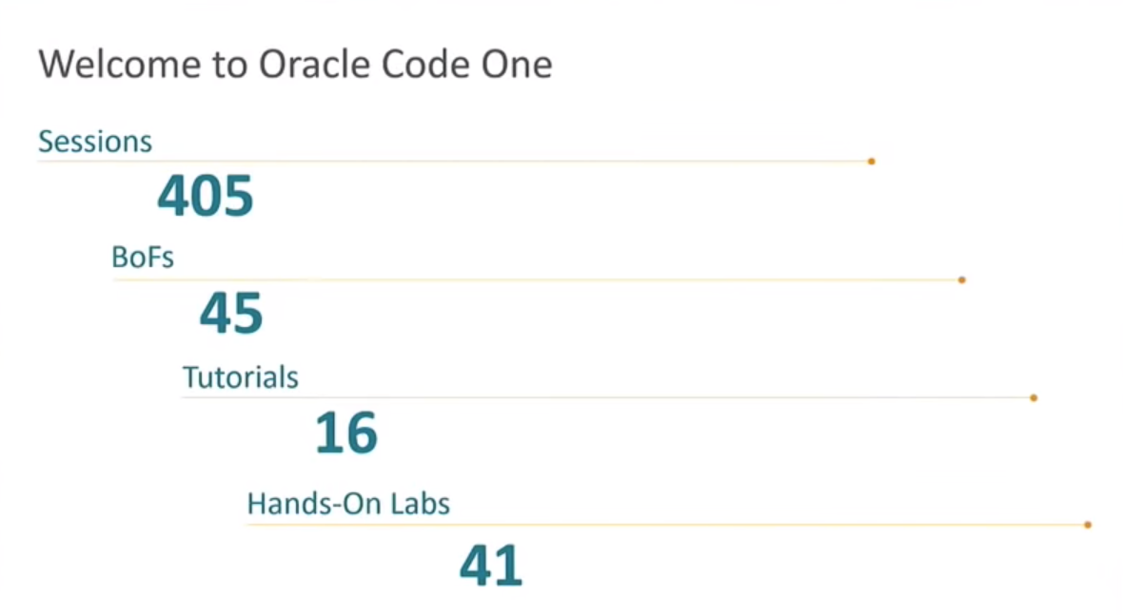
Session: Monday Keynote

Slide 9
CodeOne 2018 Sessions
Sessions and Tracks | Monday | Tuesday | Wednesday | Thursday | Total
Core Java Platform |  |  |  |  | 85 -
Emerging Technologies |  |  |  |  | 91
Database, Big Data, and Data Science |  |  |  |  | 109
Java Ecosystem |  |  |  |  | 92
Java, Server Side Development and Microservices |  |  |  |  | 86
Development Tools |  |  |  |  | 111 +
Developer Community |  |  |  |  | 69 +
DevOps and Pipelines |  |  |  |  | 78
Containers, Serverless, and Cloud |  |  |  |  | 140
Modern Web |  |  |  |  | 60
MySQL |  |  |  |  | 45
Total | 181 | 177 | 154 | 123 | 635
510 Total Unique Sessions
497 - 2017
444 - 2016
439 - 2015
Notes:
Java Keynote on Monday/Tuesday/Wednesday

Slide 10
Notes:
https://static.rainfocus.com/oracle/oow18/sess/1524413575797001dXKJ/PF/ContributingToJMC_DEV4506_15404361954180016iki.pdf
Where to get JDK Mission Control? • Release of JDK Mission Control is planned to 2019-01-30 • But OpenJDK 11 contained the first open source version JFR, what to do?
Working EA builds available here: http://jdk.java.net/jmc/

Slide 11
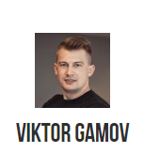
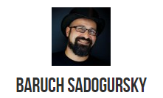
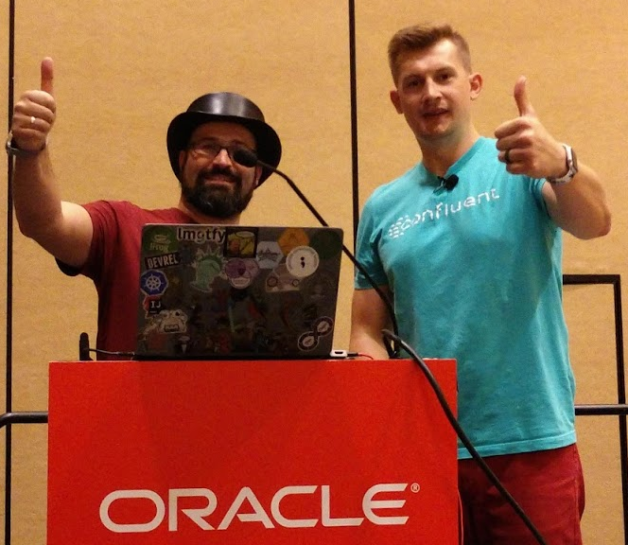
Session: Java Puzzlers NG S03: What? Where Did Those Come From?!
Developer Advocate @JFrog
Solution Architect at Confluent
Notes:
https://jfrog.com/shownote/

Slide 12
Session: Java Puzzlers NG S03: What? Where Did Those Come From?!
System.out.println(isUltimateQuestion ? 42 : isUltimateQuestion ? 42 : null);
isUltimateQuestion = false
Null
Won’t Compile
42
NullPointerException
Notes:
https://jfrog.com/shownote/

Slide 13
Session: Java Puzzlers NG S03: What? Where Did Those Come From?!
System.out.println(isUltimateQuestion ? 42 : isUltimateQuestion ? 42 : null);
isUltimateQuestion = false
Null
Won’t Compile
42
NullPointerException
Notes:
https://jfrog.com/shownote/

Slide 14
Session: Java Puzzlers NG S03: What? Where Did Those Come From?!
Notes:
https://jfrog.com/shownote/

Slide 15
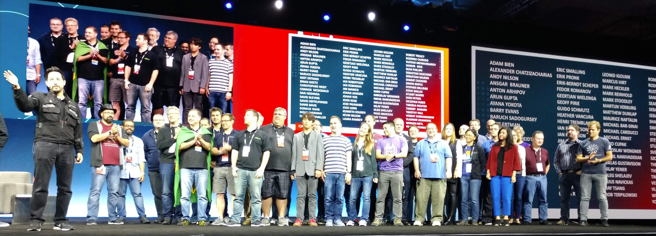
Keynote Oracle Code One!
Notes:
This Keynote on Tuesday

Slide 16
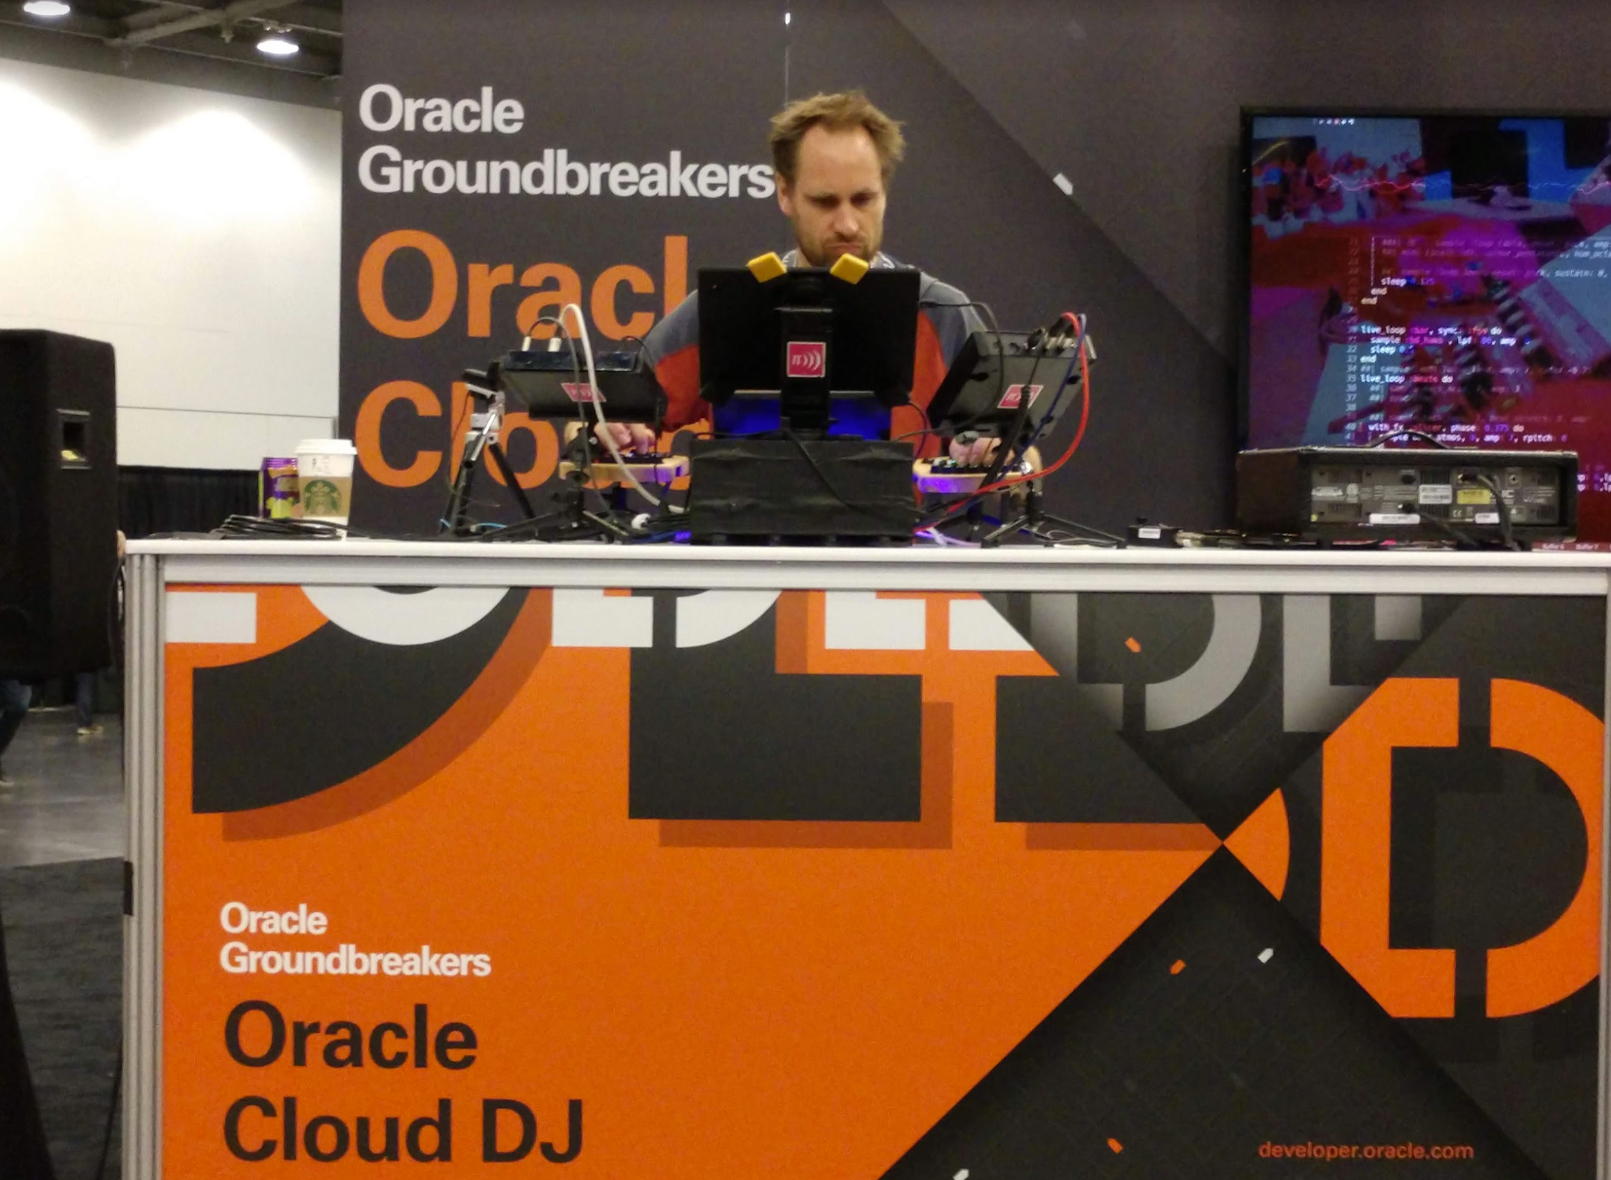
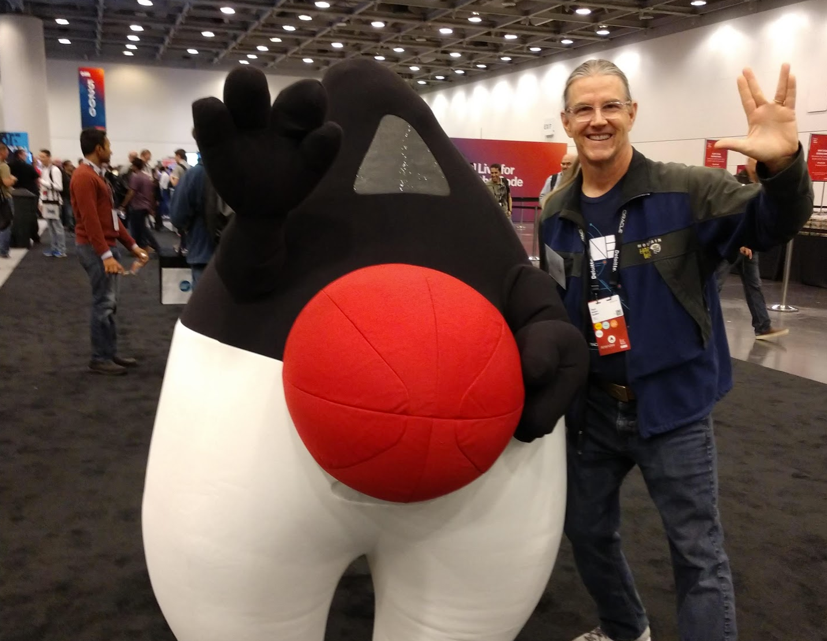
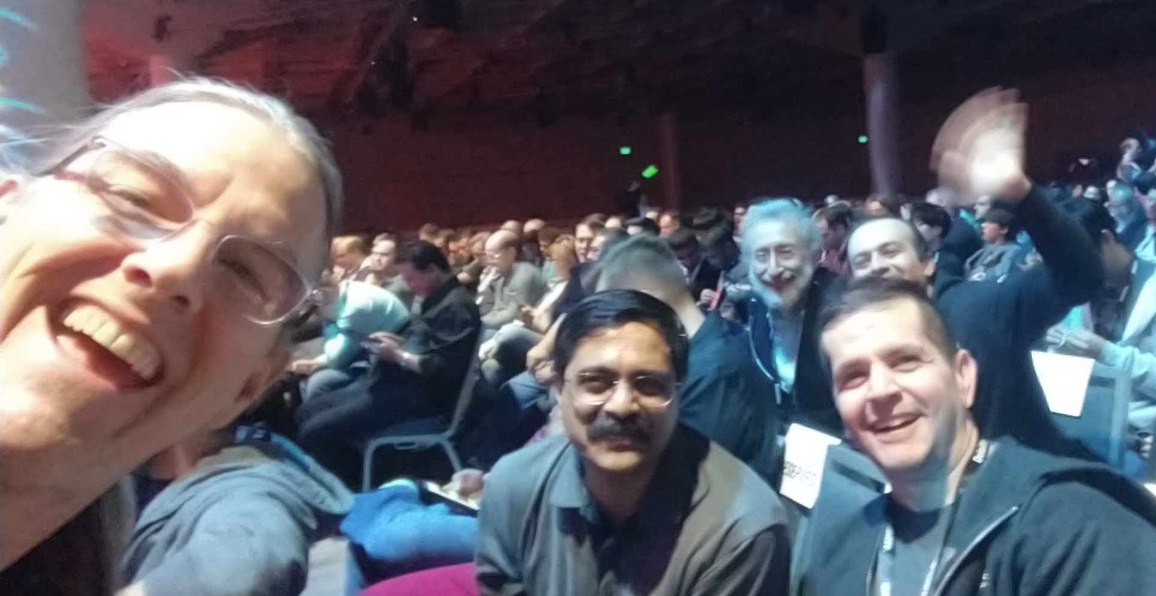
Community!

Slide 17
Questions?
Thank You!

