Slide 1
Java Licensing* and the Importance of LTS
Development
Thom Shulok
December 18, 2018
*Yes, it's full of asterisks
Deployment

Slide 2
Who is this guy?
IANAL (even the best software developer is still the worst lawyer)
First met Paul in 1988 at General Dynamics (Smalltalk was Java in '88)
After 2 ½ years, swore I’d never work at a defense contractor again
Succession of small companies, consulting, and startups (including my own)
...and, wait for it...
I've been working at Lockheed Martin for the past 14 years
Not my fault, they bought the tiny startup I was working for
IANAL

Slide 3
Ok, so what's the problem here?
There is considerable FUD surrounding Java licensing and long term support
Ambiguity in the license agreement leads to Uncertainty
Uncertainty leads to Doubt that you're doing the right thing
Doubt leads to Fear when the penalty for doing the wrong thing is potentially large (for you or your employer)
Learning more reduces uncertainty*
The more you learn, the less fear you have*
The JDK you use should now be a choice you actively make
Yes, it's a puzzle
*Sometimes ignorance is bliss

Slide 4
If you don't believe me, ask Google...

Slide 5
Well, how did we get here?
In the beginning, there was Sun...
Sold hardware, and mostly, kinda, sorta, gave away software
Java was initially under a proprietary license, but free for development and deployment for non-embedded applications (and J2EE, kinda, sorta)
Java subsequently was open-sourced* as GPL, kinda, sorta
*Not all of it was actually open-sourced

Slide 6
...and then Oracle bought Sun

Slide 7
Fun Fact #1
Oracle didn't buy Sun just to sue Google. Oracle bought Sun because so much of Oracle's own product was based on Sun's Java, and they were concerned about what would happen if someone else acquired Sun.
(and then they sued Google)

Slide 8
Suing Google is fun, but consider...
Unlike Sun, Oracle is a software company
Said another way, Oracle makes money by selling software
So it was only a matter time before...

Slide 9
First, the Binary Code License Agreement (BCL)
Developers may use only certain features of Java SE for free
Those features are free only if used for certain limited purposes
Java SE is free only for use in ‘‘general-purpose computing’’ that does not entail use of the ‘‘commercial features.’’
Embedded ~= ~General Purpose Computing
https://www.oracle.com/technetwork/java/javase/terms/license/index.html

Slide 10
General Purpose Computing?
The license agreement says that this means use "for general computing functions under end-user control (such as but not specifically limited to email, general-purpose Internet browsing and office suite productivity tools)".
However, systems and solutions that provide "dedicated functionality" or use embedded or function-specific software applications e.g. industrial control systems, mobile phones, handhelds, telematics and storage management systems are excluded from the definition

Slide 11
Lawyer's Perspective
'These terms are remarkably vague. And the problem with such vague and ambiguous definitions is compounded by the realities of modern-day computing, where the limits of “general purpose,” “mobile,” “embedded,” etc. are not easily determined.'
With little guidance from the courts, this ambiguity provides Java licensees little protection against Oracle claiming that virtually all deployments of Java are “specialized” and, therefore, subject to fee-based licensing.
https://news.bloomberglaw.com/ip-law/insight-understanding-your-oracle-java-license-not-everything-is-as-it-seems

Slide 12
Fun Fact #2
In most jurisdictions, ambiguous contracts are said to be resolved “against” the party that drafted the contract. The party that did not write the contract will generally receive the benefit of the doubt regarding ambiguities.
This is also why there are no 1 page contracts, EULA's, or Terms of Use

Slide 13
Then came LMS (License Management Services)
Oracle License Management Services audits users of Oracle technology
For Java, focused on...
Some parts of Java SE are free, some aren’t
Free parts are only free for “general purpose computing”
One customer in the retail industry with 80,000 PCs that was informed by Oracle it was in breach of its Java SE agreement.
Oracle apparently told another Java customer it owed $100,000 – but the bill was slashed to $30,000 upon challenge.
One licensee filed a lawsuit that settled before going to trial
https://www.theregister.co.uk/2016/12/16/oracle_targets_java_users_non_compliance/

Slide 14
...and then this happened...
Public updates for Oracle Java SE 8 will remain available for individual, personal use through at least the end of 2020.
Public updates for Oracle Java SE 8 released after January 2019 will not be available for business, commercial or production use without a commercial license.
If you are acting on behalf of an ENTERPRISE, Oracle recommends you review the roadmap information for Java SE 8 and beyond and begin to assess your ongoing Java support requirements in order to migrate to a later release or obtain a Java SE Subscription, as appropriate, on a timely basis.
https://java.com/en/download/release_notice.jsp

Slide 15
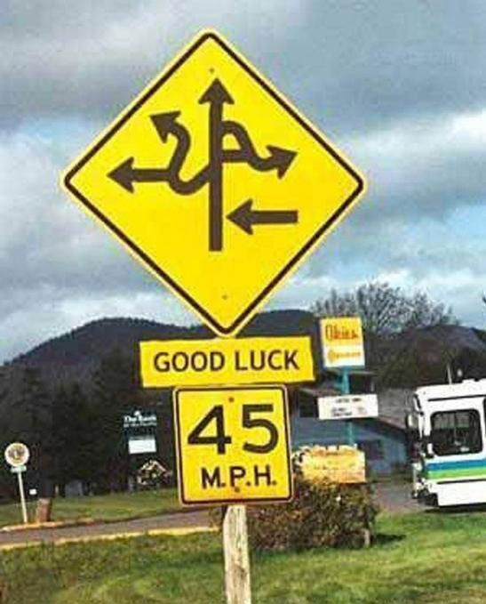
Did someone say Roadmap?

Slide 16
Can you draw me a picture of that?
..and Java 17, but lets not get crazy...

Slide 17
And now a word about LTS and deployed systems
First Rule of Maintaining a Deployed System:
CHANGE AS LITTLE AS POSSIBLE TO MEET CUSTOMER NEED
Maintenance releases support this approach
Security updates
Necessary bug fixes
Jumping from major release to major release introduces risk, additional cost, and (more) irritated customers
The zero-overlap OpenJDK cadence is a problem for long term support

Slide 18
As always, pick any two...
JDK 8u192
Forever!
Oracle
OpenJDK

Slide 19
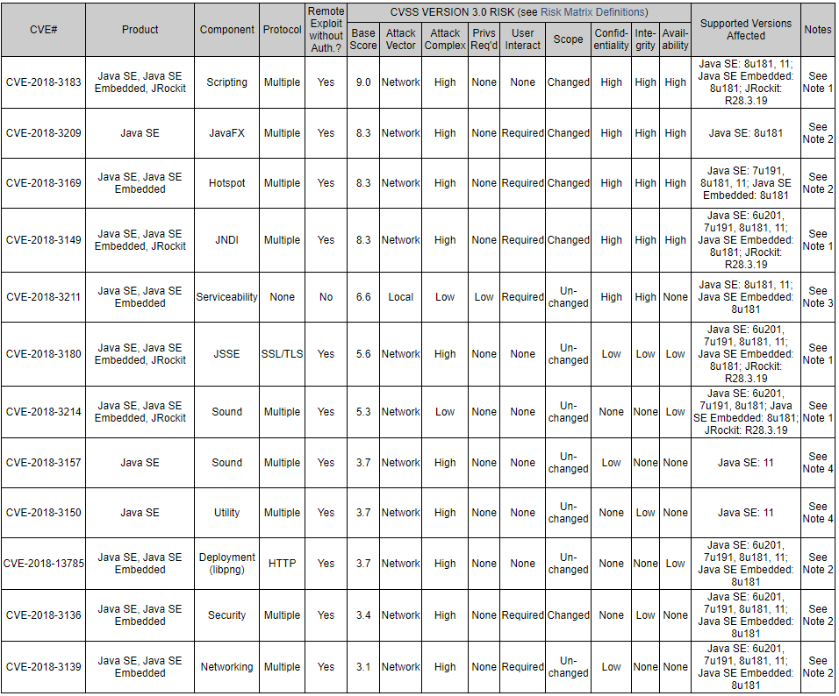
Ok, how bad is it? (Security Edition)
https://www.oracle.com/technetwork/topics/security/alerts-086861.html

Slide 20
Ok, How bad is it? (Bug Fix Edition) Java 8u192
https://www.oracle.com/technetwork/java/javase/2col/8u192-bugfixes-4479410.html

Slide 21
Which brings us to...

Slide 22
The Oracle Cost
CPU-based* Licensing: $25
Per month
Per processor
User-based** Licensing: $2.50
Per month
Per user
Volume discounts available!
*Core, actually
**Virtualized environments are a whole different can of beans: http://houseofbrick.com/mars-vs-oracle/
https://www.oracle.com/assets/java-se-subscription-pricelist-5028356.pdf

Slide 23
Fun Fact #3
Oracle and Google don't get along, in part because of Java licensing (well, and an $8.8 billion Java copyright lawsuit headed to the Supreme Court)

Slide 24
Other Options?
Java 8u192 forever!
Free and wildly insecure approach (did you see that other vulnerability slide?)
Use Oracle non-commercial distribution for commercial use
No. Just no. (did you see that audit slide?)
Rely on Linux OS updates to OpenJDK
Might work on RHEL (which you pay for anyway), YMMV on other distros
Time-to-fix vulnerability/bug may be critical
Pay someone else for OpenJDK support
Azul, IBM, etc
All are subscription-based
Some offer free Community Editions
Use AdoptOpenJDK binaries (https://adoptopenjdk.net/)
Update your production installations to a new major release every 6 months using OpenJDK
Build OpenJDK yourself, slipstreaming security patches from the Mercurial repo
If you're asleep you should wake up for this slide

Slide 25
One more interesting development...

Slide 26
Amazon Corretto
Amazon Corretto is a no-cost, multiplatform, production-ready distribution of the Open Java Development Kit (OpenJDK).
Corretto comes with long-term support that will include performance enhancements and security fixes.
Amazon runs Corretto internally on thousands of production services and Corretto is certified as compatible with the Java SE standard.
With Corretto, you can develop and run Java applications on popular operating systems, including Amazon Linux 2, Windows, and macOS.
Amazon Corretto version 8 supported at least until June 2023, version 11 supported until August 2024.
Amazon Corretto is available at no cost. There are no additional paid features or restrictions.*
*There is no asterisk

Slide 27
Fun Fact #4
Oracle and Amazon don't really get along either.
Oracle: Amazon isn’t powered by their own databases, they use Oracle’s “superior” technology.
Amazon: Amazon will "be done" with Oracle databases by 2019

Slide 28
Takeaways
If you have long running deployments, you care about long term support
If you care about long term support, you need to choose JDK 8 or 11
You need to decide just how much support you need, and if you want to pay for it (forever)
OpenJDK offers a way out, but has it's own challenges and potential costs
Corretto looks like an interesting way forward
But you need to decide (now)
If you choose not to decide, you still have made a choice...

Slide 29
Thanks*
* I am not a lawyer

Slide 31
first quarter of 2019 and will be compatible with Ubuntu and Red Hat Enterprise Linux.
The JDK is now available for free download by open users, and AWS also promises that Amazon Corretto version 8 free security updates will be available at least until June 2023, while Amazon Corretto version 11 free updates will continue until August 2024.

Slide 32
How fast can you get security patches? How long will it be supported? Do you need to be able to apply contractual pressure to a vendor to help with any issues?

Slide 33
Recent Oracle announcements regarding it’s Java platform have outlined how it will be supported and licensed in the future. Key areas to note are…
Commercial use of Oracle Java will be chargeable after January 2019, no further updates of Java SE 8 will be available.
Organisations will need to procure a long-term contract to accommodate critical bug and security fixes, as well as general maintenance.
Java SE 9 as well as Java SE 8 are free and available for redistribute on for general purpose computing. Java SE continues to be available under the Oracle Binary Code License (BCL) free of charge.
Java Runtime Environment (JRE), which is used for embedded devices or use of commercial features may require an embedded type license agreement.

Slide 34
https://www.businessinsider.com/oracle-bought-sun-because-of-ibm-not-google-2016-5?r=UK&IR=T

Slide 35
You can start to see how this impacts LTS...
First Rule of Maintaining a Deployed System
CHANGE AS LITTLE AS POSSIBLE TO MEET CUSTOMER NEED
Security updates
Necessary bug fixes
Maintenance releases support this approach
Jumping from major release to major release introduces risk

Slide 36
So what's this Oracle Google thing all about anyway?
Remember when Sun open sourced Java?
Well, not all of Java SE was open sourced
But...
Sun also released the specifications for Sun’s Java platform, including Sun’s Java virtual machine, under a free-of-charge license
The license allows developers to create “clean room” implementations of Sun’s Java specifications.
If those implementations demonstrate compatibility with the Java specification, then Sun would provide a license for any of its intellectual property needed to practice the specification, including patent rights and copyrights.

Slide 37
Okay, how do you demonstrate compatibility?
The only way to demonstrate compatibility with the Java specification is by meeting all of the requirements of Sun’s Technology Compatibility Kit (“TCK”) for a particular edition of Sun’s Java.
However...
TCKs were only available from Sun, initially were not available as open source, were provided solely at Sun’s discretion, and included several restrictions, such as additional licensing terms and fees.
Upshot being...
Although developers were free to develop a competing Java virtual machine, they could not openly obtain an important component needed to freely benefit from Sun’s purported open-sourcing of Java.

Slide 38
GPL & BCL
https://www.crowell.com/files/201809-Understanding-Your-Oracle-Java-License-Not-Everything-Is-As-It-Seems.pdf
2007, Sun licensed Java for free under the
GNU General Public License (‘‘GNU GPL’’). The GNU
GPL enabled end users to modify, use, and copy Java
software regardless of the application and without payment
of royalties. Further, pursuant to the GNU GPL, distribution of software applications derived from Java was subject to the same free license terms
2010, Oracle acquired Sun
and began offering Java Standard Edition (SE) under
its Oracle Binary Code License Agreement (‘‘BCL’’),
which provides that developers may use only certain
features of Java SE for free, and even those features are
free only if used for certain limited purposes. H

Slide 39
https://www.oracle.com/technetwork/java/java-se-support-roadmap.html

Slide 40
https://www.azul.com/eliminating-java-update-confusion/

Slide 41
https://www.azul.com/products/zulu-enterprise/
Zulu Enterprise Pricing
Zulu Enterprise is priced by term based upon the number of systems (desktops plus virtual or physical servers) running Java applications. Here's our pricing:
Max # of Supported Systems Price/year (Standard Support) Price/year (Premium Support)
25 $13,200 Not available
100 $31,600 $37,900
1,000 $94,900 $113,900
Unlimited $284,600 $341,500

Slide 42
https://news.bloomberglaw.com/ip-law/insight-understanding-your-oracle-java-license-not-everything-is-as-it-seems

Slide 43
https://www.zdnet.com/article/the-real-history-of-java-and-android-as-told-by-google/

